Slide 1
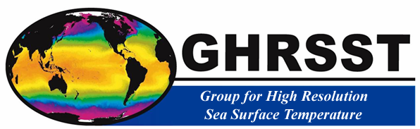
An example of international science community building: the GHRSST project
Peter J. Minnett
Meteorology and Physical Oceanography
Rosenstiel School of Marine and Atmospheric Science
University of Miami, Miami, USA

Slide 2
Background
GHRSST-PP was part of GODAE:
  GODAE High-Resolution Sea-Surface Temperature Pilot-Project
Required to bring some order to the plethora of SSTs derived from satellite and other sources
Has evolved into the “Group for High-Resolution Sea-Surface Temperature”

Slide 3
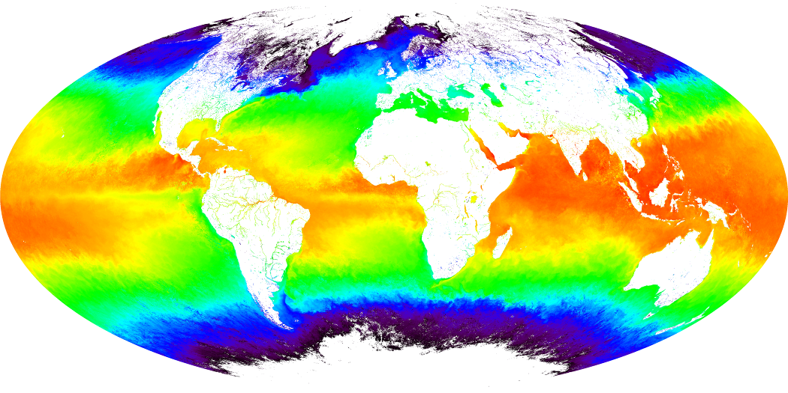
Satellite retrievals of SST
SST is an essential climate variable (ECV).
SST is reasonably well defined.
Long time series of satellite-derived SSTs available.
Technology exists to validate satellite derived SSTs.
Significant effort currently directed at generating SST CDRs.

Slide 4
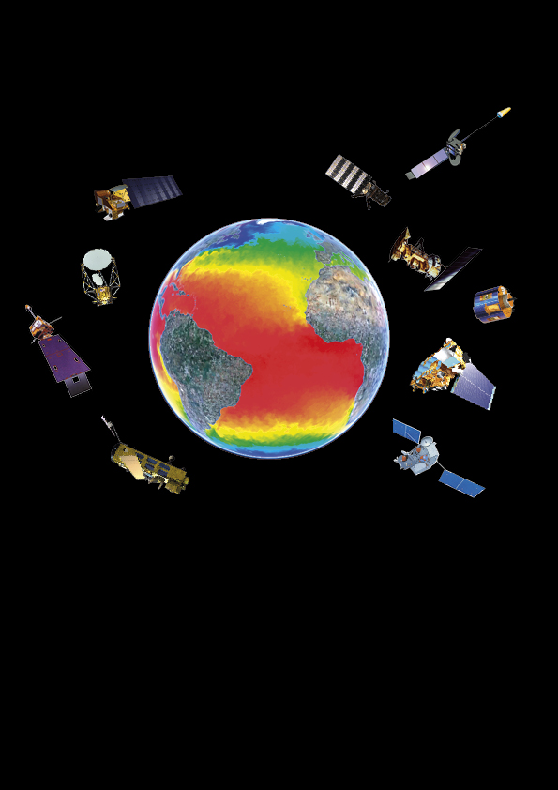
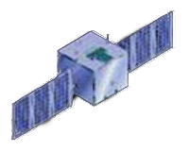
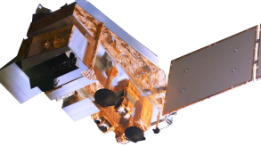
HY-2
AVHRR & IASI
MODIS
MTSAT
†AMSR-E
AVHRR
Windsat
SEVIRI
GOES
MODIS
TMI & VIRS
† AATSR
VIIRS

Slide 5
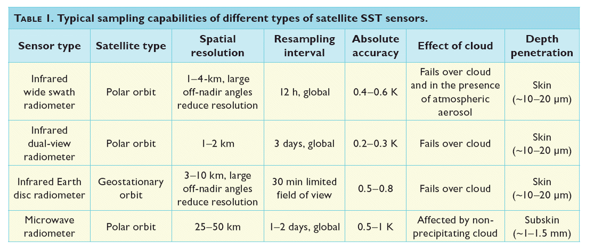
SST satellite sensors

Slide 6
GHRSST
International group drawn from research and operational communities
International Project Office to provide logistical support
Annual “Science Team” Meetings
Established working groups to address scientific, operational and logistical problems
Working Groups organize Workshops as desired
Distributed processing and data assembly (RDACs and GDAC)
Leverage national research and operational activities and investments

Slide 7
Objectives of GHRSST
Coordinate efforts, both research and operational, within and across national borders
Make SST fields more accessible to forecasters, modelers and researchers
Provide estimates of uncertainties on a pixel-by-pixel basis
Stimulate collaborative research

Slide 8
Mission Statement
“The aim of the GHRSST is to provide the best quality sea surface temperature data for applications in short, medium and decadal/climate time scales in the most cost effective and efficient manner through international collaboration and scientific innovation.”

Slide 9
Scientific issues
Characteristics of different sensors
What is SST?
  Skin effect
  Diurnal heating
Atmospheric effects
  Water vapor
  Aerosols
  Residual cloud contamination
Sea ice effects
  Generate ice mask at high resolution
  Anomalous atmospheric effects in the vicinity of sea ice
Absolute accuracies
  How to determine accuracies?
  How to generate a CDR?

Slide 10
Logistical issues
Transfer research results to the operational environment
Data exchange
  Common data format
  Agreement to adhere to the data formats
Mechanism for comparisons between SST fields, and validating data
Long-term stewardship

Slide 11


SST- VC
GHRSST Project Office
International Stakeholder Advisory Council
International GHRSST Science Team
Diurnal Variability DVWG
SST Validation ST-VAL
Inland Waters IWWG
Rescue & Reprocessing of Historical AVHRR Archives
R2HA2-WG
Estimation Methods
EARWiG
Data Assembly and Systems DAS- TAG
Application and User Services AUS-TAG
Inter-comparisons
IC-TAG
High Latitude HL-TAG
Climate Data Records CDR-TAG
User requirements for high resolution SST data products and services from operational and scientific communities

Slide 12
providing a framework for SST data sharing, best practices for data processing and a forum for scientific dialog,
bringing SST to the user.
Science Team
Peter Minnett (Science Team Chair), RSMAS, University of Miami, USA
Craig Donlon (chair 2000-2011), ESA, The Netherlands
Olivier Arino, ESA-ESRIN, Italy
Ed Armstrong, JPL PO.DAAC, USA
Viva Banzon, NOAA NCDC, USA
Ian Barton, CSIRO Marine Research, Australia
Helen Beggs, Bureau of Meteorology, Melbourne, Australia
Ken Casey, NOAA/NESDIS NODC, USA
Sandra Castro University of Colorado, USA
Mike Chin, NASA JPL, USA
Gary Corlett, University of Leicester, UK
Peter Cornillon, University of Rhode Island, USA
Steinar Eastwood, met.no, Norway
Bill Emery, University of Colorado, USA
Bob Evans, RSMAS, University of Miami, USA
Chelle Gentemann, Remote Sensing Systems, USA
Lei Guan, Ocean University of China, China
Ted Habermann, NOAA NGDC, USA
Andy Harris, NOAA/NESDIS ORA, USA
Jacob Høyer, Danish Meteorological Institute, Denmark
Shiro Ishizaki, JMA, Japan
Misako Kachi, JAXA, Japan
Alexey Kaplan, Columbia University, USA ,
Hiroshi Kawamura, JAXA/University of Tohoku, Japan
Pierre LeBorgne, Meteo France OSI SAF, France
Tim Liu, NASA JPL, USA
David Llewellyn-Jones, University of Leicester, UK
Matt Martin, MetOffice, UK
Doug May, Naval Oceanographic Office, USA
Chris Merchant, University of Edinburgh, UK
Jon Mittaz, NOAA, USA
Tim Nightingale, Rutherford Appleton Laboratory, UK
Anne O'Carroll, EUMETSAT, Germany
Jean-Francios Piolle, IFREMER, France
David Poulter, National Oceanography Centre, UK
Nick Rayner, Hadley Centre, Met Office, UK
Richard Reynolds, NOAA CDC, USA
Ian Robinson, National Oceanography Centre, UK
Jorge Vasquez, JPL, PO.DAAC, USA
Gary Wick, NOAA ETL, USA

Slide 13
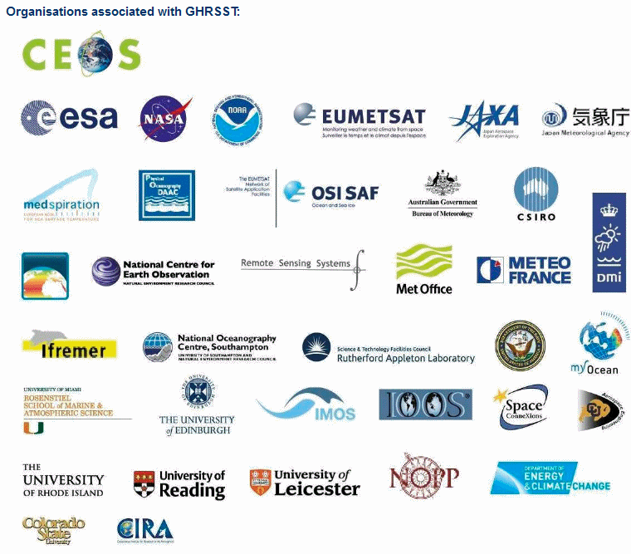
Organizations associated with GHRSST

Slide 14
GHRSST Working Groups & Technical Advisory Groups
Diurnal Variability WG (DV-WG) - Gary Wick, NOAA-ESRL, USA
High Latitude TAG (HL-TAG) - Jacob L. Hoeyer, Danish Meteorology Institute, DK
Estimation And Retrievals WG (EARWiG) - Andy Harris, NOAA-CICS, University of Maryland, USA
Satellite SST Validation WG (STVAL WG) - Gary Corlett, University of Leicester, UK
Inter Comparison TAG (IC-TAG) - Alexey Kaplan, LDEO, Columbia University, USA
Applications and User Support TAG (AUS-TAG) - Jorge Vasquez, NASA -JPL, USA
Data Assembly and Systems TAG (DAS-TAG) - Ed Armstrong, NASA-JPL, USA
Climate Data Records TAG (CDR-TAG) - Chris Merchant, University of Edinburgh, UK
Inland Waters WG (IW-WG) - Simon Hook, NASA-JPL, USA
Rescue & Reprocessing of Historical AVHRR Archives WG (R2HA2-WG) - Peter Cornillon, University of Rhode Island, USA

Slide 15
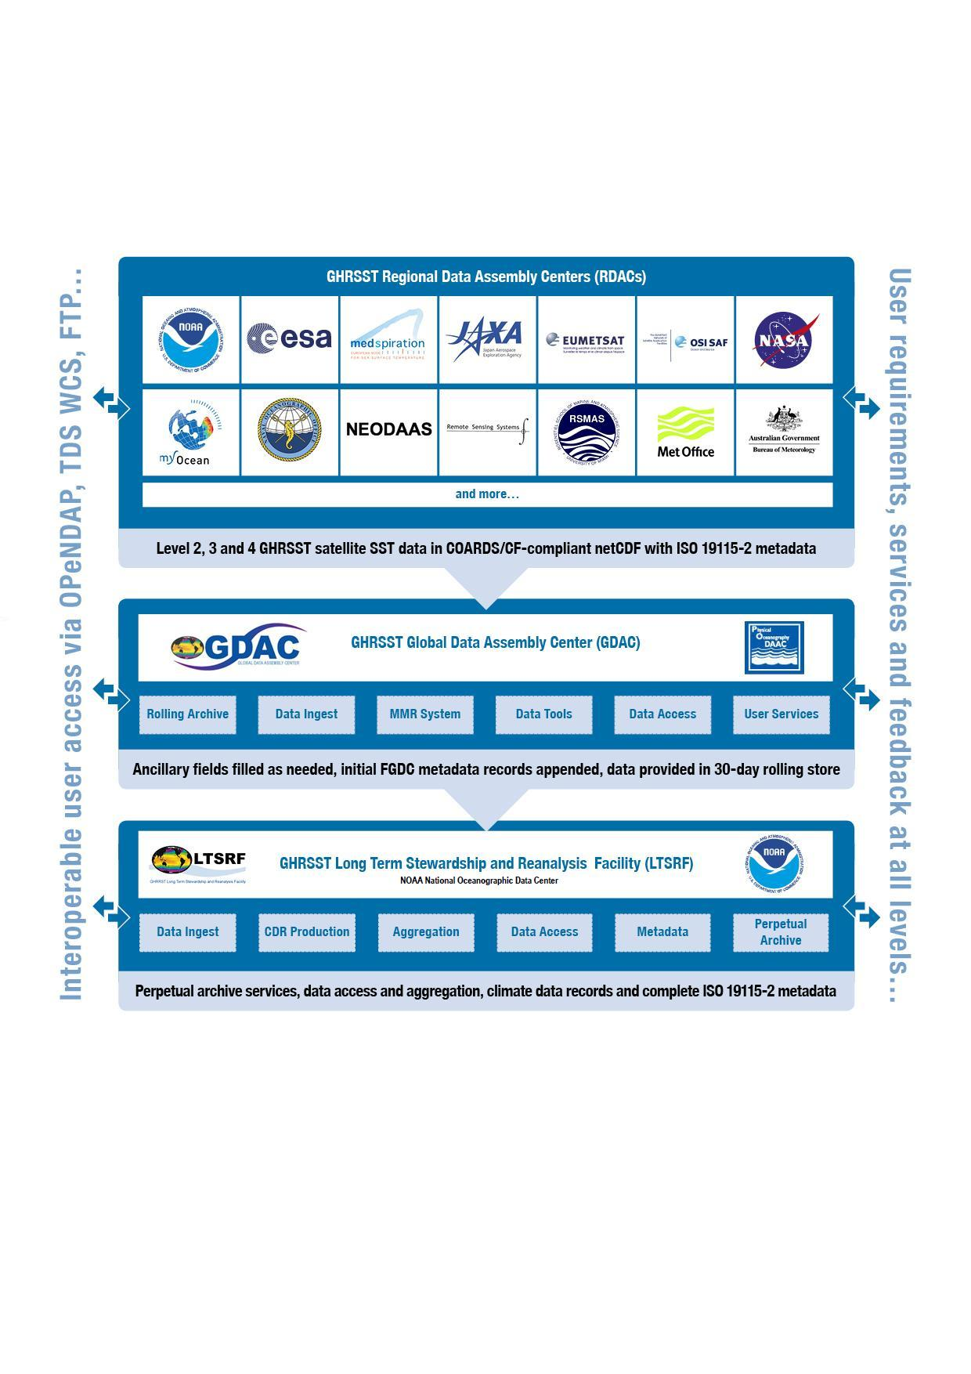
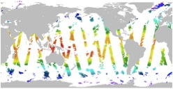
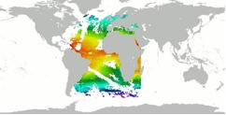
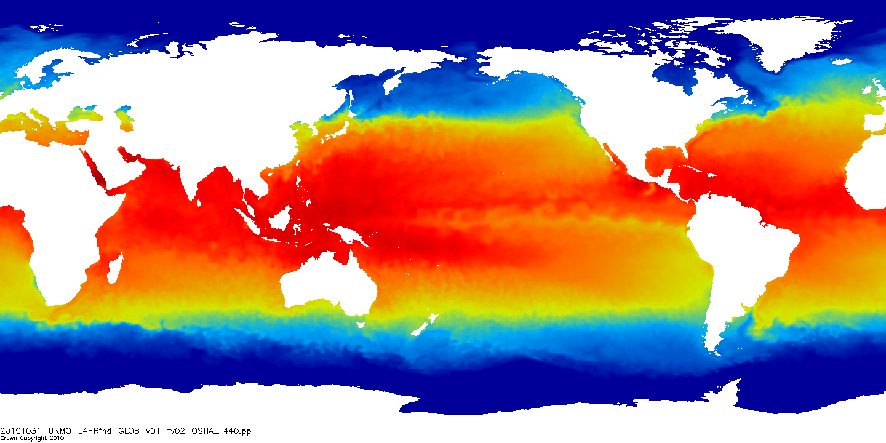
GHRSST Task Sharing
NASA JPL PO.DAAC
NOAA National Oceanographic Data Centre

Slide 16
Data Format: L2P
For every L2 file (swath georeferenced SSTs) GHRSST produces a matching L2 preprocessed (L2P) product:
Identical SST values in the same geographical layout plus
  an estimate of the bias error and standard deviation of error derived from the SSES,
  surface wind speed,
  aerosol optical depth,
  surface solar irradiance (SSI),
  sea ice concentration,
  time of observation,
  quality control flags.

Slide 17
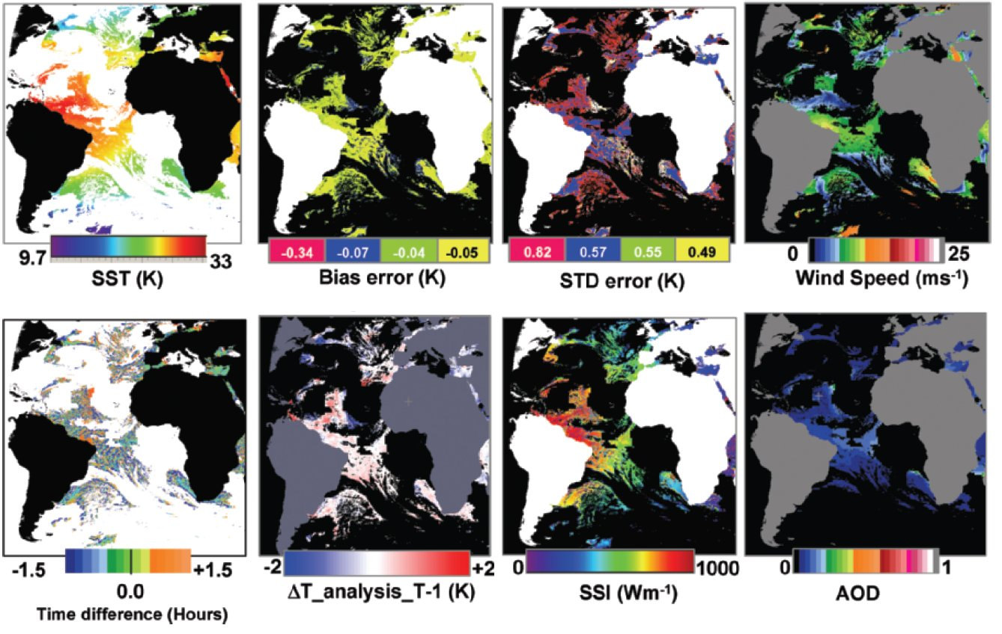
GHRSST L2P variables
SEVIRI SST retrievals with error estimates and diagnostic parameters.
After Donlon et al. (2007) The Global Ocean Data Assimilation Experiment High-resolution Sea Surface Temperature Pilot Project. Bulletin of the American Meteorological Society 88:1197-1213

Slide 18
Data flow

Slide 19
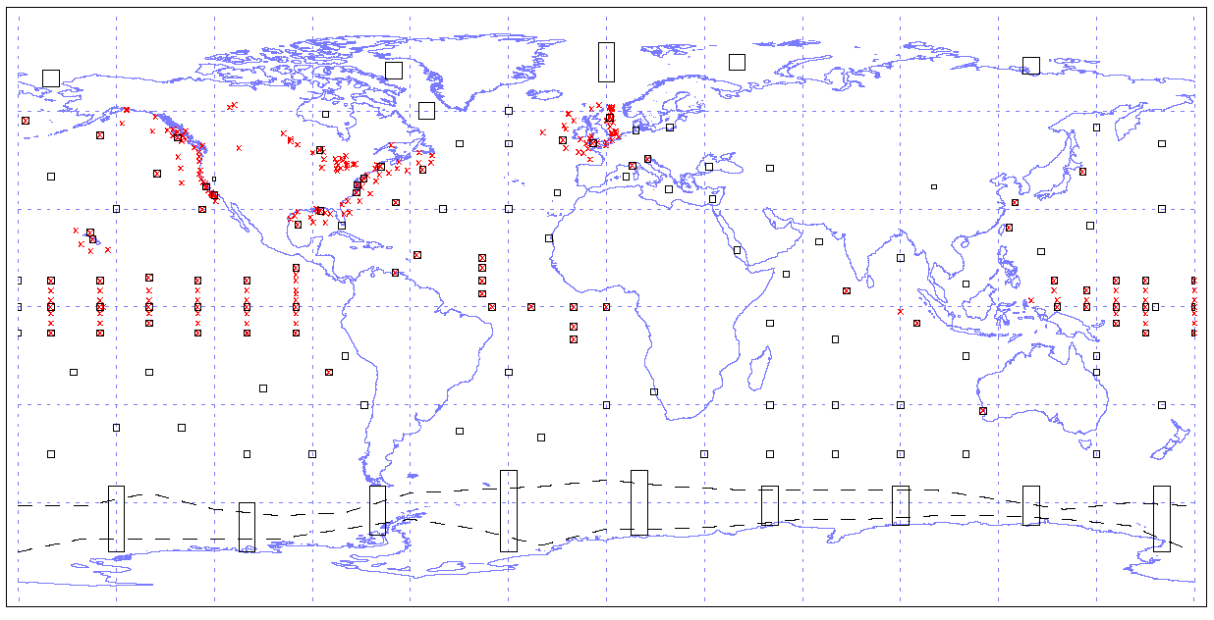
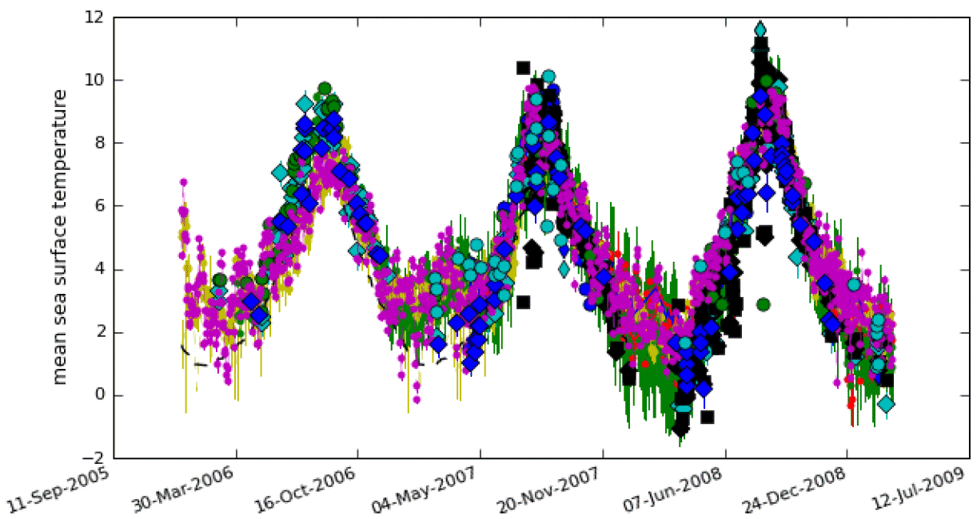
HR-DDS
Characteristic sites in the DDS
Interactively view, compare, and analyze L2P and L4 SST data products, ocean model data sets, and auxiliary data sets from the various data streams within GHRSST
Time series of satellite & in situ SST from Labrador Sea in DDS
http://www.hrdds.net
19
Notes:
19

Slide 20

Long Term Stewardship
30 days after an observation has been made, GHRSST data are transferred from the GDAC to the LTSRF where stewardship is provided in perpetuity.

Slide 21
Achievements
Successful coordination of research groups
Supported dialogue between research and operations communities
Adoption of L2P formats….
Improved knowledge and understanding of the processes that influence SST
Improved techniques for data merging to provide “filled” SST fields
Improved estimates of satellite SST retrieval uncertainties
Successful transition of research results to operations
Improved forecasting skills – including hurricane intensity and track
Scores of publications in the reviewed literature

Slide 22
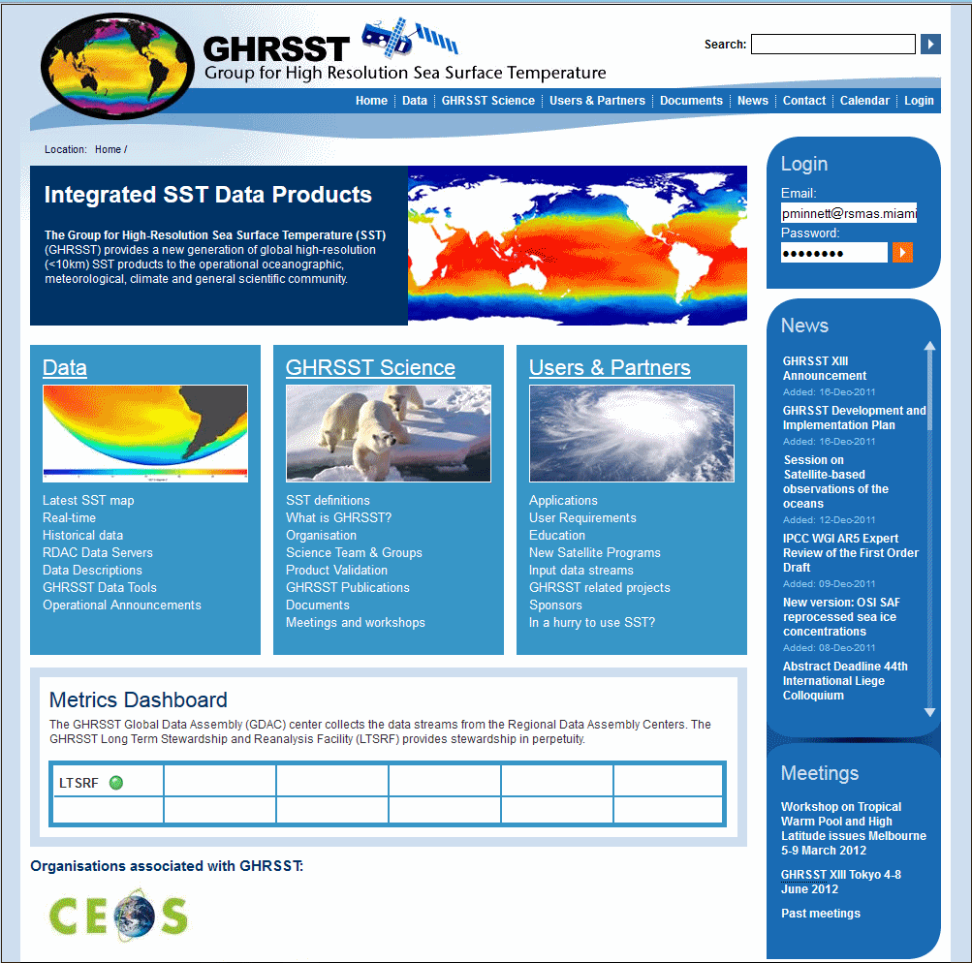
GHRSST Web Pages: www.ghrsst.org

Slide 23
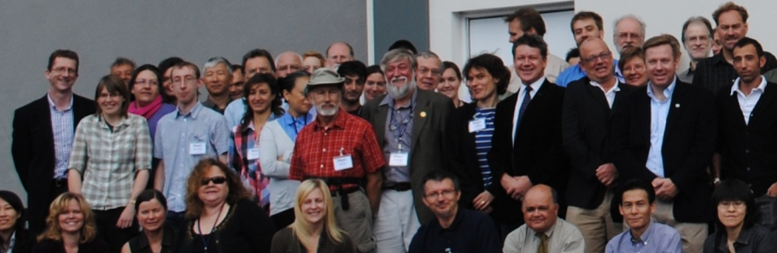
GHRSST Science Team 2011/12
Peter Minnett (ST Chair), RSMAS, Univ. of Miami, USA | Hiroshi Kawamura JAXA/Univ. of Tohoku, Japan | Chris Merchant, Univ. Edinburgh, UK | Anne O'Carroll, EUMETSAT
Craig Donlon (previous chair 2000-2011), ESA, | Nick Rayner, Hadley Centre, Met Office, UK | Olivier Arino, ESA-ESRIN, Italy | Misako Kachi, JAXA, Japan
Chelle Gentemann, Remote Sensing Systems, USA | Bob Evans, RSMAS, Univ. of Miami, USA | Peter Cornillon, Univ. of Rhode Island, USA | Shiro Ishizaki, JMA, Japan
Tim Nightingale, Rutherford Appleton Laboratory, UK | Pierre LeBorgne, Meteo France OSI SAF, France | David Poulter, National Oceanography Centre, UK | Viva Banzon, NOAA NCDC, USA
Doug May, Naval Oceanographic Office, USA | Andy Harris, NOAA/NESDIS ORA, USA | Sandra Castro Univ. of Colorado, USA | Bill Emery, Univ. of Colorado, USA
Gary Wick, NOAA ETL, USA | Ed Armstrong, JPL PO.DAAC, | Alexey Kaplan, Columbia University, USA | Lei Guan, Ocean Univ. of China, China
Ian Barton, CSIRO Marine Research, Australia | Ken Casey, NOAA/NESDIS NODC, USA | Jacob Hoeyer, Danish Meteorological Institute, Denmark | Gary Corlett, Univ. of Leicester, UK
Ian Robinson, National Oceanography Centre, UK | Jorge Vasquez, JPL, PO.DAAC, USA | Steinar Eastwood, met.no, Norway | Jon Mittaz, NOAA, USA
Helen Beggs, Bureau of Meteorology, Melbourne, Australia | David Llewellyn-Jones, Univ. of Leicester, UK | Mike Chin, NASA JPL, USA | Tim Liu, JPL, USA
Richard Reynolds, NOAA CDC, USA | Jean-Francois Piollé, IFREMER, France | Matt Martin, MetOffice, UK

Slide 24
MISST – US Component of GHRSST
www.misst.org
PO.DAAC GHRSST data server
http://ghrsst.jpl.nasa.gov
26 scientist partners in US
-All current and future US satellite SSTs in GHRSST format
-Multiple blended SST products
-Research
-Improve error representation
-Improve use by IOOS

Slide 25
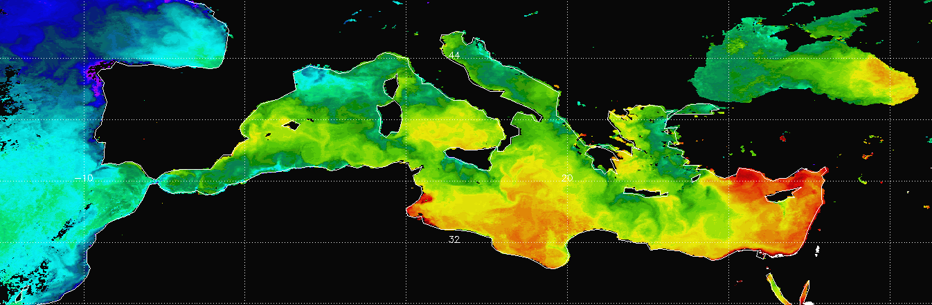
Questions?
Questions about GHRSST: pminnett@rsmas.miami.edu

Slide 26
Multi-year satellite radiometer measurements
Satellite-derived SSTs and uncertainties
CDR of SST
Significant differences between SI & non-SI uncertainties ?
N
Derivation of SST from satellite measurements
Y
SI Traceable uncertainty budget
Non – SI Traceable uncertainty budget
Matchup analysis of SI collocated measurements
Ship radiometer measurements
Matchup analysis of non-SI collocated measurements
Laboratory calibration
Laboratory
water-bath blackbody calibrator
Non-SI traceable in situ measurements
SI-traceable thermometers
Radiometric characterization
e.g. NIST TXR
SI-standard blackbody calibrator

Slide 27
Multi-year satellite radiometer measurements of SST
Non – SI Traceable uncertainty budget
SI Traceable uncertainty budget
Significant differences between SI & non-SI uncertainties ?
Y
N
CDR of SST

Slide 28
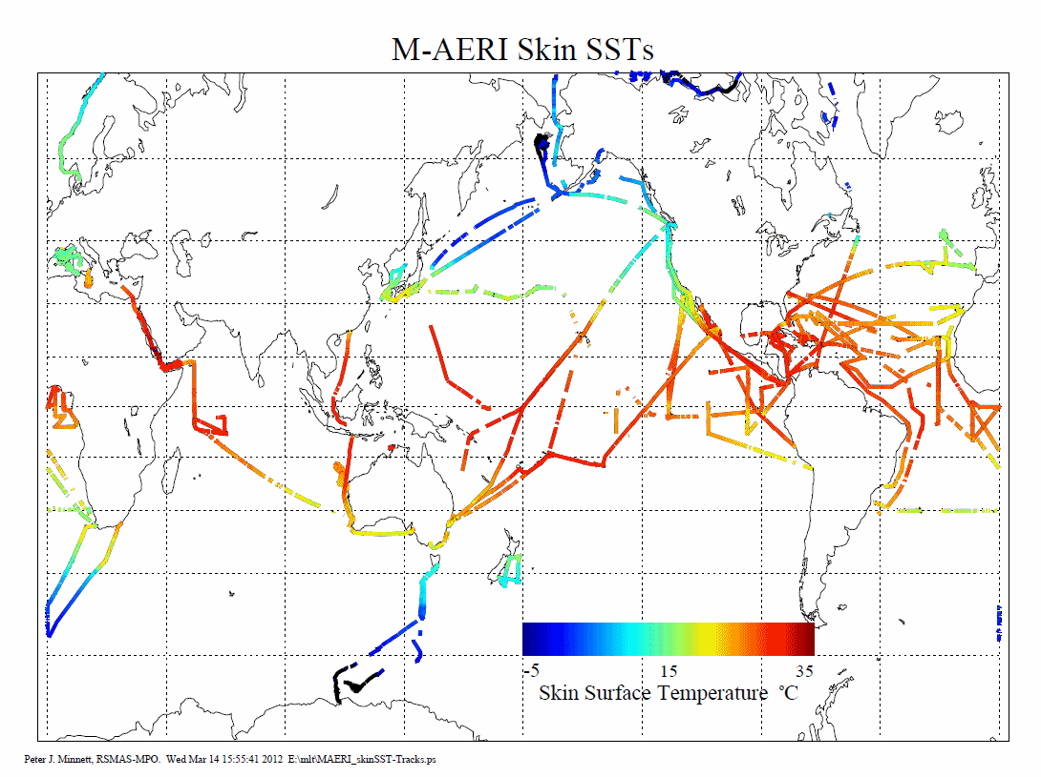

Slide 29
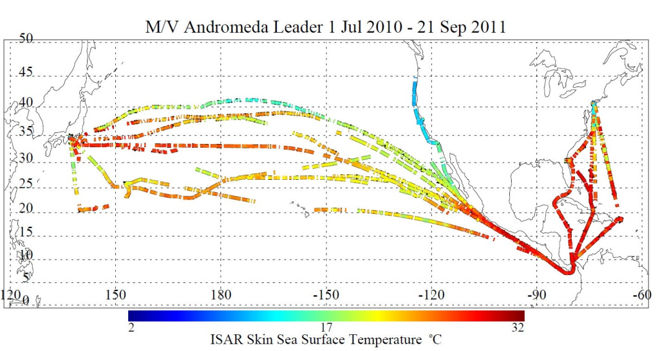
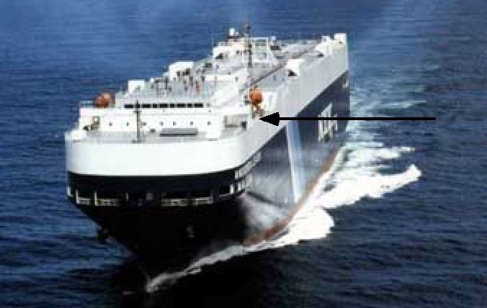
RSMAS ISAR
Over time full range of atmospheric and oceanic variability can be sampled.
ISAR on NYK vessel Andromeda Leader
Notes:
Second bullet added.

Slide 30
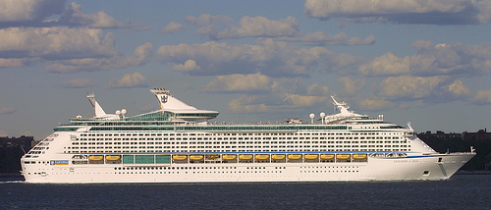
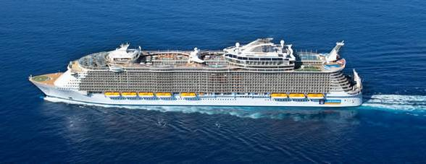
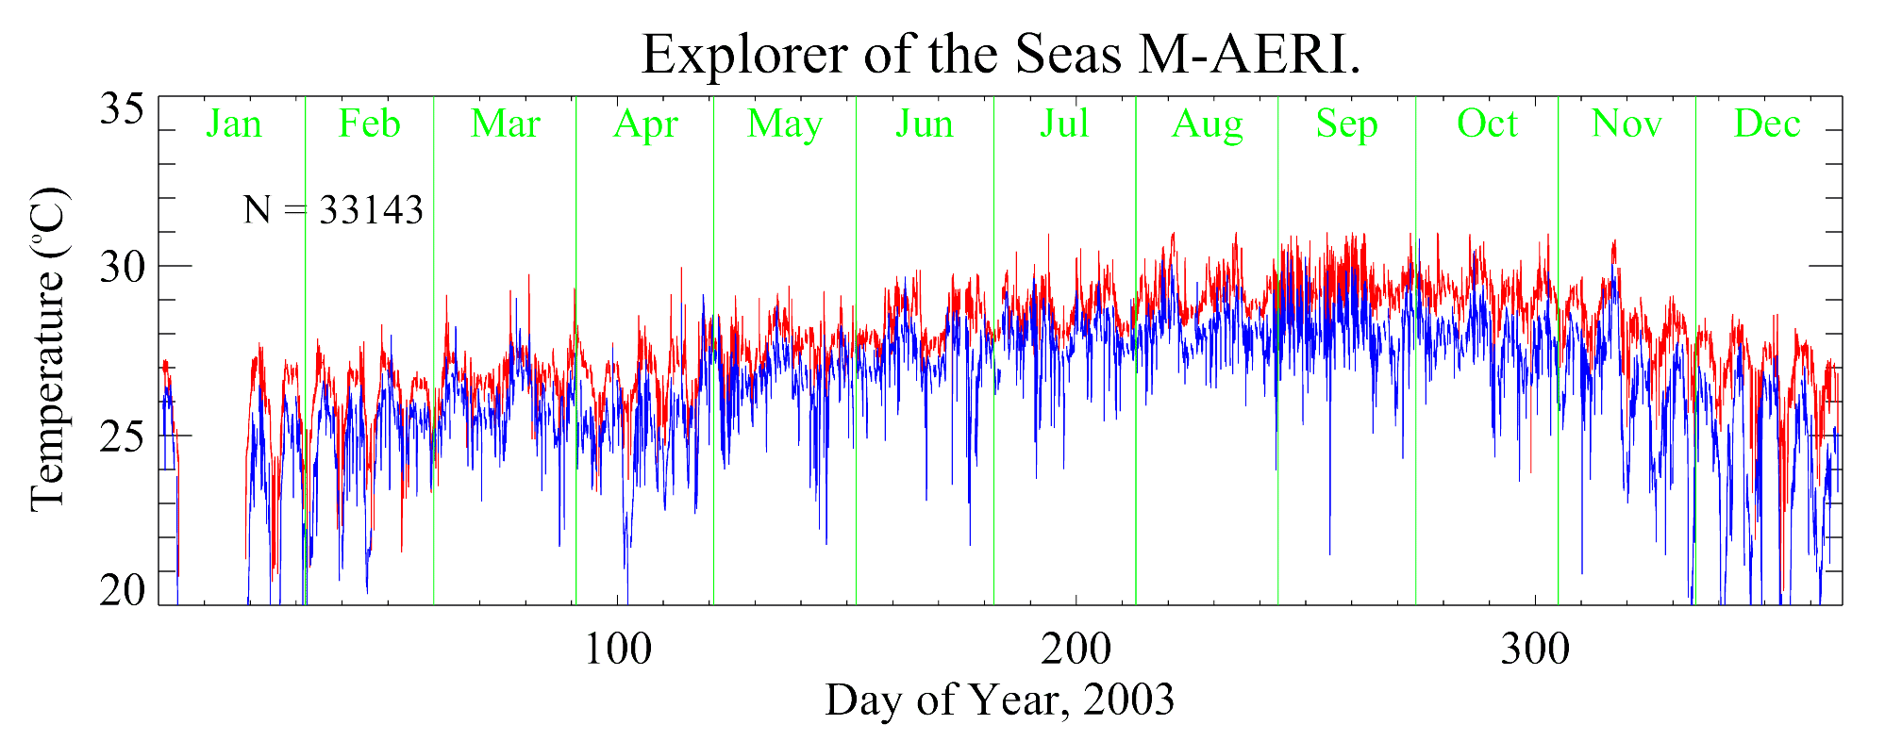
Royal Caribbean Cruise Lines
Use of commercial cruise liners provides a cost-effective mechanism for generating long time-series of radiometric measurements of skin SST, often along repeating tracks.
M-AERI on:
Allure of the Seas, starting 2012;
Explorer of the Seas, 2000-2006, restarting in 2012.
Notes:
Added plot of skin SST (red) and near-surface air-temperature (blue). Gap in January was a dry dock.

Slide 31
MISST – US component of GHRSST-PP
5-year project funded in 2004 by NOPP
Strong partnership (24 scientists)
Industry:
(Lead-PI): Remote Sensing Systems: Chelle L. Gentemann
Academic Partners:
U. Colorado: Sandra Castro, Florida State U.: Eric Chassignet,
U. Miami: Robert Evans, Peter J. Minnett, U. of Maryland: Andrew Harris,
U. Edinburgh: Christopher J. Merchant, Nat. U. Ireland: Brian Ward
Governmental Partners:
NRL: James Cummings, Nancy Baker, Charlie Barron, James Goerss
Naval Oceanographic Office: Doug May, Bruce McKenzie
NOAA: Gary A. Wick, Eileen Maturi, Kenneth Casey, Joe Cione, Mark DeMaria,
Ming Ji, Richard Reynolds, Joseph Sienkiewicz,
NASA: Jorge Vasquez
Other Partners:
European Space Agency: Craig Donlon

Slide 32
Define SST
SST is a reasonably well-defined quantity
But its value depends on the depth of measurement, and how it is measured.

Slide 33
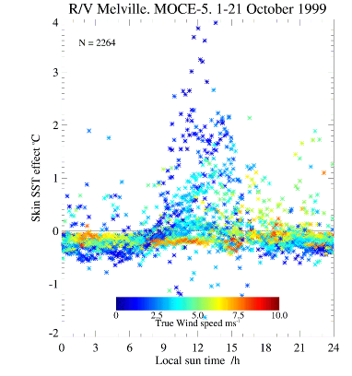
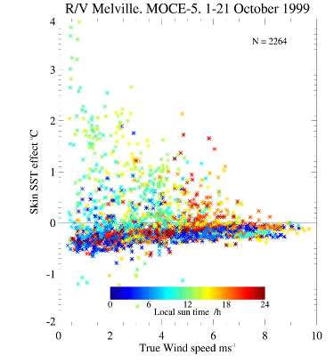
Skin – bulk SST differences
Example of wind speed dependence of diurnal & skin effects – off Baja California
From: Minnett, P. J., 2003: Radiometric measurements of the sea-surface skin temperature - the competing roles of the diurnal thermocline and the cool skin. International Journal of Remote Sensing, 24, 5033-5047.

Slide 34
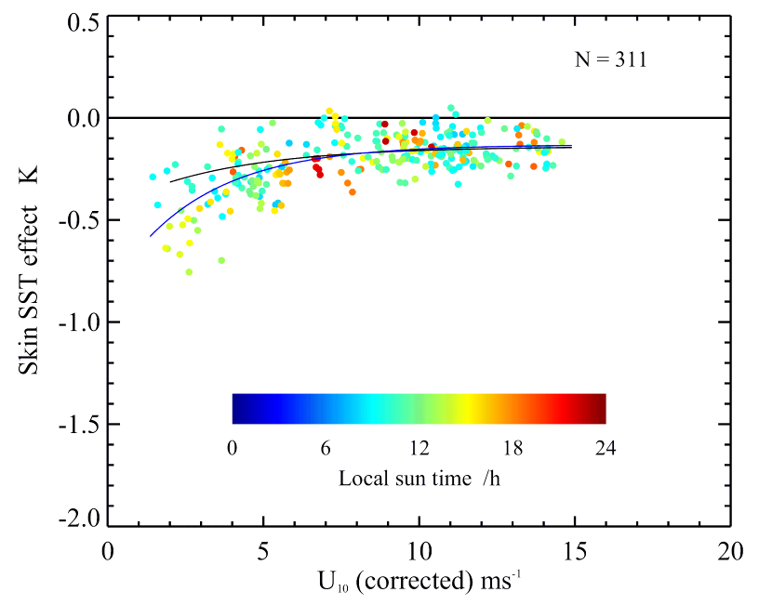
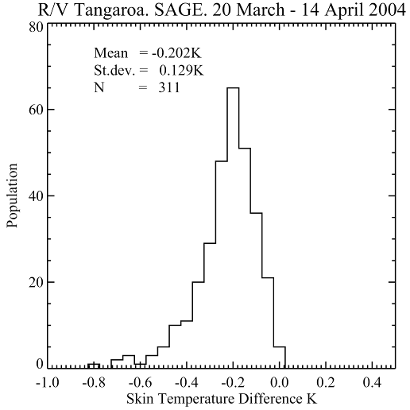
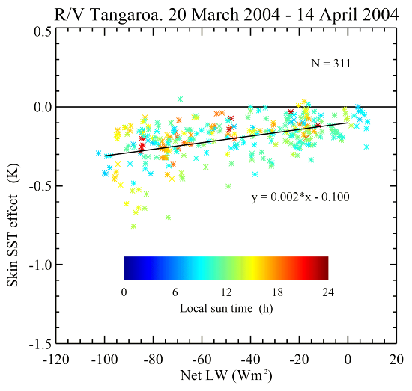

Skin effect
Caused by molecular conduction being the mechanism for heat flow from ocean to atmosphere.
First order correction:
  ΔT ≈ 0.2K
Better correction requires:
  accurate wind-speeds for U₁₀<7ms⁻¹,
  net infrared heat flux at the surface,
  incident solar radiation at the surface,
  SST.
σ = ±0.095K.
Minnett, P. J., M. Smith, and B. Ward, 2010: Measurements of the oceanic thermal skin effect. Deep Sea Research II, Accepted

Slide 35
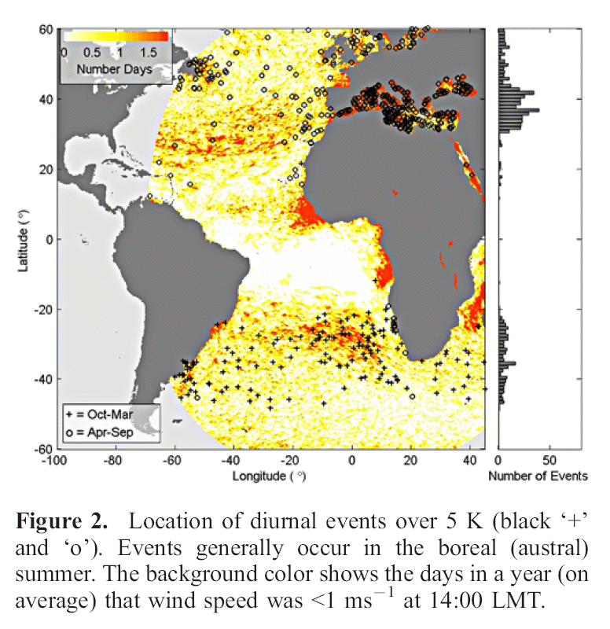
Diurnal Heating
Large diurnal heating events are relatively rare, and smaller amplitudes much more common.
Effects are not greatly diminished by averaging.
Consequences on:
  Deriving coefficients for atmospheric correction algorithms
  SST validation using buoys (temporal, horizontal and spatial gradients)
  SST validation using radiometers (temporal gradients)
Correction requires:
  accurate wind-speeds for U₁₀<5ms⁻¹, over the past several hours
  time series of incident solar radiation at the surface since sunrise
  upper ocean absorption for turbid waters
From Gentemann et al. (2008) Multi-satellite measurements of large diurnal warming events. Geophysical Research Letters 35:L22602

Slide 36
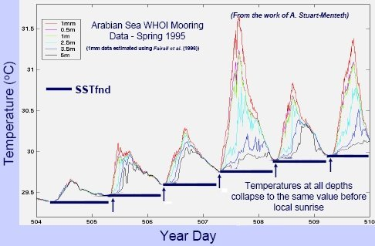
Foundation Temperature
The foundation SST (SSTfnd) is the temperature of the water column free of diurnal temperature variability - daytime warming and nocturnal cooling
(Donlon, et al., 2007, The Global Ocean Data Assimilation Experiment High-resolution Sea Surface Temperature Pilot Project. Bulletin of the American Meteorological Society, 88, 1197-1213).
From Cornillon et al, 2010, Sea-Surface Temperature Error Budget White Paper. In preparation.

Slide 37
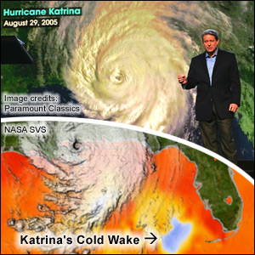
Public Impact
MISST SSTs used in “An inconvenient Truth”
Imagery prepared by NASA SVS

Slide 38
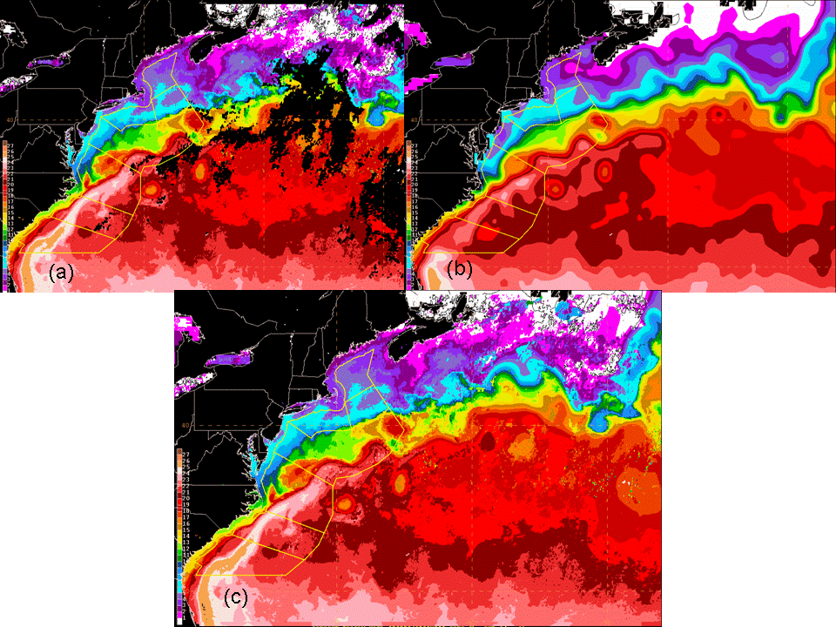
N-AWIPS operational workstations use GHRSST products
Reynolds 25 km and GOES now available to forecasters
Notes:
The OPC has focused on setting up a daily data flow for the OISST and establishing a process to easily create an acceptable file format for display in the National Centers Advanced Weather Interactive Processing System (N-AWIPS) operational workstations. Data flow and file conversion processes were established in early January 2008. Operational production for OPC forecasters began January 10, 2008. Several of the issues encountered are described below. Fig. 1 shows a global view of the OISST as displayed on the OPC N-AWIPS workstations.
OPC forecasters are interested in SST boundaries and features such as warm and cold rings in association with the Gulf Stream region. Daily and three daily GOES SST IR based products from NOAA NESDIS are available to forecasters for tracking such features, however persistent cloudiness often obscure the features of interest for days or even weeks during the winter months when majority of severe ocean storms that threaten the safety of commercial marine transportation, commercial fishing, and coastal mariners occur. Fig. 2 illustrates one operational use of the OISST as a compliment to IR sources of SST such as from the GOES. By super-positioning GOES SST three day composites with the OISST the continuity of ocean thermal features is easily maintained by forecasters.

Slide 39
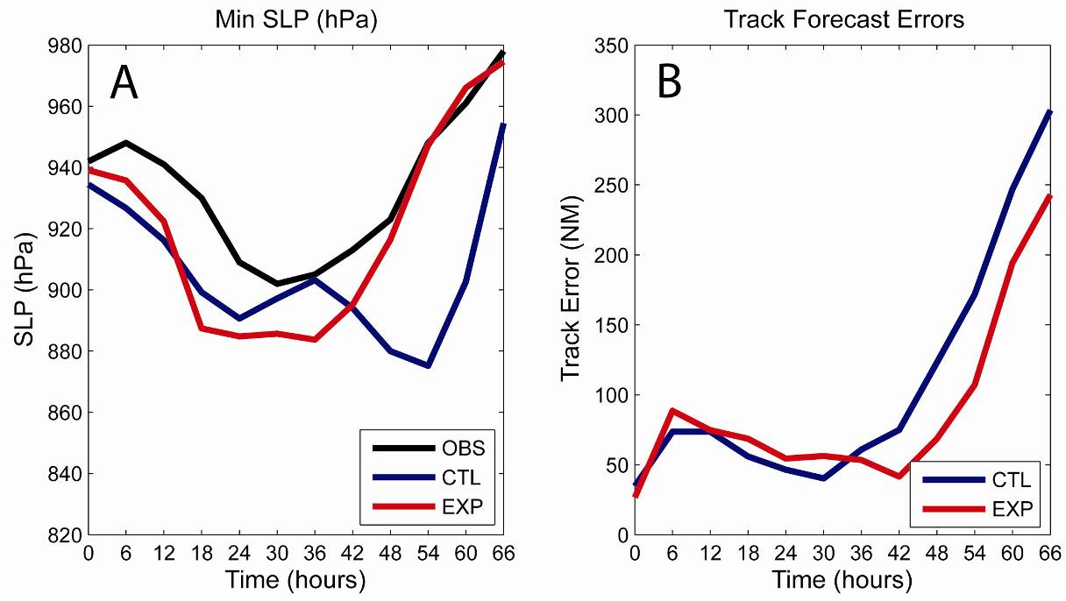
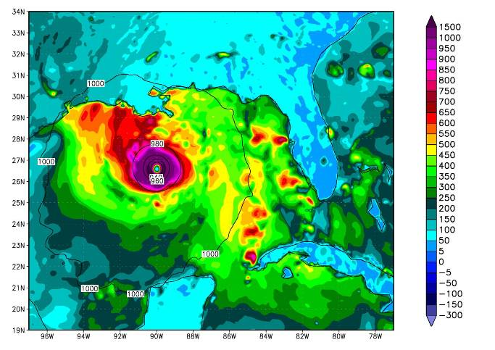
NCODA SSTs in COAMPS Katrina simulations
Improved track forecast
Better enthalpy fluxes
Better intensity forecasts
Notes:
CTL = contrl –AVHRR
Epx = experimental inclr AMRS-e – 48 hr forecast improvement important for evacuation…

