Slide 1






Developing and Applying an Integrated Multi-scale Earth System Modeling Framework to Study the Impacts of Changing Climate, Local Weather, and Land Use on Watersheds and Downstream Coastal Ecosystems
Award Number, NNX11AE42G
NASA Ocean Color Research Team meeting
Seattle, WA
22 April 2011
Zong-Liang Yang, Cédric H. David, Xitian Cai, Lisa H. Meyer, Ahmad A. Tavakoly, Zhongfeng Xu, Paul A. Montagna, Evan L. Turner, Hongjie Xie, Almoutaz El Hassan, Eric Kouba, Weimin Hao, Shawn Urbanski David R. Maidment, James W. McClelland, Claire G. Griffin

Slide 2

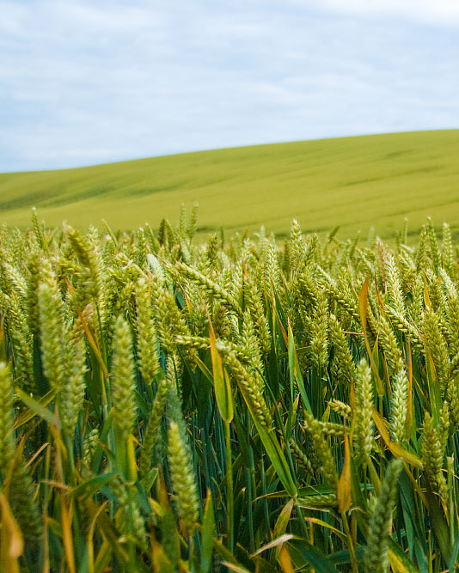
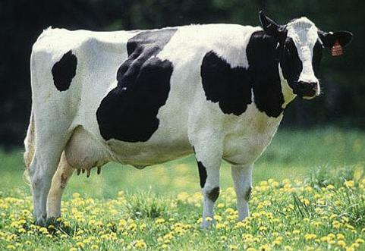
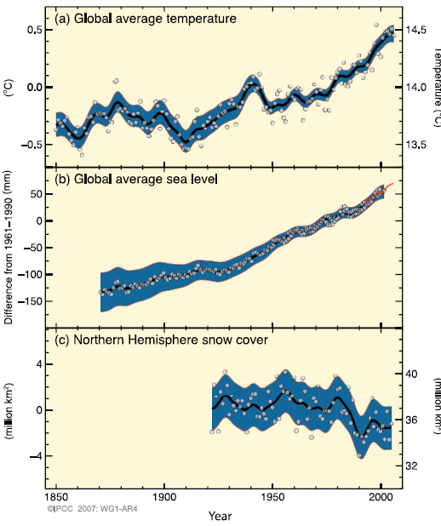
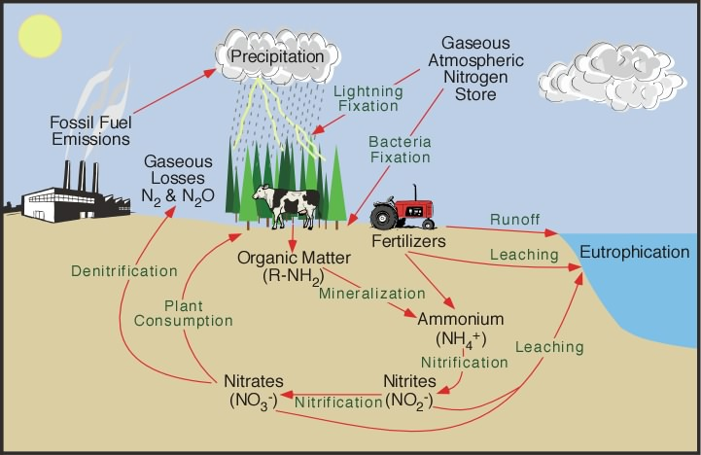

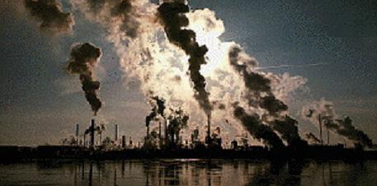
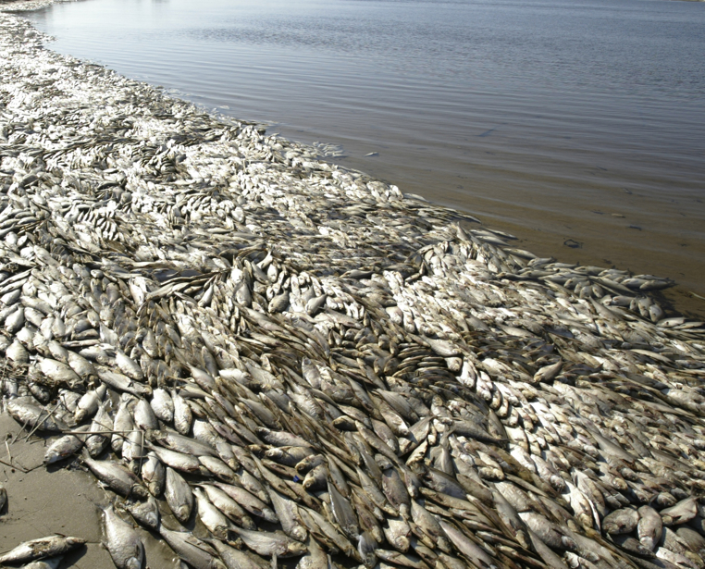
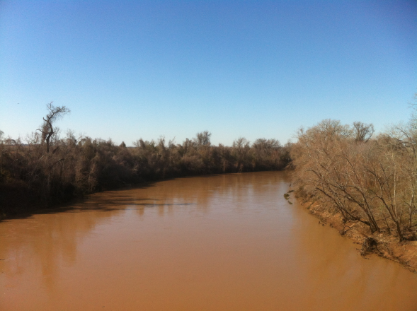
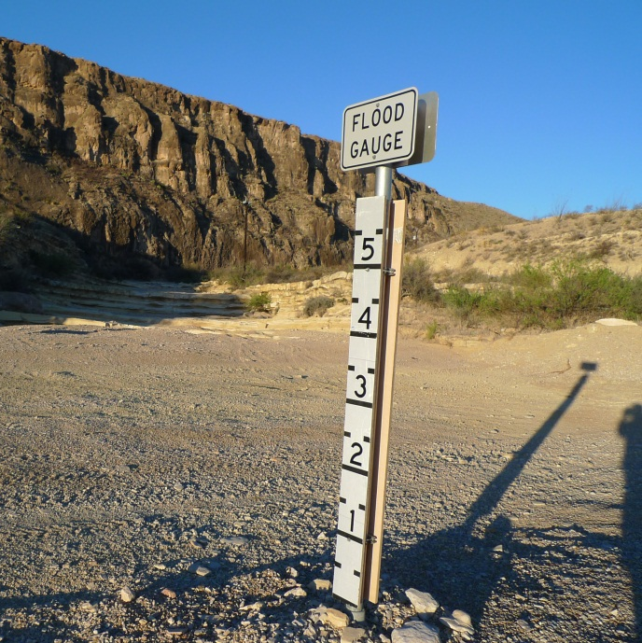
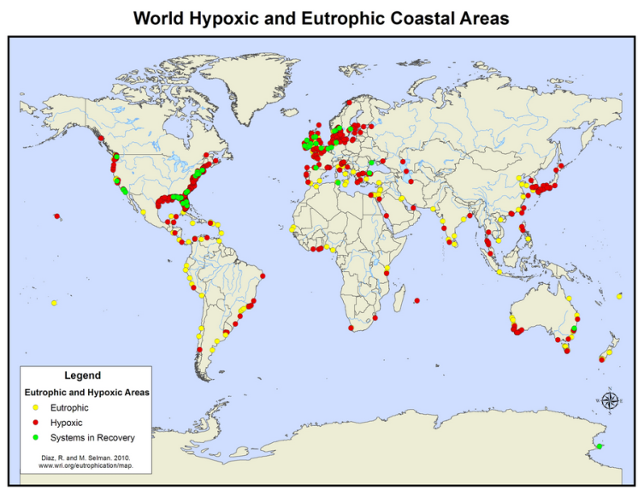
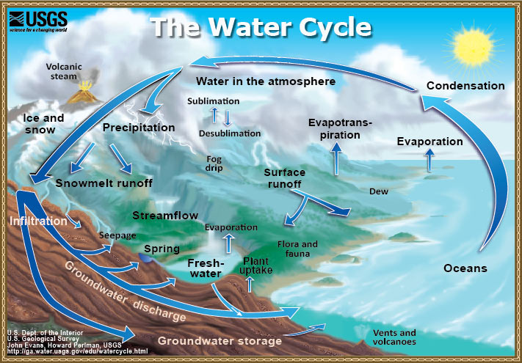
IPCC (2007)
physicalgeography.net (2012)
Selman et al. (2008)
usgs.gov (2012)

Slide 3
Everything is interconnected…
But we lack integrated models of climate, extreme weather, land surface, river flow, biogeochemistry, and ecology for integrated understanding

Slide 4
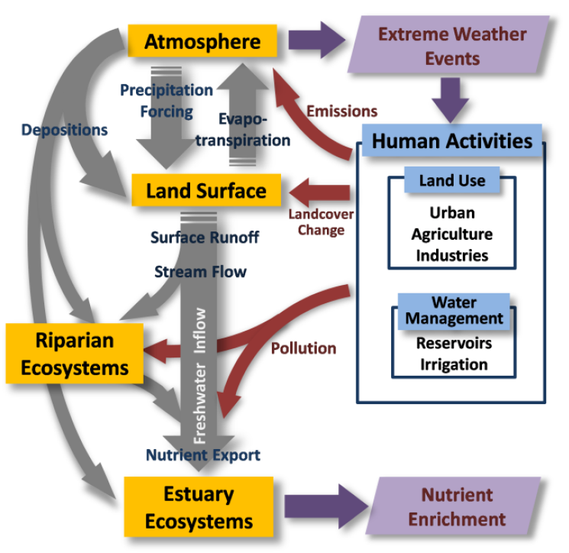
NASA Interdisciplinary Science (IDS) project
Improve our understanding of how terrestrial and aquatic ecosystems that are connected by watersheds respond to combined changes in the hydrological and biogeochemical cycles that result from changes in climate and land use.
Develop and utilize a model framework for predicting how terrestrial and coastal estuary ecosystems may change in response to future perturbations.
Yang et al. 2009

Slide 5
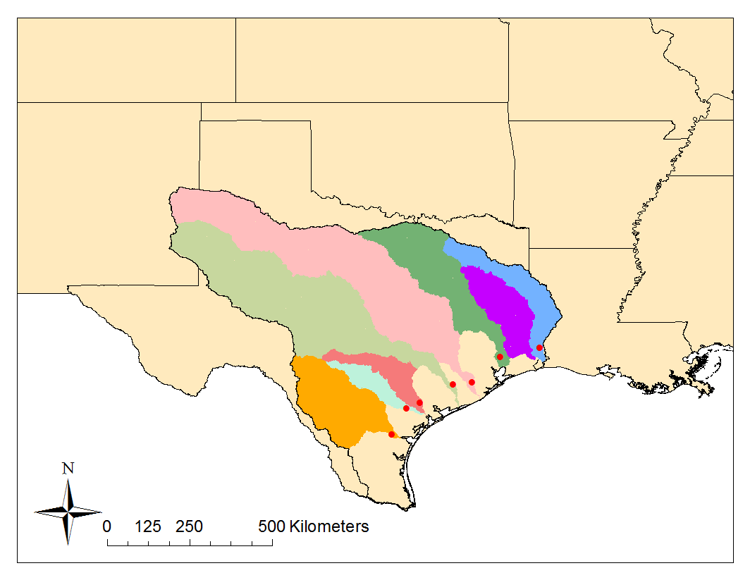
Study area: Texas and its river basins
  Texas
  Texas Gulf Basins
  Guadalupe and San Antonio Basins
  San Antonio Basin
  San Antonio Bay
  Also… the Mississippi Basin
460,000 km², large agriculture production, many industrial facilities
8 river basins, 7 bays

Slide 6
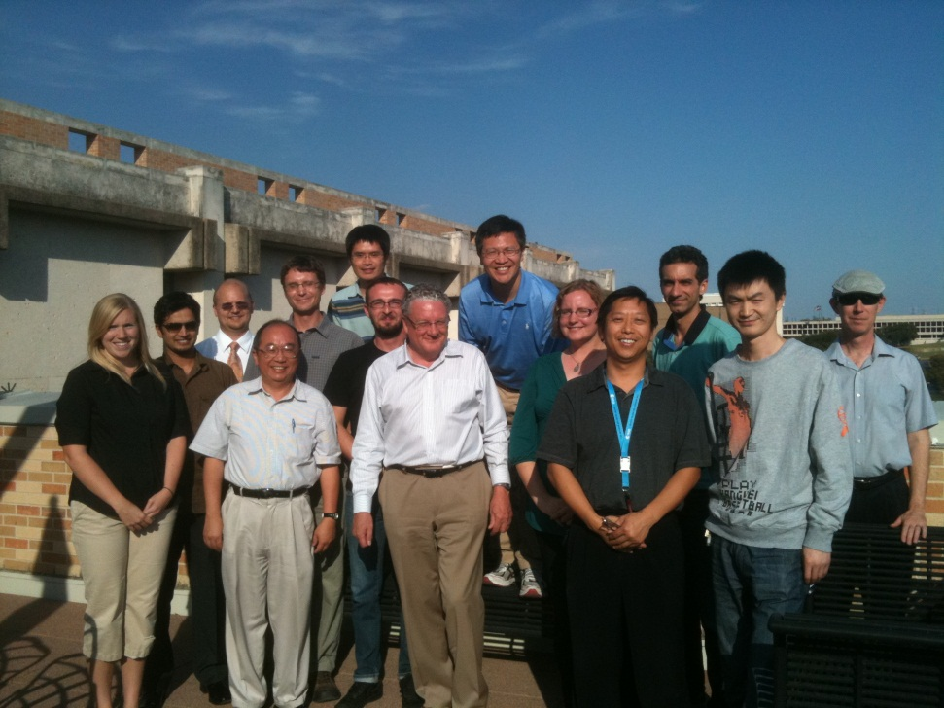
The team
PI: Zong-Liang Yang
Co-PI: Paul Montagna, Hongjie Xie,
Wei Min Hao, David Maidment, James McClelland
Contributors: Xitian Cai,
Cédric David,
Lisa Meyer,
Ahmad Tavakoly,
Zhongfeng Xu,
Evan Turner, Almoutaz El Hassan, Eric Kouba,
Shawn Urbanski, Claire Griffin
Austin, TX, 28 September 2011
All contributed to this presentation, thanks!

Slide 7
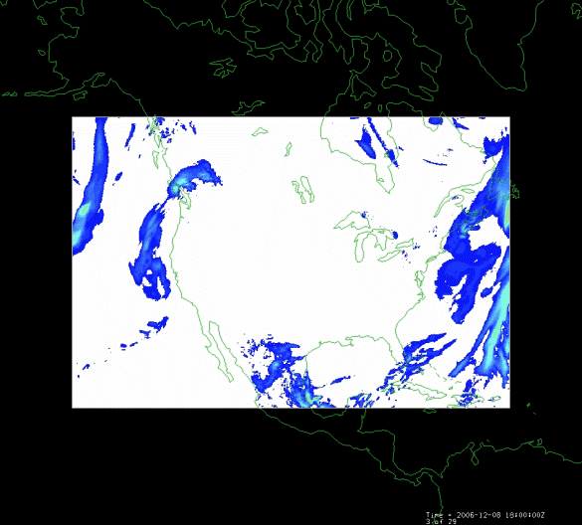
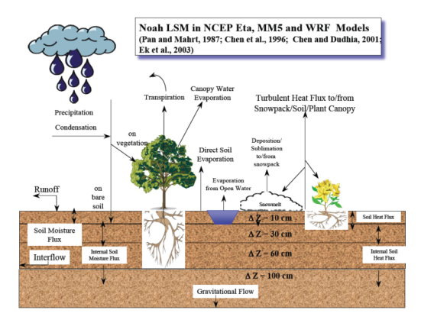
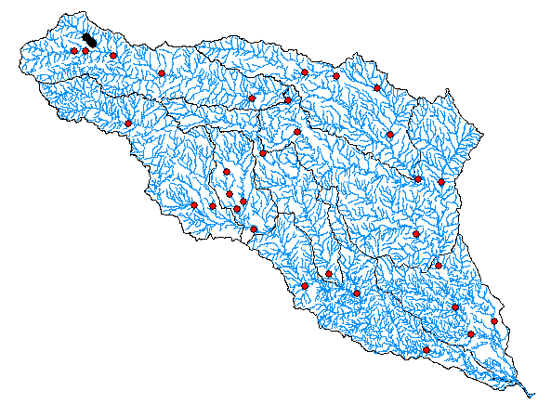
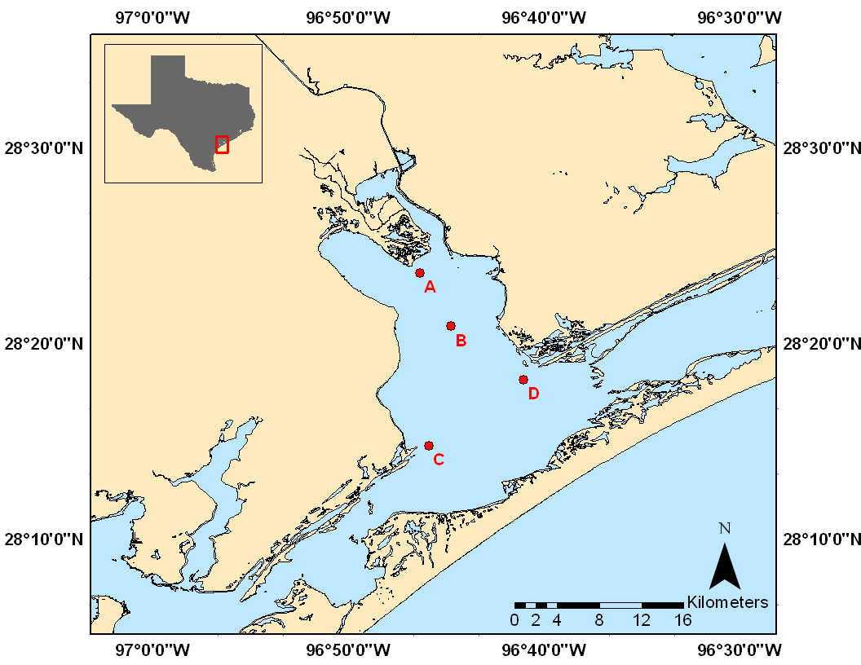
Outline
Atmospheric Model
Precipitation
Nitrogen deposition
Land Surface Model
Evaporation
Nitrogen fixation
River Model
Flow
Nitrogen transport
10 sections, all pieces of the main puzzle and part of a large integrated framework
Estuary Model
Primary production

Slide 8
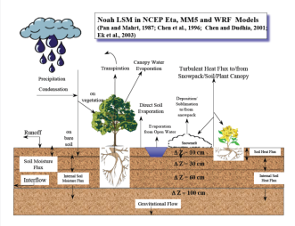
Climate Change and terrestrial water resources
1/10
Cédric H. David (cedric.david@utexas.edu) and Zong-Liang Yang

Slide 9
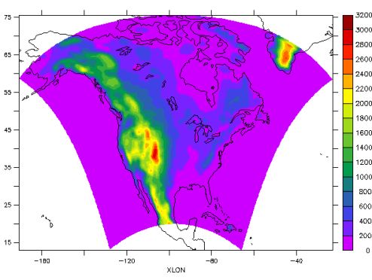
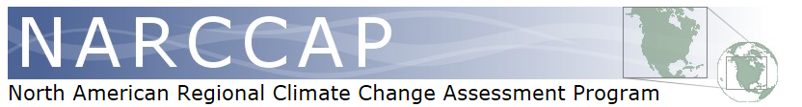
NARCCAP
North American Regional Climate Change Assessment Program
  Global
    Reanalysis → “current” (NCEP/DOE AMIP-II)
    Models → “current” and “future using A2” (CCSM, CGCM3, GFDL, HadCM3)
  Six regional models (CRCM, ECPC/RSM, HRM3, MM5I, RCM3 and WRF)
3-hourly
50 km
Dynamically downscaled current and future climate data

Slide 10
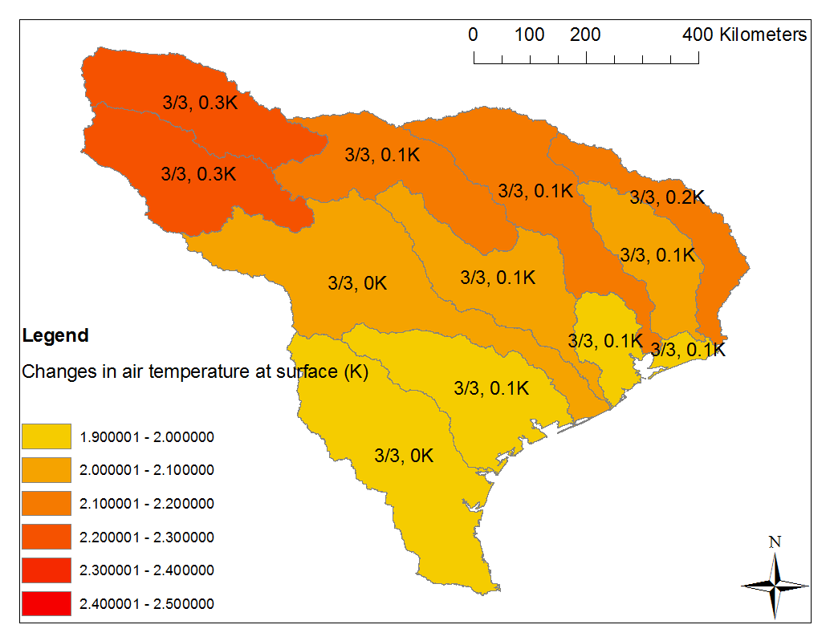
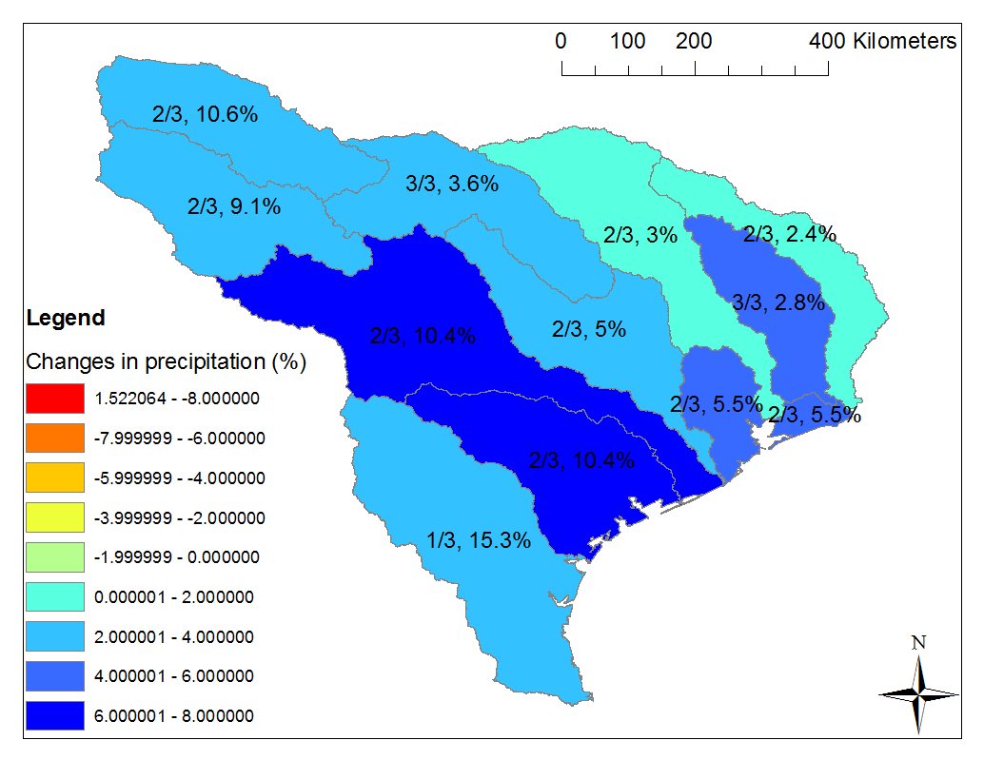
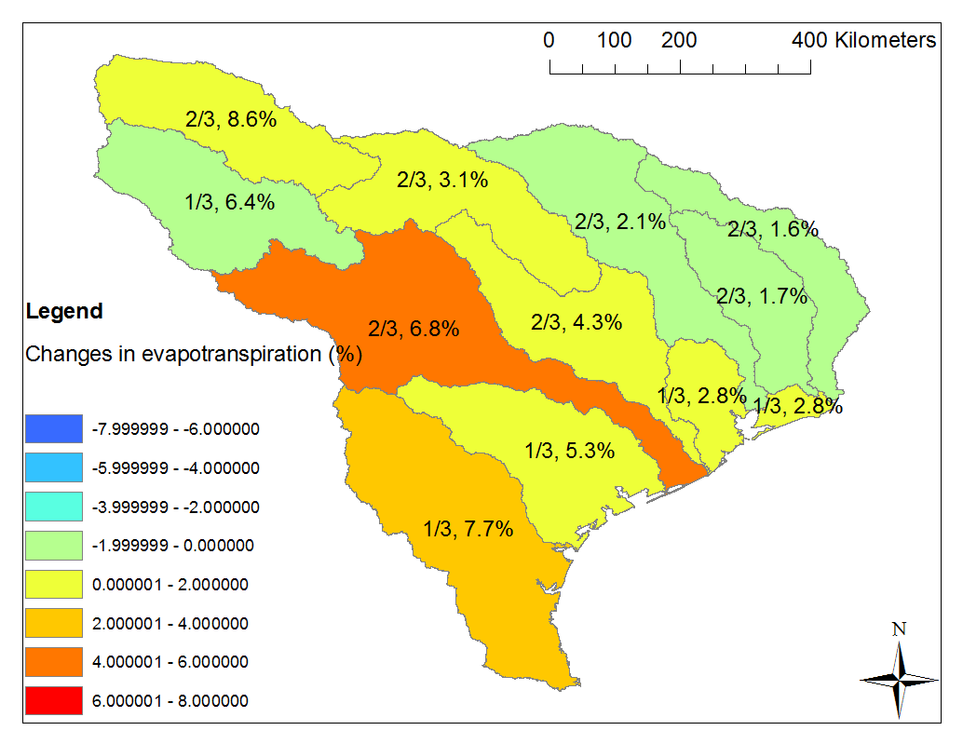
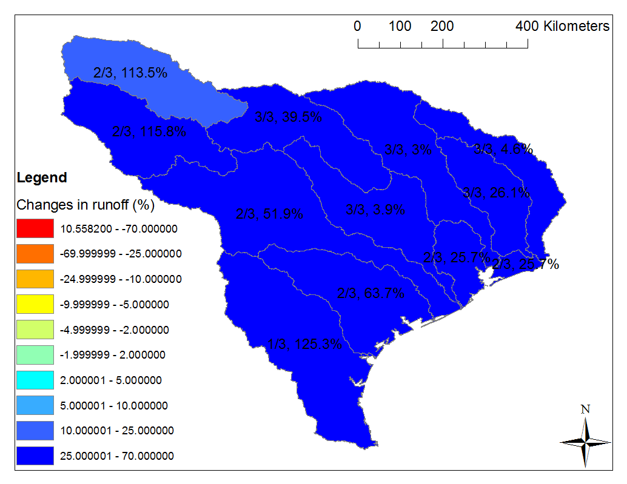
How much water tomorrow?
Temperature
Precipitation
Evapotranspiration
Runoff
Variability of predictions increases from T to R
Biases are large (not shown)

Slide 11
Improving dynamical downscaling methods
2/10
Zhongfeng Xu (xuzf.iap@gmail.com) and Zong-Liang Yang

Slide 12
Correcting GCM bias before dynamical downscaling
Global reanalysis
Global circulation model
Past
GCMbc1
GCM
→ corrects the average
Future
Time
Time
Past
GCMbc2
GCM
→ corrects the std. dev.
Future
Time
Time
Applied to 5 variables, each model grid, every 6 hours

Slide 13
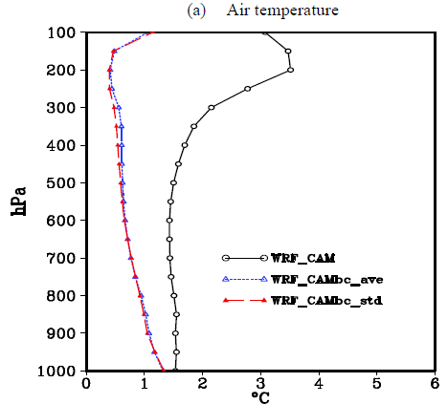
Impact on dynamical downscaling results
Xu and Yang (2012 Journal of Climate)
Correcting GCM bias prior to downscaling allows reducing errors, also improves modeling of extremes

Slide 14
Land surface modeling over the Mississippi basin
3/10
Xitian Cai (xtcai@utexas.edu), Zong-Liang Yang and Cédric H. David

Slide 15
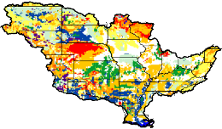
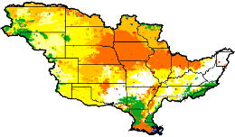
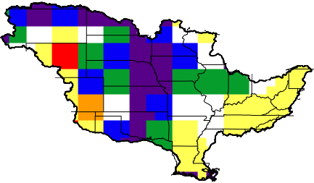
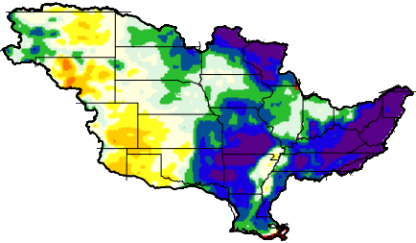
Noah-MP land surface model
Land surface features
NLDAS atmospheric forcing
Soil
type
Temperature
Precipitation
Wind speed (U, V)
Specific humidity
Surface pressure
Downward SW radiation
Downward LW radiation
Noah-MP land surface model
Land
cover
Soil
color
Green
vegetation fraction
Surface runoff
Sub-surface runoff
Soil moisture
Evapotranspiration
Water table ……
Model output
Noah-MP is now one option in the atmospheric model used for U.S. numerical weather prediction (WRF)

Slide 16
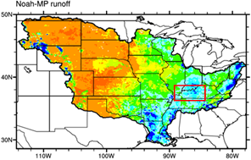
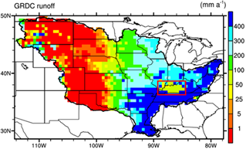
Noah-MP applied to Mississippi Basin
Spatial distribution
  Noah-MP captures the general spatial patterns of runoff
  High runoff over the southeast, low over the northwest
  Red box: observation error
Annual climatology runoff
Noah-MP captures the spatial patterns of runoff

Slide 17
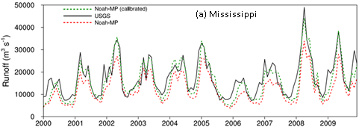
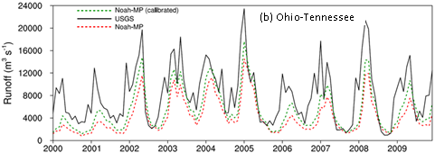
Noah-MP lumped hydrographs
Hydrograph
  Calibration on sub-basin level
  Result is improved by calibration
Noah-MP is capable of capturing the temporal patterns of runoff

Slide 18
Nitrogen budget of texas
4/10
Lisa H. Meyer (lisa.meyer@utexas.edu) and Zong-Liang Yang

Slide 19
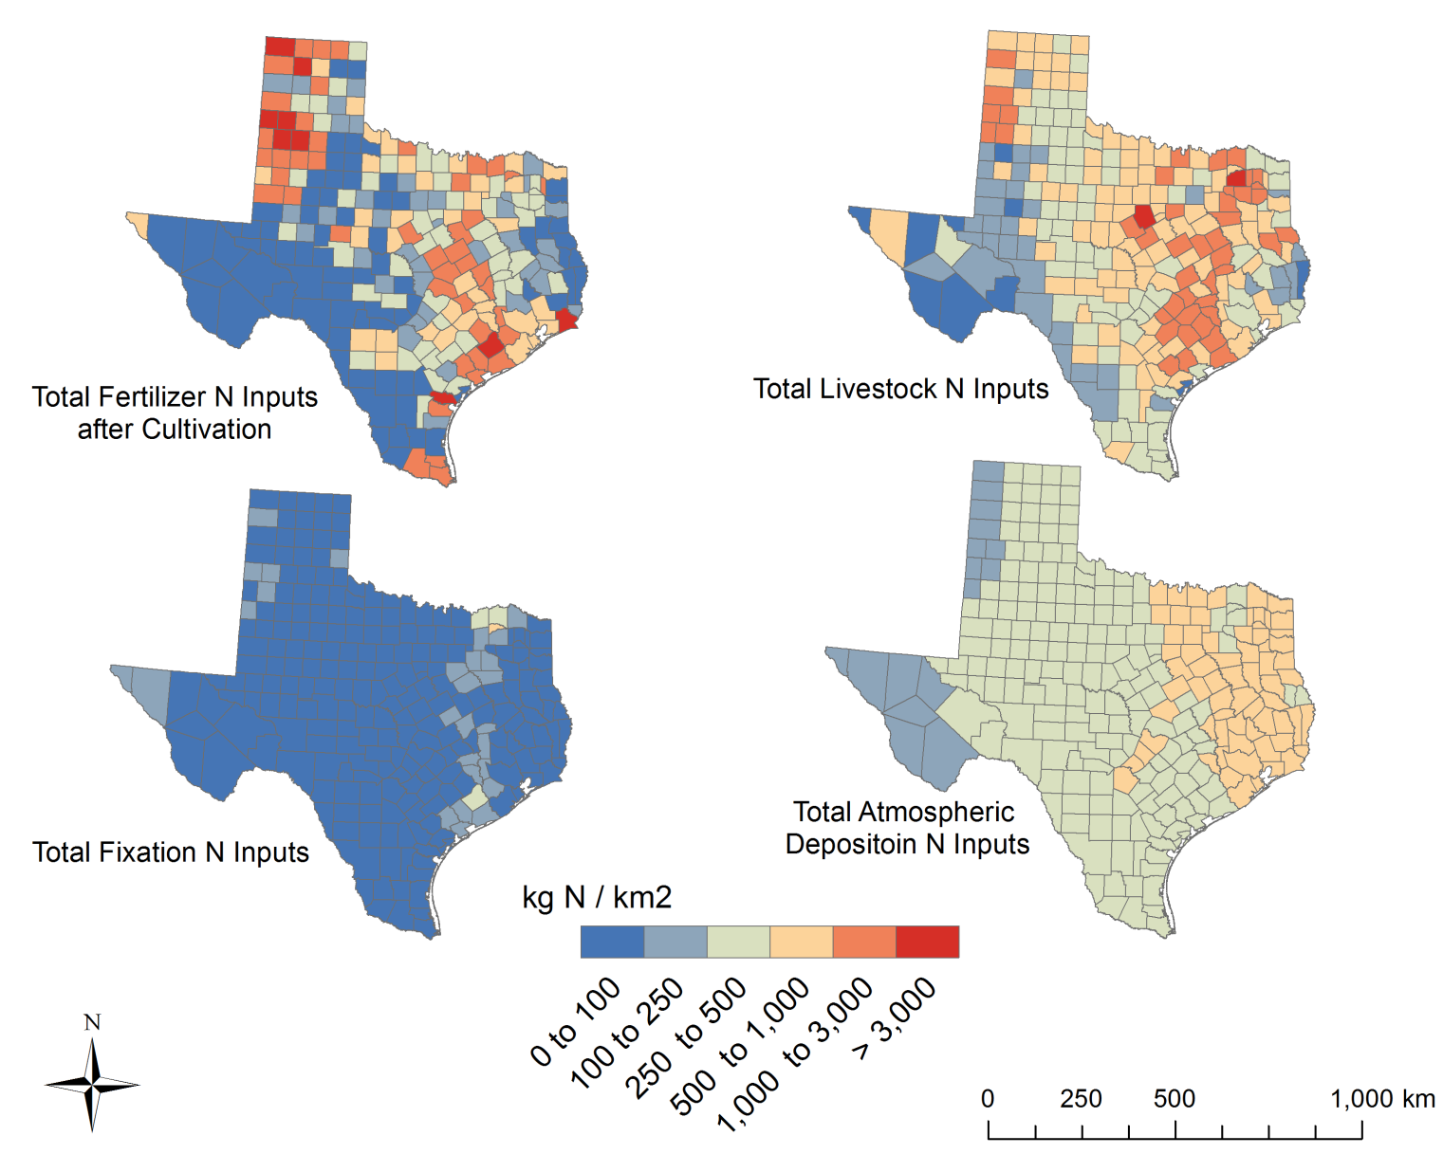
Distribution of Nitrogen Sources in Texas
Fertilizer
Livestock
38%
37%
Legumes
Atm. Deposition
2%
23%
In Texas, the majority of the sources of N are from Agriculture
Notes:
We also have looked at the regional (from Texas) sources of nutrients, specifically N, and the spatial variability. (top right = N from manure from livestock, top left = N from fertilizer after crops have removed N for growth ..30% per crop area was removed, bottom left is fixation influence: all N from legume fixation, bottom right = oxidized atmospheric deposition).
Fertilizer after removal from crops matches well with areas where livestock is also high, due to much of the crops in texas being grown for food for the livestock industry.
Fixation is a small percentage (from legumes), however the significant inputs aline well with the location of much of the livestock as well. This is due to a large percentage of legumes existing in pasture lands where cattle graze. The atmospheric deposition is of oxidized N, typically the sources are combustion products (NO2). The spatial trend actually highlights the I-35 corridor well as well as the large urban areas like dallas-fort worth, Houston, austin, and san antonio.
The majority of the N sources in texas are from livestock, hwoever urbanization cannot be ignored.

Slide 20
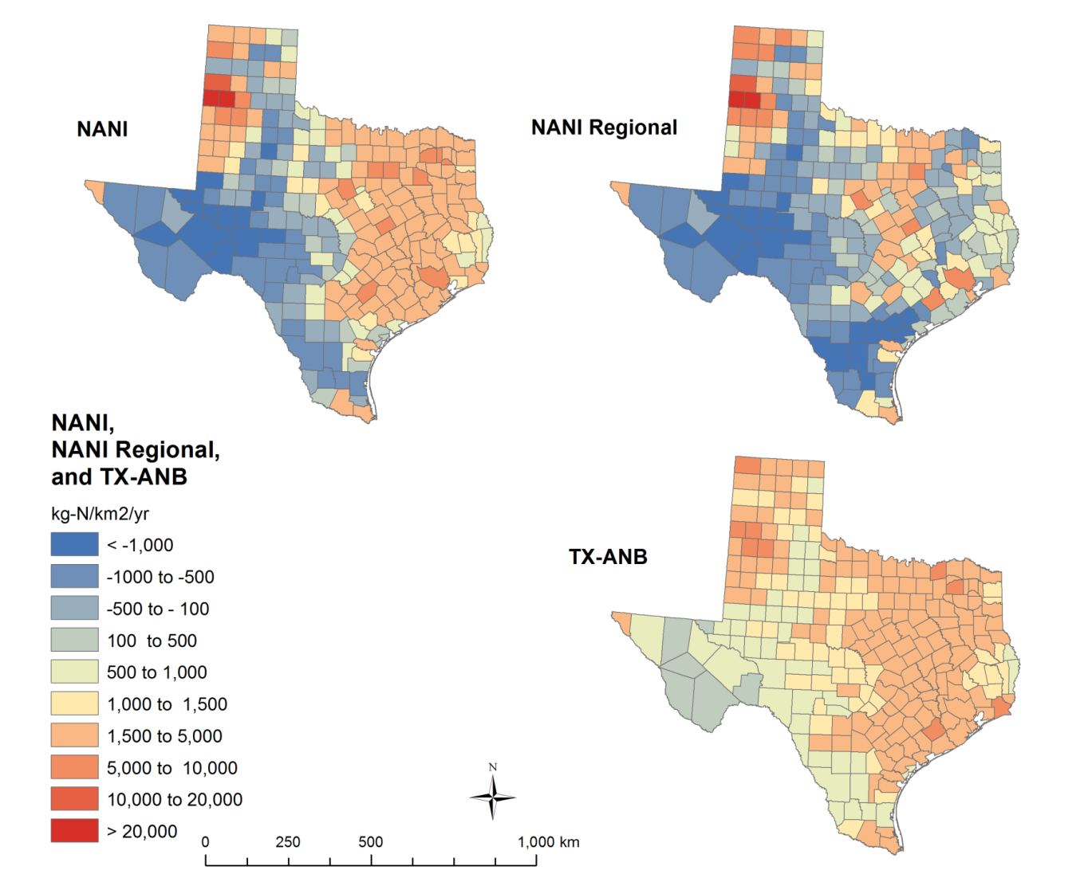
Regional (TX-ANB) vs. National (NANI) Comparisons of Nitrogen Sources and Inputs
Texas Regional Sources spatially compare well to national budgets. Understanding regional sources is important when considering total N input and anthropogenic impacts
Notes:
Once considering regional sources of N from Texas, it was important to compare these (Texas – Anthropogenic Nitrogen Budget: TX-ANB) with national estimates of sources of N (NANI- Net Anthropogenic Nitrogen Inputs). Some differences were fertilizer data sets on a national scale were from the USGS vs. Texas has its own fertilizer accounting system. Legume fixation rates were based on a regional estimate for fixation in pasturelands (from TX A&M) vs. Nationally the legume pasture fixation rate is much higher.
NANI is the Net Anthropogenic Nitrogen Inputs from cornell university, it is a nationally available dataset which is based on estimates from Boyer et al. 2002 and Howarth et al. 1996. Their original work was conducted for the Northeast. Climate there is very different, in dryer regions, such as texas, fixation in pasture lands is very different. Fixation in pasturelands depends on legume coverage within the pasture. In Texas, the pasture lands are only covered ~2% with legumes, vs. in the Northeast, this number is much larger, thus the fixation estimates for the National budget (NANI) are much higher. In addition, the fertilizer data set was different, and crop data was from the National Agriculture Statistics service’s Cropland Data layer (NASS-CDL)project. This crop data is based on remote sensing. The NANI uses Census of Agriculture data for their crop data…
Basically the three differences between NANI and TX-ANB are: fertilizer data is regional for TX-ANB, legume fixation is less in TX-ANB, and NASS-CDL is used for TX-ANB (so crop data is different).
NANI is a toolbox so different data can be input and the same algorithms run. This was done for NANI Regional: TX-ANB regional information was input into NANI and run to produce NANI Regional.

Slide 21
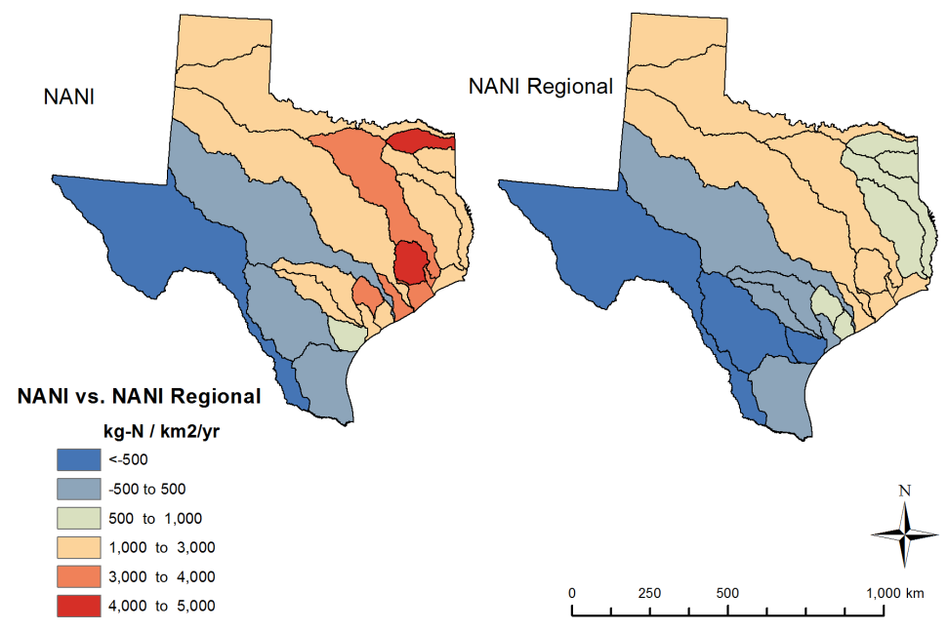
National (NANI) vs. Regional (NANI-R) Potential Export
NANI
NANI-R
Regional source information is critical for nutrient export information
Notes:
The NANI toolbox also converts the county information into basin scale information to look at implications of sources on export of N. Some areas in the northeast had much larger values in NANI. This is due to the differences in the crop information; a lot of N from fixation is produced with NANI vs. with NANI regional N from fixation is much less (pasturelands mainly). This shows how important it is to use regional estimates. Over estimating N inputs from fixation could potentially lead to a gross over estimation of N export from eastern Texas. When considering source comparisons, this was the main reason for the difference (legumes). As you saw from TX-ANB, legumes only play a small role in Texas when considering regional estimations for fixation, therefore understanding a region’s climate (directly impacts legume coverage in pasturelands) is critical for understanding the N cycle and potential N loads.

Slide 22
River Modeling in the texas gulf coast hydrologic region
5/10
Cédric H. David (cedric.david@utexas.edu) and Zong-Liang Yang

Slide 23
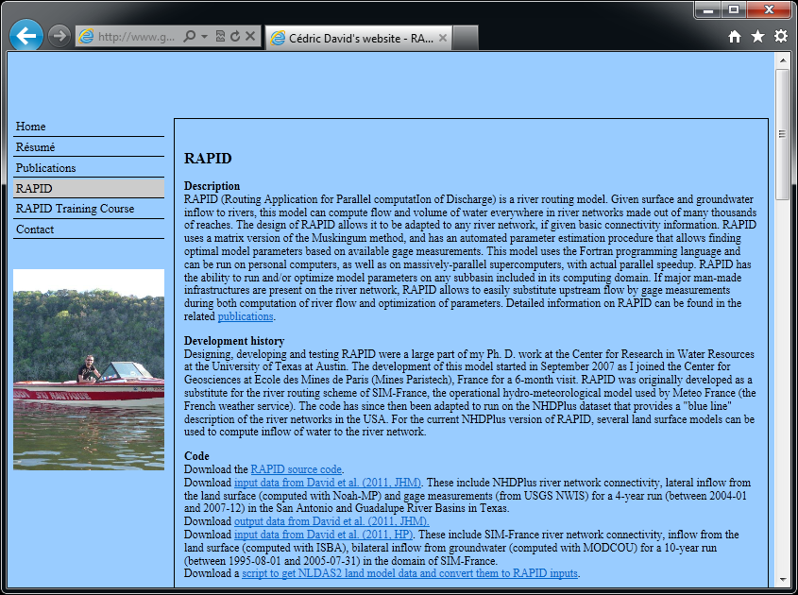

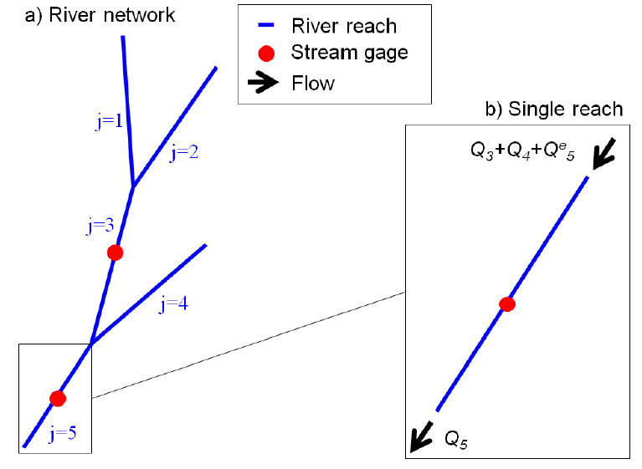
River model
RAPID (Routing Application for Parallel computatIon of Discharge)
Computes flow and optimizes model parameters
Model code, input data and animations are available at http://www.geo.utexas.edu/scientist/david/rapid.htm
Muskingum method applied to vector-based river network
Speedup achieved with high-performance computing
Available online

Slide 24
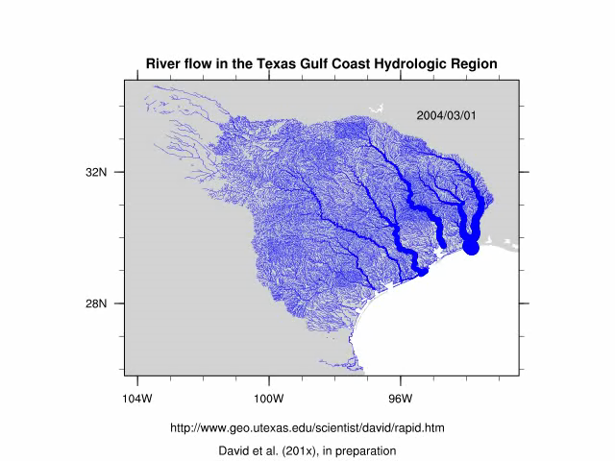
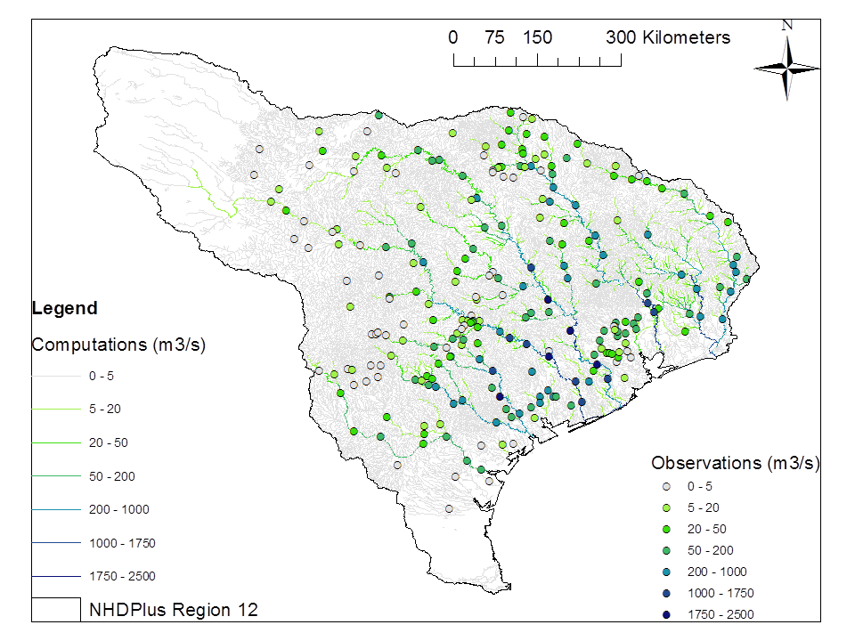
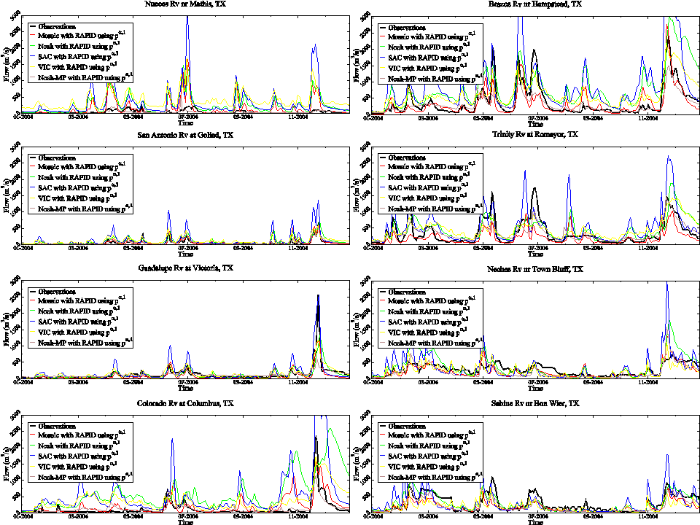
River flow simulations
See poster #9!!!

Slide 25
River modeling over the Mississippi basin
6/10
Ahmad A. Tavakoly (tavakoly@utexas.edu), Cédric H. David, Zong-Liang Yang and David R. Maidment

Slide 26
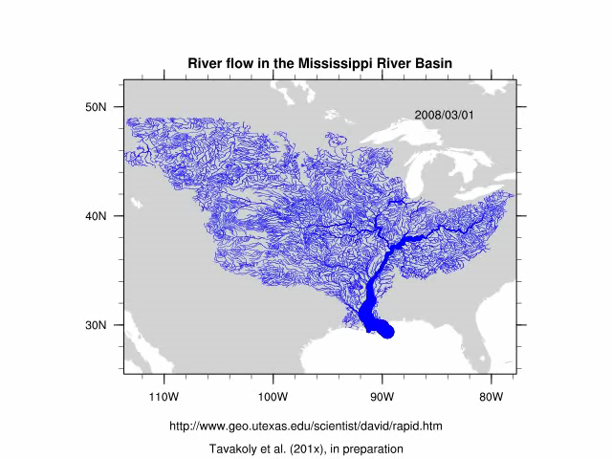
River modeling over the Mississippi River Basin

Slide 27
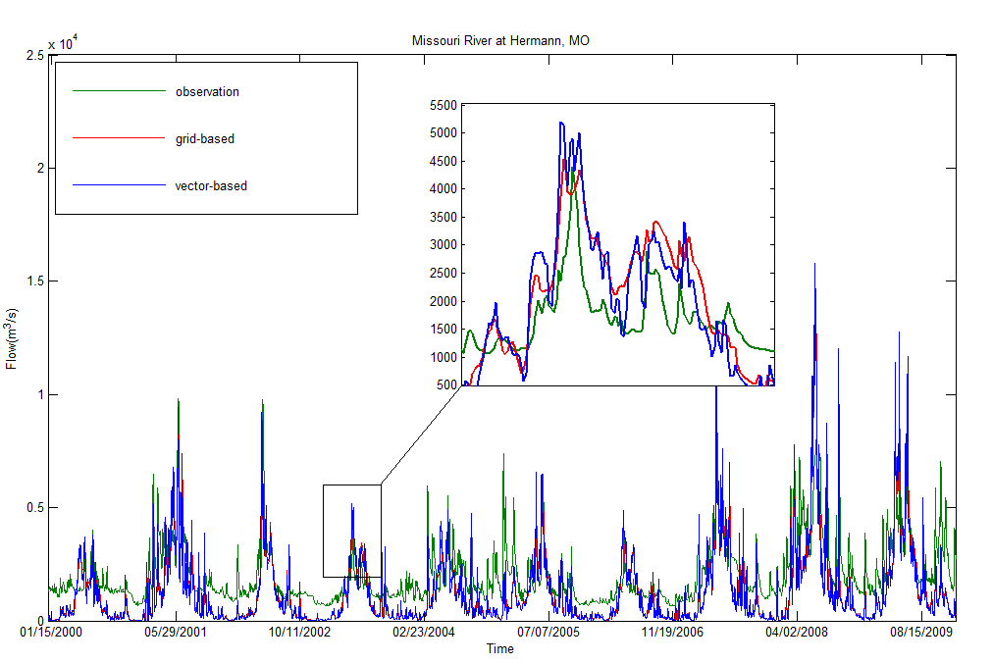
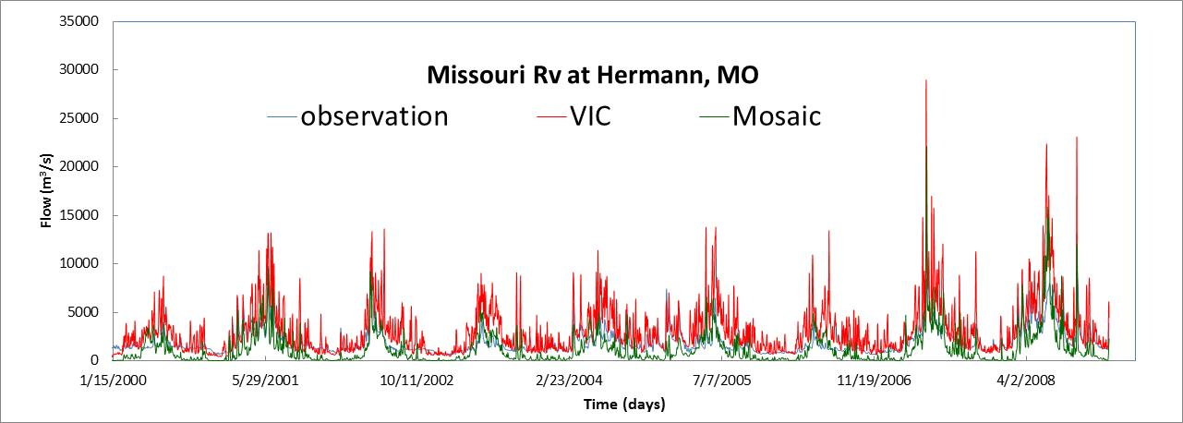
Compare two land surface models and two river networks
  The differences between the gridded and vector approach are small when watershed areas are comparable
Model results are underestimated using Mosaic LSM. The VIC runoff data give better results.
(a)
(b)
Comparison of observed and calculated hydrographs at Missouri River at Hermann, MO (a) using grid-based and vector-based river networks over ten years; (b) using VIC and Mosaic LSMs.

Slide 28
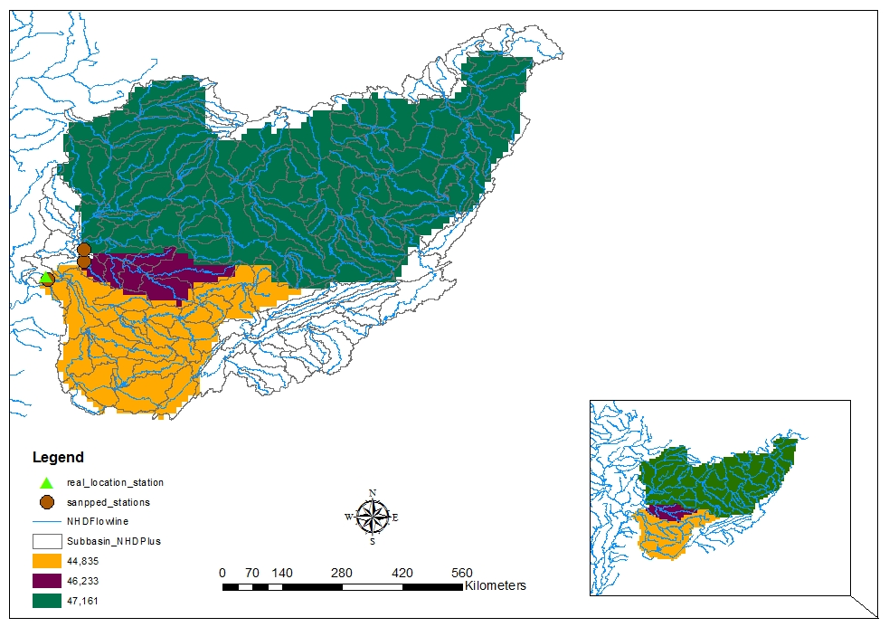
Compare Grid based and Vector based river networks
Drainage area is a key factor affecting the mean flow, particularly wetter climates.
The location of river gauges is more easily determined with vector river networks (no need for snapping), one can hence use as many gauges as possible.
Grid-based network Requires careful placement of gauges where flow accumulation is high (snapping)

Slide 29
Modeling Water Quality in San Antonio River Basin using Radar Rainfall Data
7/10
Almoutaz El Hassan (almoutaz@gmail.com) and Hongjie Xie

Slide 30
Observing and modeling riverine pollution
The current water quality monitoring frequency from the Texas Commission for Environmental Quality (TCEQ) is twice a year during low flow events in most observing stations
Soil and Water Assessment Tool (SWAT) was used to estimate the missing water quality data in San Antonio River basin for the period from 06/01/2008 to 12/31/2009.
The number of rain gauges in the San Antonio Basin is small compared to the basin area.
To benefit from distributed rainfall available from the Next Generation Radar (NEXRAD), the model was forced with this data using NEXRAD SWAT Tool.

Slide 31
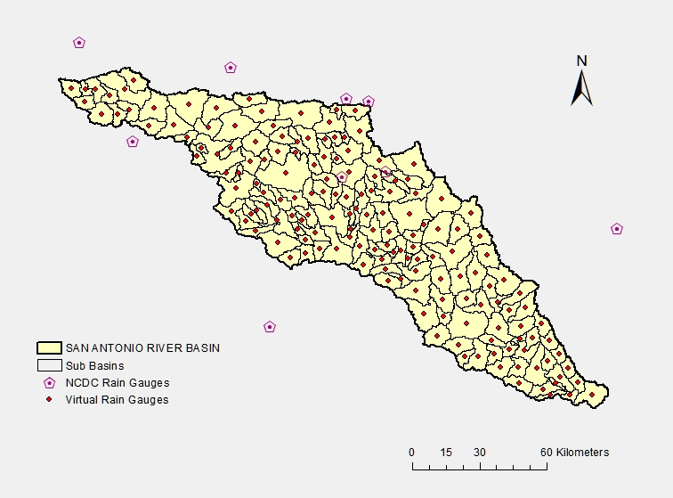
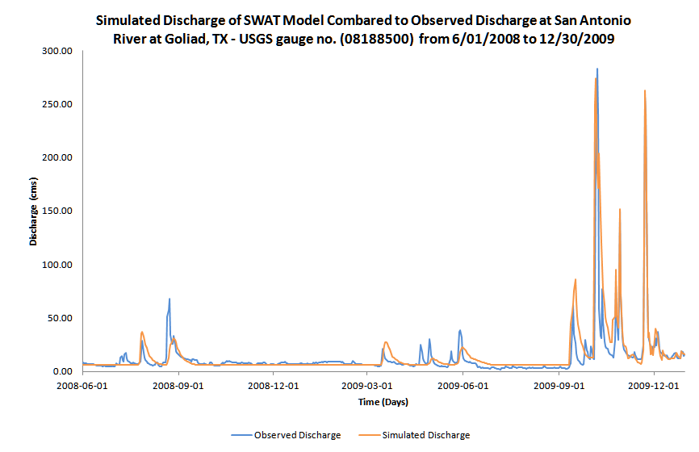
Calibration/validation of SWAT hydrology
Virtual NEXRAD rain gauges were created in the centers of 164 sub-basins and were added to the SWAT database.
Results after Sensitivity analysis and calibration
NSE = 0.84
SWAT can capture the hydrology of the San Antonio Basin

Slide 32
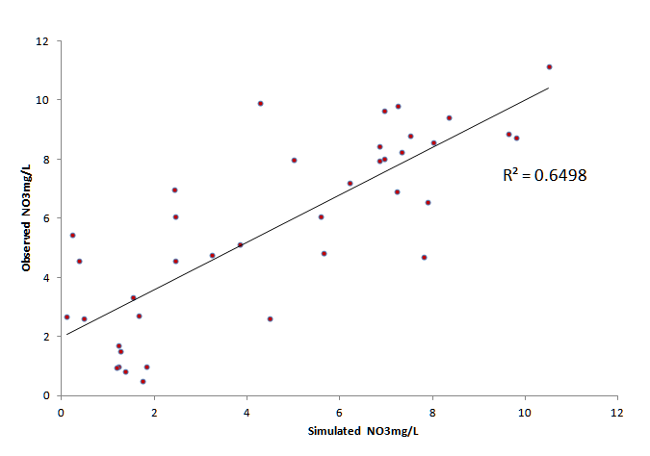
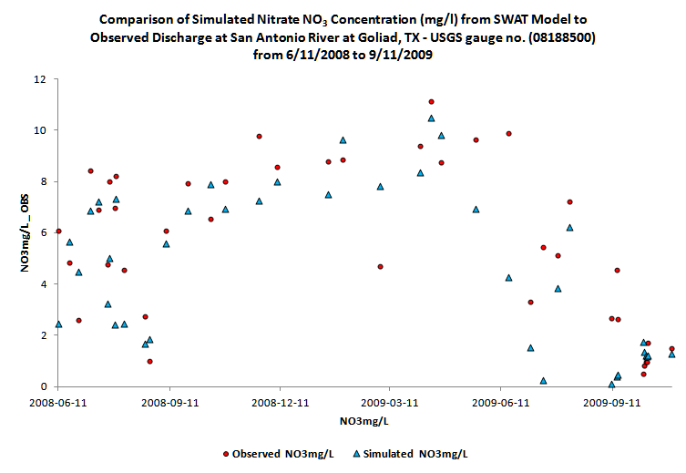
Water Quality with SWAT
Observed water quality (discrete in time) compared to simulated data.
Correlation (pair wise) for NO₃ (mg/L) was 0.8
Water quality can be estimated (up to 64% of variation) from SWAT modeling.

Slide 33
Nutrient sampling
8/10
Claire G. Griffin (claire.griffin@mail.utexas.edu) and James W. McClelland

Slide 34
Historical Data from Texas Commission of Environmental Quality
 | Nueces | Guadalupe | San Antonio | Colorado | Brazos | Trinity | Sabine
TOC | 47 | 0 | 148 | 125 | 0 | 75 | 200
Kjeldahl N | 14 | 32 | 135 | 148 | 90 | 103 | 63
NO3 | 55 | 62 | 169 | 149 | 98 | 38 | 264
NH4 | 55 | 63 | 219 | 144 | 101 | 167 | 142
Ortho-PO4 | 0 | 19 | 66 | 152 | 99 | 104 | 102
Organic Nitrogen | 0 | 0 | 0 | 32 | 0 | 0 | 0
Organic Nitrogen* (Calc) | 14 | 31 | 133 | 142 | 89 | 102 | 45
Dates | 1998 - 2011 | 1990-2011 | 1990-2011 | 1990 - 2011 | 1990-2010 | 1990-2010 | 1990-2011
*Organic nitrogen calculated by Kjeldahl N minus NH4
Significant amounts of baseflow historical data available
Notes:
While historical data is available for rivers routinely sampled and others along a east-west/wet-dry gradient, the data does not include high flow events.
This data is being used for LOADEST runs to estimate fluxes of nitrate, ammonium, phosphate, organic nitrogen and organic carbon.

Slide 35
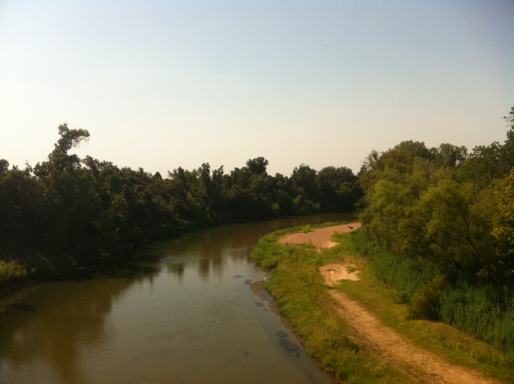
High nutrient concentration at high flow
Concentrations of constituents change dramatically with flow
  DOC and DON flux often dominate flood events
  Inorganic nutrients often diluted
Colorado River Drought
Field sampling must target high-flow events
Colorado River Flood

Slide 36
Field sampling along a climate gradient
Routine and targeted event sampling of four rivers
  From east to west: Colorado, Guadalupe, San Antonio, Nueces
  Captures a wide range of climates and watershed characteristics
Nueces River
Characterizing river fluxes along a climate gradient
San Antonio River

Slide 37
Simulating Nutrient Cycles in Estuary Waters
9/10
Evan L. Turner (evanlee.turner@gmail.com) and Paul A. Montagna

Slide 38
Box model of San Antonio Bay
San Antonio
Guadalupe
Gulf
Inlet
Box
Kim (2009)

Slide 39

Simulating Nutrient Cycles in Estuary Waters
The Turner Nutrient Producer Consumer (NPC) Model
  Combines simple NPZ relationship with competition from benthic producers
Translates a pelagic model system to estuary dynamics

Slide 40
Simulating Nutrient Cycles in Estuary Waters with Multiple Models
Use multiple models in an ensemble approach
  Models use Nutrient-Phytoplankton- Zooplankton approach (NPZ)
  Varying complexities and input requirements
Model | NO2+NO3 | NH3 | DIN (NO2 + NO3 + NH3) | DON
Steele and Henderson (1992) |  |  | X
Fasham (1990) | X | X |  | X
Franks (2002) |  |  | X
Kim (2009) | X | X |  | X
Turner (2012) |  |  | X
Legend
Table: Nutrient input parameters by model
Premise that multiple model designs will be superior

Slide 41

Multi-model primary production response to nutrient load
Couples river nutrient flux data with primary production in Bay waters
  Current focus Copano Bay, Texas and San Antonio Bay, Texas
Response of primary production to nutrient load
Developing generic methods to model estuary production

Slide 42
Ocean & bay Color from Satellites
10/10
Eric Kouba (nty143@utsa.edu) and Hongjie Xie

Slide 43





Ocean Chlorophyll Measured from Satellites
Phytoplankton is green
  Measure ocean color to estimate chlorophyll, as proxy for phytoplankton
  First satellite in 1978
  Global daily access since 1997
  But: coverage limited by clouds, sun glint, etc
Combine with surface data to regain some Texas coverage
Chlorophyll mg/m³
43
43

Slide 44

Challenges in Getting Bay Chlorophyll from Satellites
Extract from NASA Goddard
global dataset processed
into 4.6 km resolution pixels
Native resolution for
Ocean Color sensors
range from ~250 m to ~1 km
Chlorophyll estimates difficult for bays and coastal areas
  Standard algorithms intended for open ocean
  Texas in situ data exists for spot locations
  But: satellites cover broad areas with low resolution
Chlorophyll mg/m³
Find acceptable algorithm for Texas bays and coastal areas
44

Slide 45
Potential for Multivariate Relationships
Phytoplankton affected by sunlight, nutrients, temperature, currents, etc
  Each of these factors can be measured or modeled, independent of clouds
  Use full-sun data to search for multivariate relationships between these factors and resulting bay/coastal chlorophyll concentrations
Use multivariate relationship to estimate chlorophyll concentrations in cloudy areas
45

Slide 46
Summary and conclusions
Integration!
  Our tools are designed to be connected to (coupled with) climate models, and among each other
Strengths
  State-of-the-art atmospheric and land surface models for climate science
  Local nutrient budget
  River network model using blue lines from the map
  Targeted river sampling events
  Multi-model approach to bays
What’s next?
  Adding nutrients to Noah-MP
  Adding nutrient transport to RAPID
  Connecting the dots
Developed for Texas Gulf, applicable to the entire Gulf of Mexico, or larger domains

Slide 47

Thank you!
Questions?
Project PI: Zong-Liang Yang (liang@jsg.utexas.edu)
47
Notes:
47

