Slide 1
Why an special session
at the occasion of the
NASA 2012 OCRT meeting?
Introduction and
Overall Goals of the Special Session
David Antoine
Chair, IOCCG

Slide 2
Overall goals:
To inform the community about IOCCG and its current activities (what, why, who ??)
To propose an International Ocean Color Science Team Meeting, starting in 2013 (to get feedback from the audience on the need and organization of such a meeting)
Note: a similar session will be organized in October 2012, at the occasion of the 3rd MERIS/(A)ATSR & OLCI/SLSTR Preparatory Workshop

Slide 3
What’s IOCCG?
The International Ocean-Colour Coordinating Group (IOCCG) was established in 1996 following a resolution endorsed by the Committee on Earth Observation Satellites (CEOS). The group is made up of an international Committee of experts comprising representatives from both the provider (Space Agencies) and user communities (scientists, managers). The objectives of the IOCCG are to develop consensus and synthesis at the world scale in the subject area of satellite ocean colour radiometry (OCR). Specialised scientific working groups are established to investigate various aspects of ocean-colour technology and its applications, and their findings are published in the highly-acclaimed IOCCG Report Series. Continuity of ocean colour radiance datasets is addressed through the CEOS OCR-Virtual Constellation. The IOCCG also has a strong interest in capacity building, and conducts and sponsors advanced training courses on applications of ocean-colour data in various countries around the world.
The IOCCG is an Affiliated Programme of the Scientific Committee on Oceanic Research (SCOR), and an Associate Member of CEOS. The activities of the IOCCG are supported by financial contributions from a number of national Space Agencies and other organisations, and upon infrastructure support from SCOR and the Bedford Institute of Oceanography (Department of Fisheries and Oceans, Canada), which hosts the IOCCG Project Office.

Slide 4
Objectives of IOCCG
To foster expertise in using ocean-colour data (training)
Broaden the user community for ocean color data, particularly in developing countries, through training courses, workshops and international symposia.
To provide a common voice for the user community
Develop a consensus among users on key issues related to satellite-ocean-colour science and technology, and communicate the collective view to the appropriate international bodies and space agencies.
To advocate the importance of ocean-colour data to the global community
Promote the importance of ocean colour data to the global community.
Optimize quality of data for calibration and validation
Encourage the formation of an international calibration and validation network for ocean colour and ensure that sea-truth measurements conform to accepted international protocols.
Advocate the collection of essential ocean and atmosphere data.
Identify key variables relevant to the application of ocean-colour data and promote data-collecting strategies to fill existing gaps in time and space.
Facilitate merging and access to ocean-colour data
Encourage agencies to agree on common data products and algorithms and conform to common formats for accessing and exchanging data.

Slide 5
Terms of reference of IOCCG
To serve as a communication and coordination channel between data providers and the global, user community of satellite-ocean-colour data, and so to maximize the benefits that accumulate from international investments in ocean-colour science and technology.
To construct a partnership, at the international level, between the space agencies and the users of satellite-ocean-colour data to develop and coordinate data utilization.
To work closely with the appropriate international bodies (including CEOS, IOC and SCOR), international scientific programs (such as IGBP and GOOS), satellite-ocean-colour-mission offices and other agencies (such as environmental and fishing agencies) to harmonize the international effort and advance ocean-colour science and its applications.
To develop a collective voice for the community of users of ocean-colour data and to articulate this voice to the appropriate international bodies, international scientific programs and space agencies.
To promote the long-term continuity of satellite ocean-colour data sets; the development of operational, ocean-colour data services and new generations of ocean-colour sensors; and the integration of data from complementary ocean sensors.

Slide 6
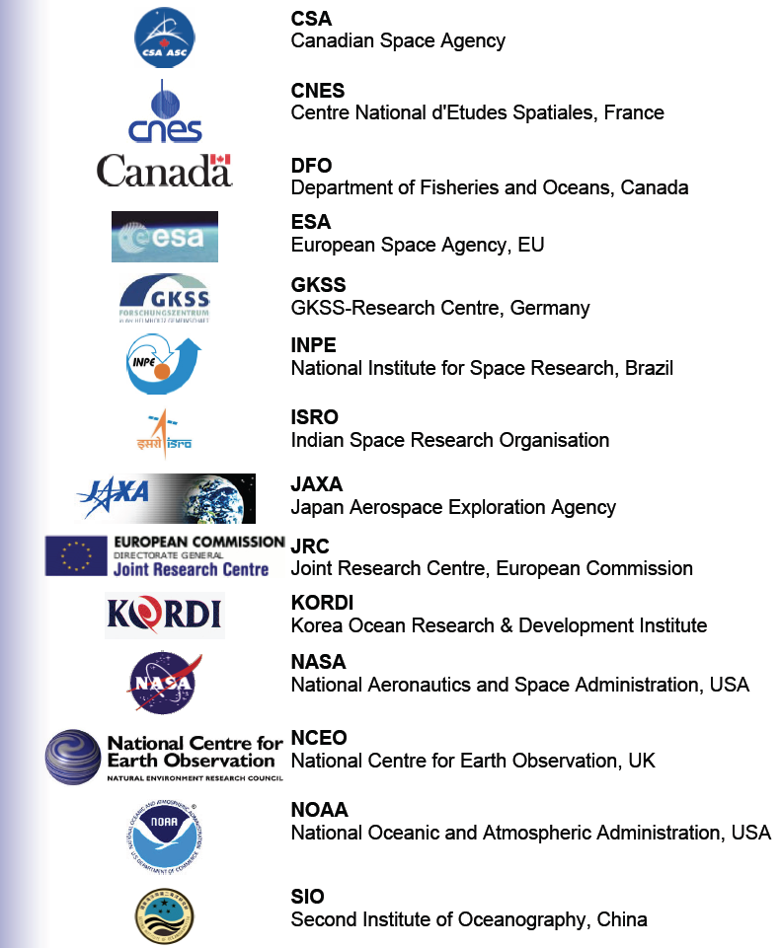
IOCCG sponsors

Slide 7
Members of IOCCG
Representatives from space agencies and scientific members (about 50/50). Executive committee is formed by contributing agencies, Chair and past Chair, and executive scientist (Venetia Stuart)
3-year terms, renewable once (on proposal of the executive committee)
Currently 25 members
Past scientific members: 40 international scientists since the creation of IOCCG
Chairmanship:
- Trevor Platt (1996-2006)
- Jim Yoder (2007-2009)
- David Antoine (2010-…)
Executive scientist: Venetia Stuart (since the beginning of IOCCG)

Slide 8
IOCCG Committee Members (2012)
Ahn, Yu-Hwan - Korea Ocean Research and Development Institute, Korea
Antoine, David (Chairman) - Laboratoire de Physique et Chimie Marines, France
Bernard, Stewart - Council for Scientific and Industrial Research, South Africa
Bonekamp, Hans - EUMETSAT, EU
Bontempi, Paula - NASA HQ, USA
Chauhan, Prakash - ISRO, India
Crevier, Yves - Canadian Space Agency, Canada
DiGiacomo, Paul - NOAA NESDIS, USA
Doerffer, Roland - GKSS, Germany
Dowell, Mark - JRC, Italy
Dutkiewicz, Stephanie - MIT, USA
*Feldman, Gene - NASA HQ, USA
Greb, Steven - Wisconsin Department of Natural Resources, USA
*Hardman-Mountford, Nick - CSIRO, Australia
Ishizaka, Joji - Nagoya University, Japan
Kampel, Milton - INPE, Brazil
Lambin, Juliette - CNES, France
Mao, Zhihua - Second Institute of Oceanography, China
Murakami, Hiroshi - JAXA EORC, Japan
Pozdnyakov, Dmitry - NIERSC, Russia
Regner, Peter - ESA/ESRIN, Italy
Sathyendranath, Shubha - NCEO, UK, and Plymouth Marine Laboratory
Tanaka, Tasuku - Yamaguchi University, Japan
Yoder, James (Past-Chair) - Woods Hole Oceanographic Institution, USA
*Zibordi, Giuseppe - JRC. EU

Slide 9
IOCCG working groups
Past (report has been published)
Minimum Requirements for an Operational Ocean-Colour Sensor (Chaired by A. Morel).
Status and Plans for Satellite Ocean-Colour Missions: Considerations for Complementary Missions (J. Yoder)
Ocean-Colour in Case 2 Waters (S.Sathyendranath).
Standardizing the Extraterrestrial Solar Flux Spectrum (A. Morel and J. Mueller)
Ocean-Colour Data Binning (D. Antoine)
Ocean-Colour Algorithms (Z.-P. Lee)
Coordination of Merged Data Sets (W. Gregg and P. Bontempi)
Why Ocean Colour? The Societal Benefits of Ocean- Colour Technology (C. Brown, T. Platt and N. Hoepffner)
Remote Sensing in Fisheries and Aquaculture (M.-H. Forget, V. Stuart, T. Platt)
Partition of the Ocean into Ecological Provinces: Role of Ocean-Colour Radiometry (M. Dowell and T. Platt)
Atmospheric Correction for Remotely-Sensed Ocean-Colour Products (M. Wang)
Past (report under press)
Bio-Optical Sensors on Argo Floats (H. Claustre)
Ocean color observations from the geostationary orbit (D. Antoine)
Current
Calibration of Ocean-Colour Sensors (R. Frouin)
Phytoplankton Functional Types (S. Sathyendranath)
Mission Requirements for Ocean Colour Remote Sensing (C. McClain, G. Meister, P. Bontempi)
Harmful Algal Blooms (S. Bernard)
Polar Seas Ocean Colour Remote Sensing (M. Babin)
Intercomparison of retrieval algorithms in coastal waters (K. Ruddick)

Slide 12
Training / capacity building
A number of summer schools, in particular for developing countries (ocean color fundamentals, training to using ocean color satellite data, to deploying instrumentation etc...)
This is a recurrent and ongoing activity, complemented from 2012 by a summer lecture series (more fundamental aspects)

Slide 13
IOCCG special session: towards an international ocean color science team meeting
9:00-9:10 Introduction and Overall Goals of the Special Session – D. Antoine/LOV
9:10-9:30 The development of IOCCG since its inception, and the role it currently has in the
international ocean color community – J. Yoder/WHOI
9:30-9:50 Current IOCCG activities related to global ocean color CDRs, and rationale for an
International Ocean Color Science Team Meeting – D. Antoine/LOV
9:50-10:10 IOCCG standing working group on ocean color CDRs evaluation – J. Yoder/WHOI
10:10-10:30 Current status of the CEOS/IOCCG INSITU-OCR initiative – S. Bailey/NASA GSFC
10:30-10:50 BREAK
10:50-11:10 An example of international science community building: the GHRSST project –
P. Minnett/University of Miami
11:10-11:30 Lessons learned from SIMBIOS, in particular in terms of international coordination –
B. Franz/NASA GSFC
11:30-12:00 Discussion session, in particular about: what would you expect from an annual IOCST meeting? What type of organization/content would be appropriate? What sort of outputs would be useful? Which balance between talks, working sessions, posters would be appropriate – All

