Slide 1
Update on the Ocean Color MEaSUREs Project Current and future evaluation products S. Maritorena¹, J. Frew², N.B. Nelson¹, D.A. Siegel^{1,3}, M. Behrenfeld⁴ and the OBPG at GSFC
1. Institute for Computational Earth System Science, University of California at Santa Barbara
2. Bren School of Environmental Science & Management, University of California at Santa Barbara
3. Department of Geography, University of California at Santa Barbara
4. Department of Botany and Plant Pathology, Oregon State University, Corvallis, Oregon

Slide 2
Ocean Color MEaSUREs (Making Earth Science Data Records for Use in Research Environments) NASA Earth Science Data Systems
Emphasis in MEaSUREs
link together multiple satellites
develop the means of utilizing multiple data sources to form coherent time series
facilitating the use of extensive data in the development of comprehensive Earth system models.
ROSES-2006: proposals were solicited to focus on the creation of Earth System Data Records (ESDRs), including Climate Data Records (CDRs).
ESDR: a unified and coherent set of observations of a given parameter of the Earth system, which is optimized to meet specific requirements in addressing science questions.
CDR: a time series of measurements of sufficient length, consistency, and continuity to determine climate variability and change
CDRs and ESDRs are critical to understanding Earth System processes, to assessing variability, long-term trends, and change in the Earth System, and to provide input and validation means to modeling efforts.
~30 MEaSUREs projects (Land, Atmosphere, Ocean) focus on product generation, availability, and utility.
OCRT Meeting – 11-13 May, 2010 - New Orleans
Notes:
Multiple satellites into a constellation. Ocean Color (UCSB) and PAR (R. Frouin)

Slide 3
Ocean Color MEaSUREs
The ICESS/UCSB Ocean Color MEaSUREs Project:
Create and distribute, for evaluation, a variety of established and new OC products which are candidates to become ESDR’s
Implement and distribute quality indices for these products
Determine the suite of products that can be considered OC-ESDR’s in consultation with the data users in the ocean color community
Web and data access: ftp, OPeNDAP, Web-based,…
Ultimately, data production and distribution are taken over by a NASA data center (OBPG/GSFC)

Slide 4
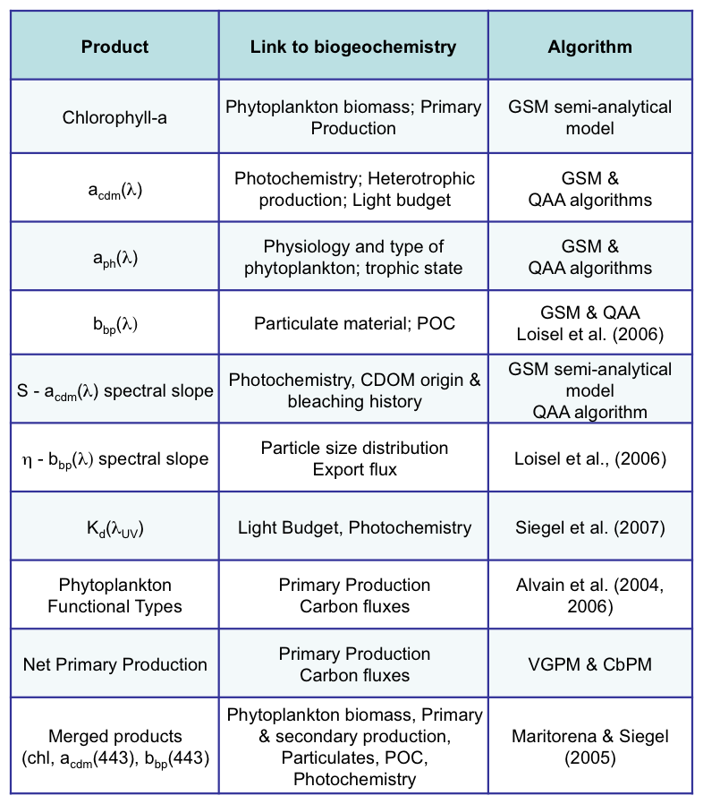
The Ocean Color MEASURES Project
Original list of products proposed for evaluation
Other products: PSD,…

Slide 5
Ocean Color MEaSUREs
Original calendar of provisional ESDR products availability
Availability | Products
End of 1st Year (June 2009) | GSM01 products: CHL, CDM, BBP SeaWiFS, AQUA (and MERIS) MERGED CHL, CDM, BBP SeaWiFS-AQUA and SeaWiFS-AQUA-MERIS NPP: VGPM and CbPM
End of 2nd Year (June 2010) | QAA spectral IOPs GSM spectral IOPs Kd(UV) (+ Kd(Vis.)) 2nd generation CbPM (spectrally resolved)
End of 3rd Year (June 2011) | PFT (several) Spectral IOPs characteristics (η, S) 3rd generation NPP
Notes:
Validation products at the same time as the products- Other products like PSD.

Slide 6
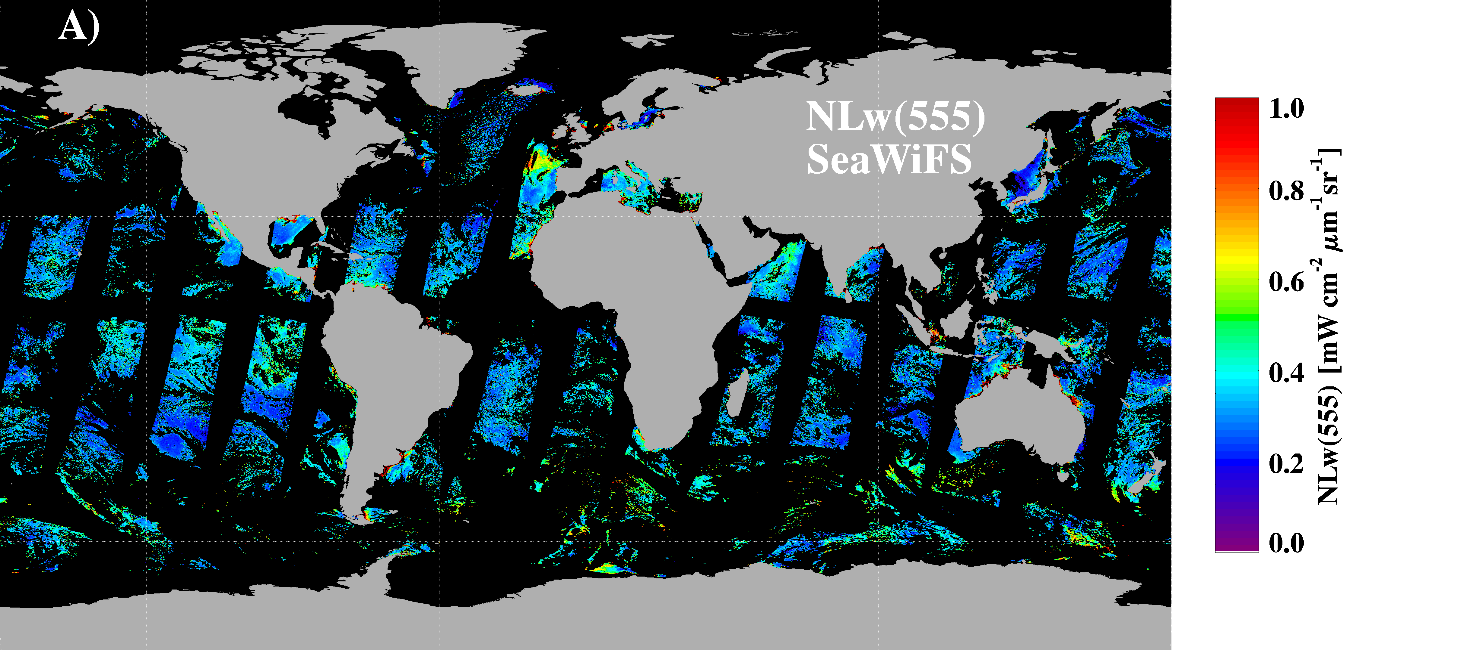
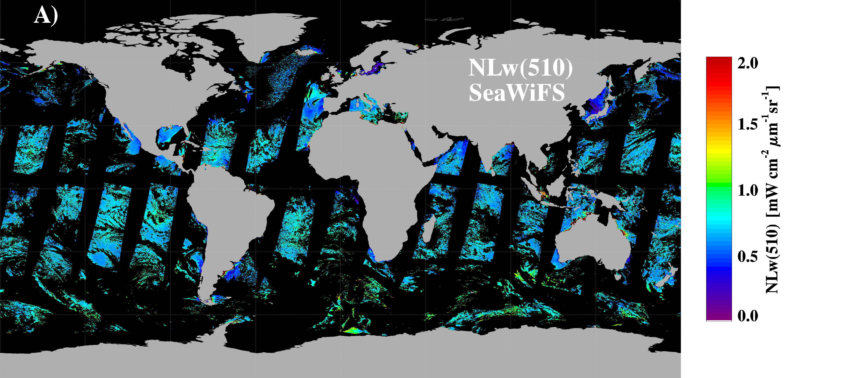
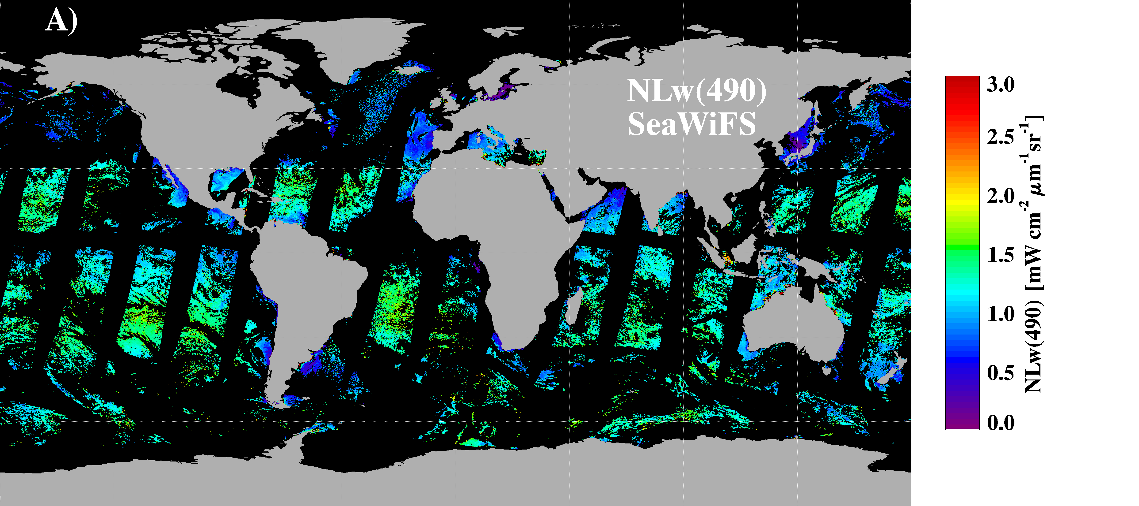
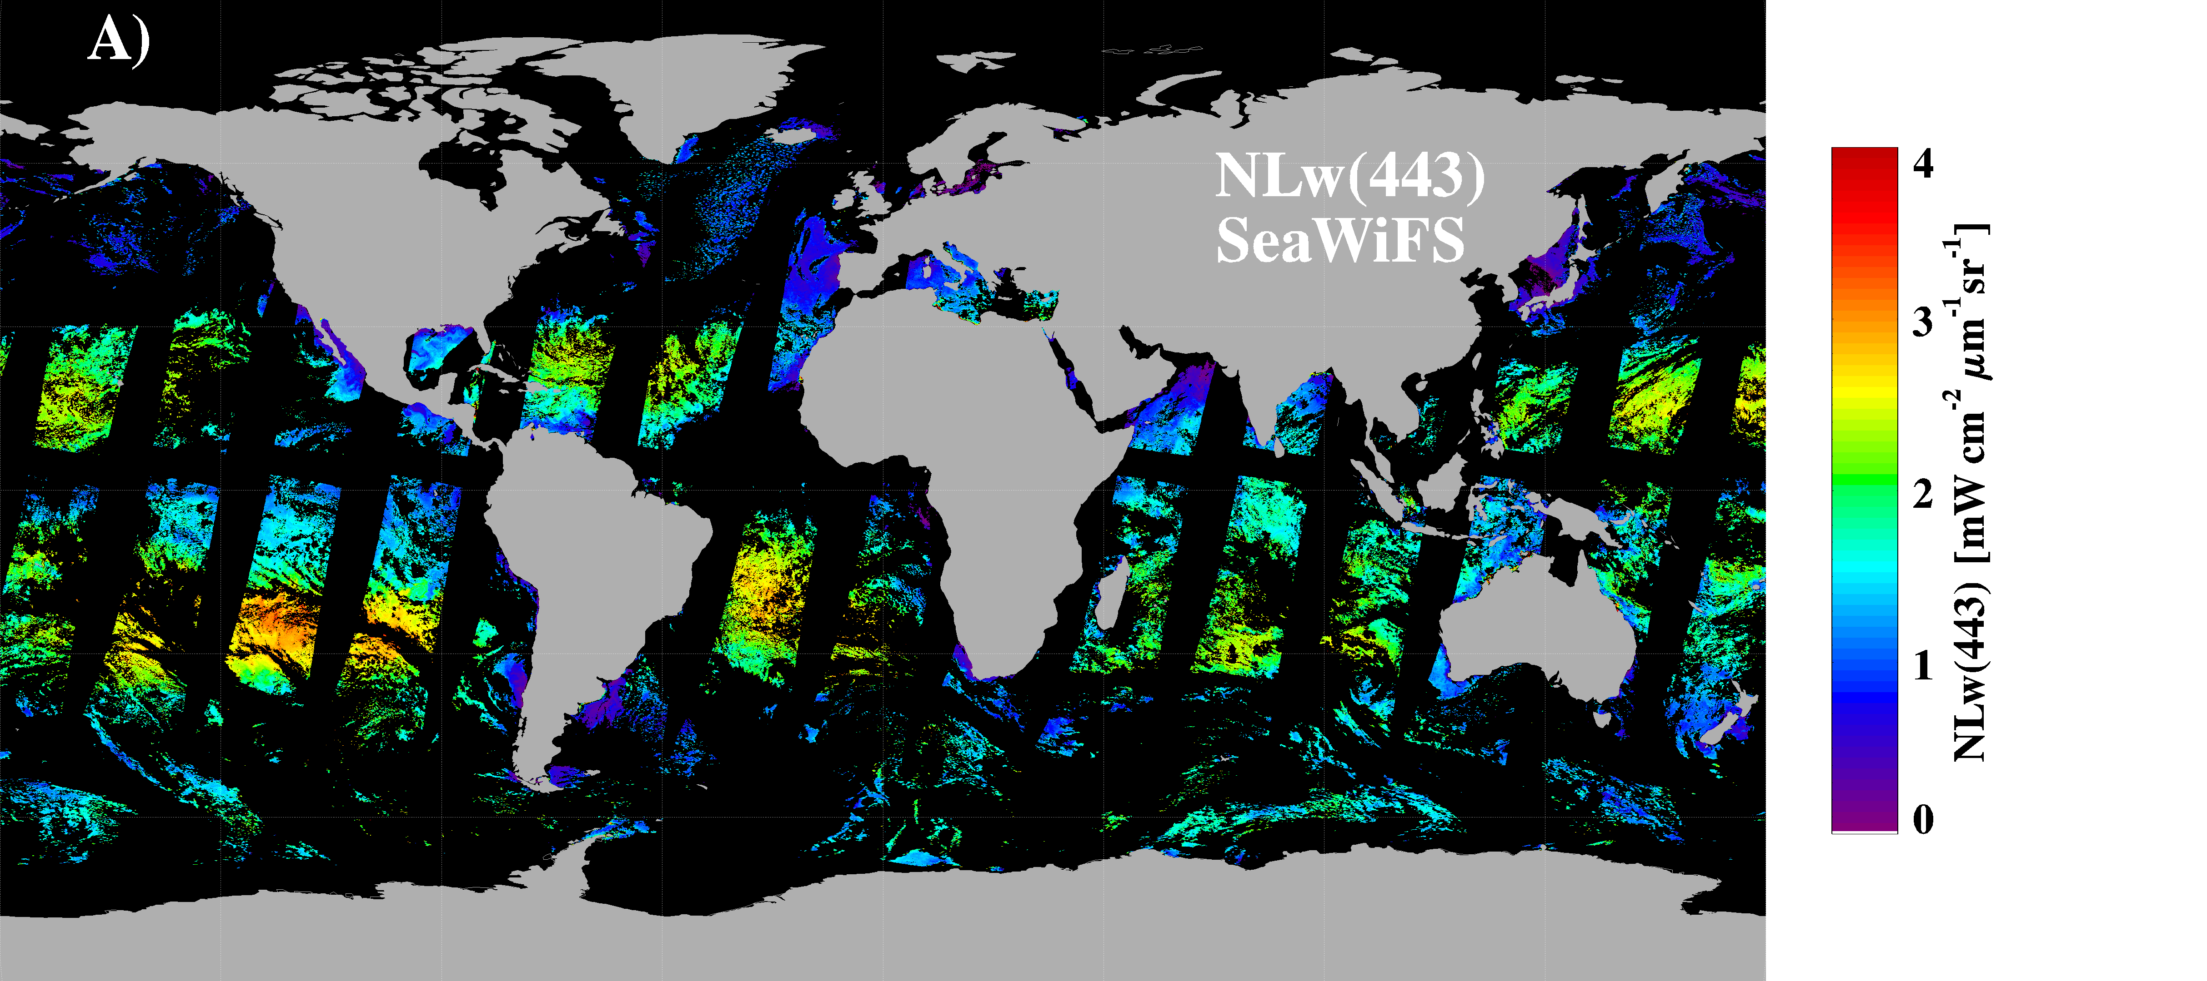
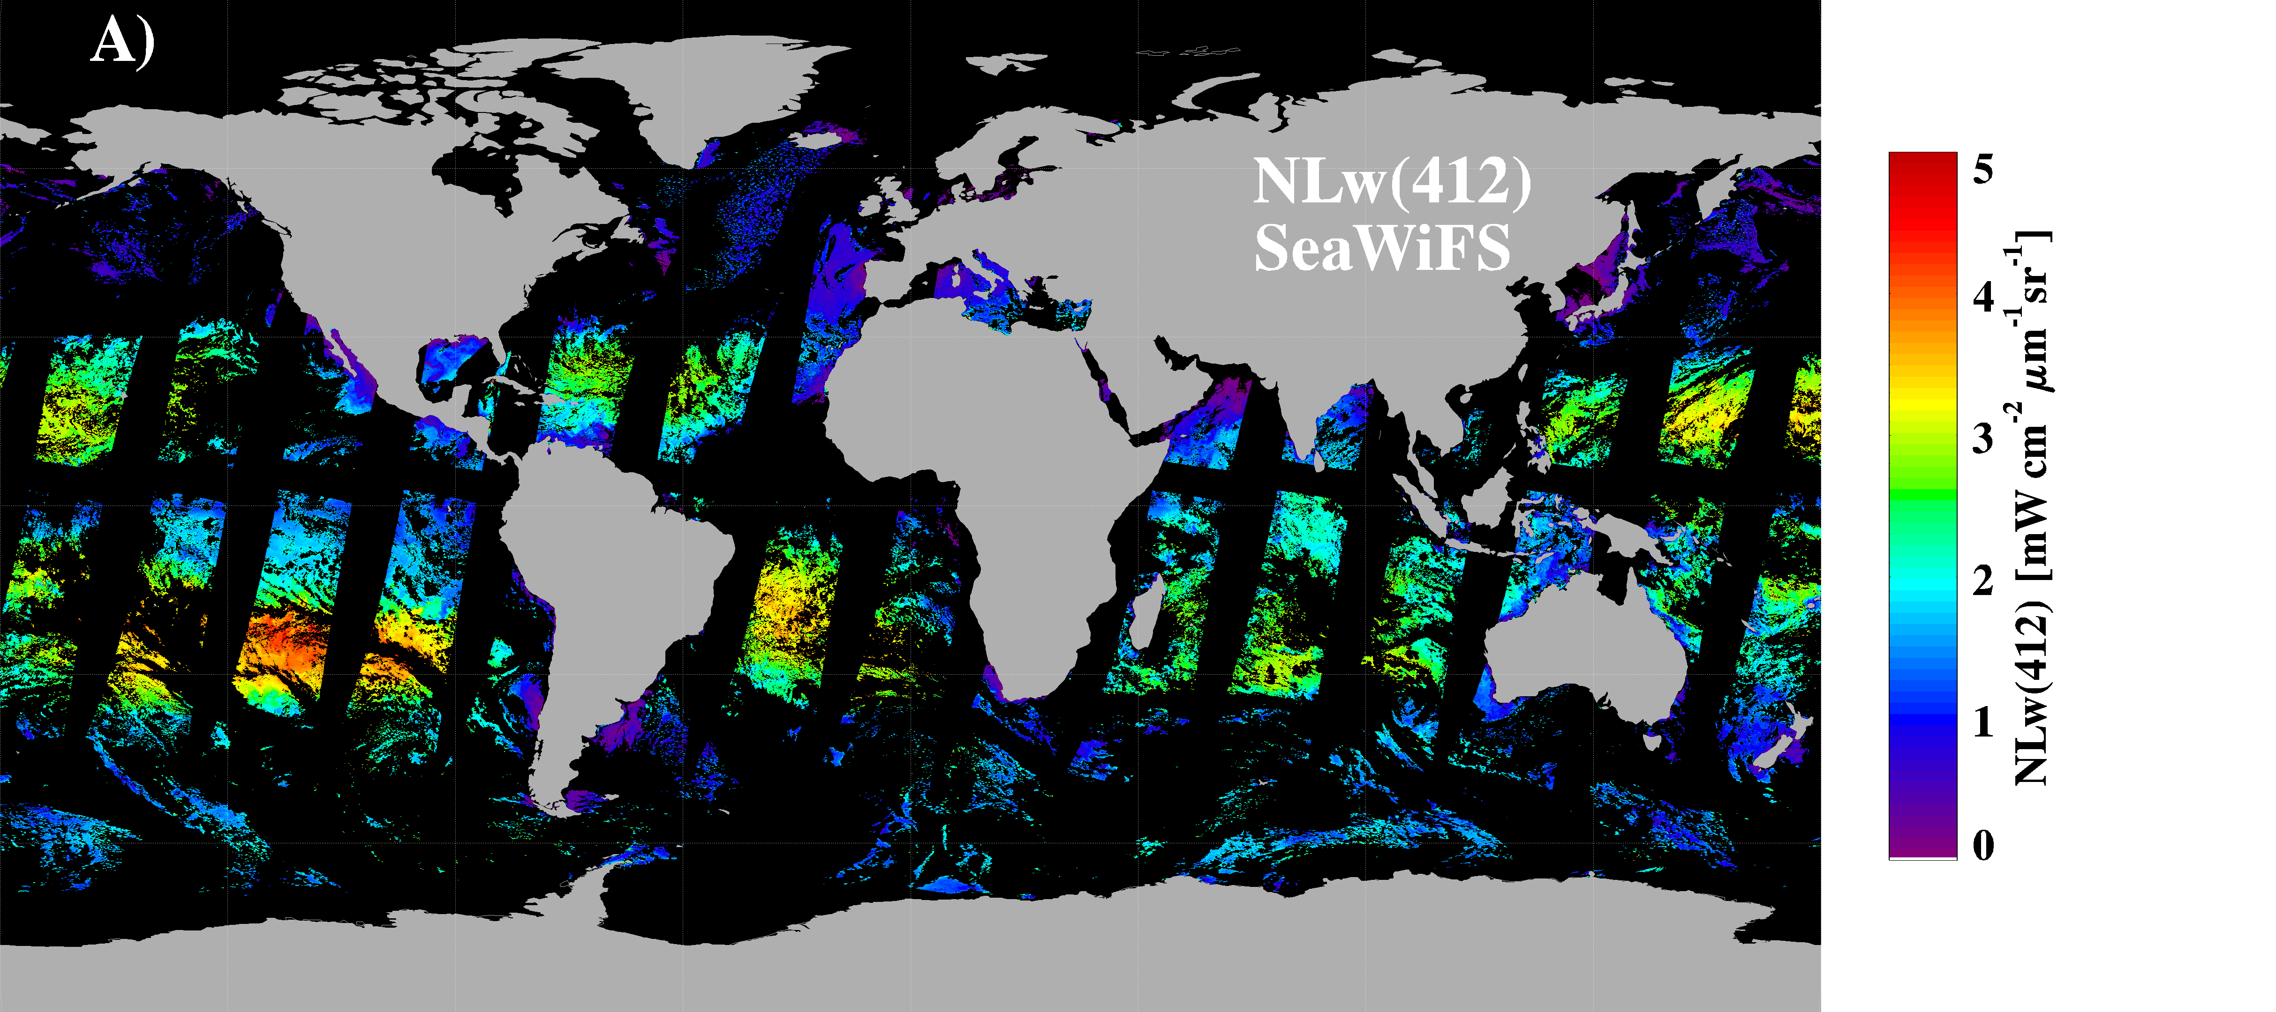
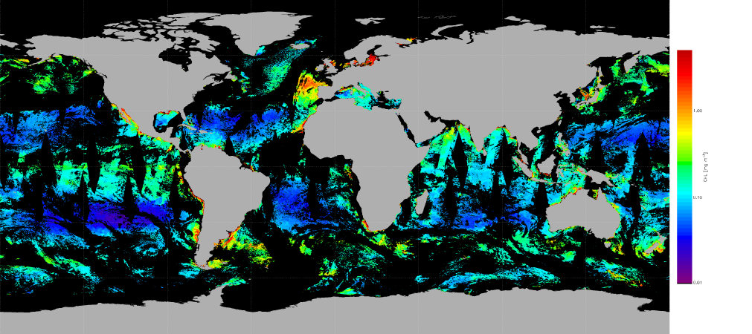
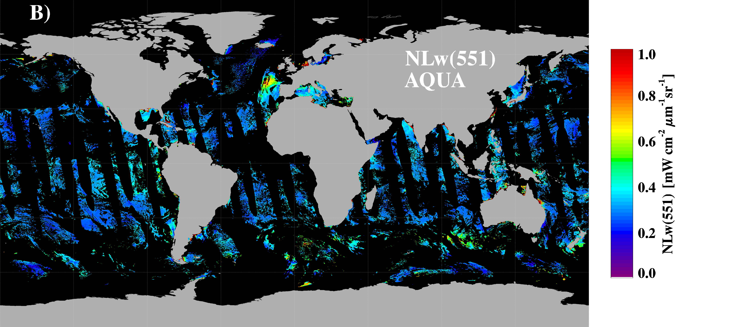
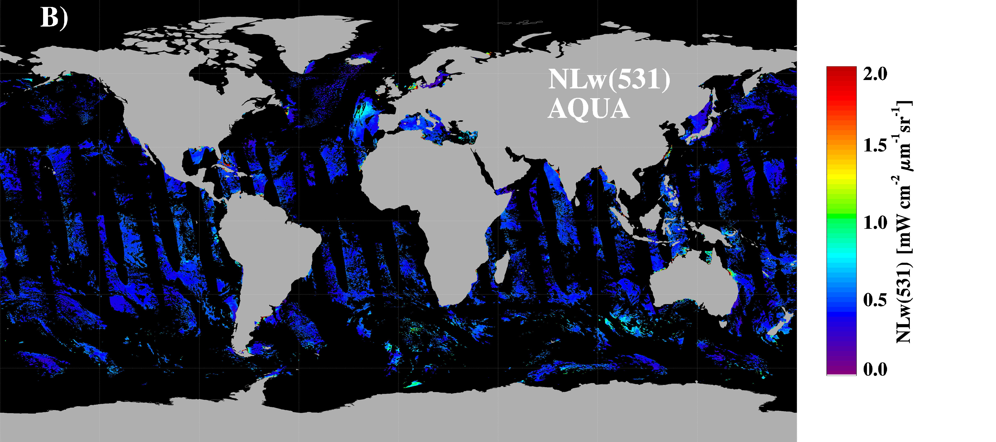
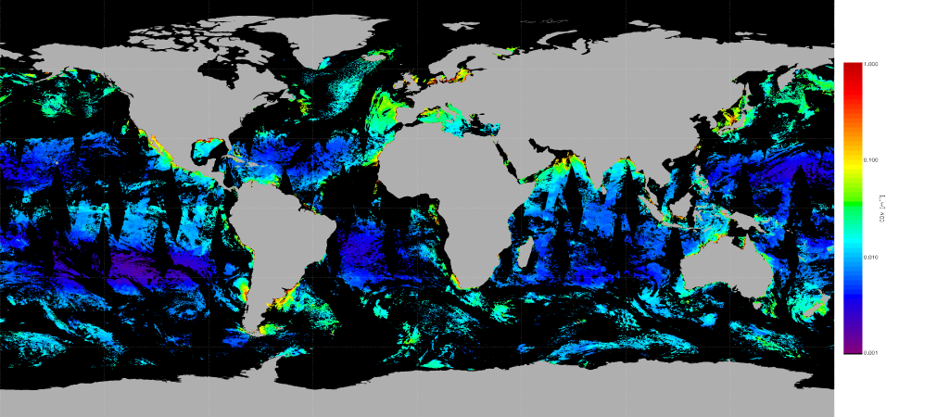
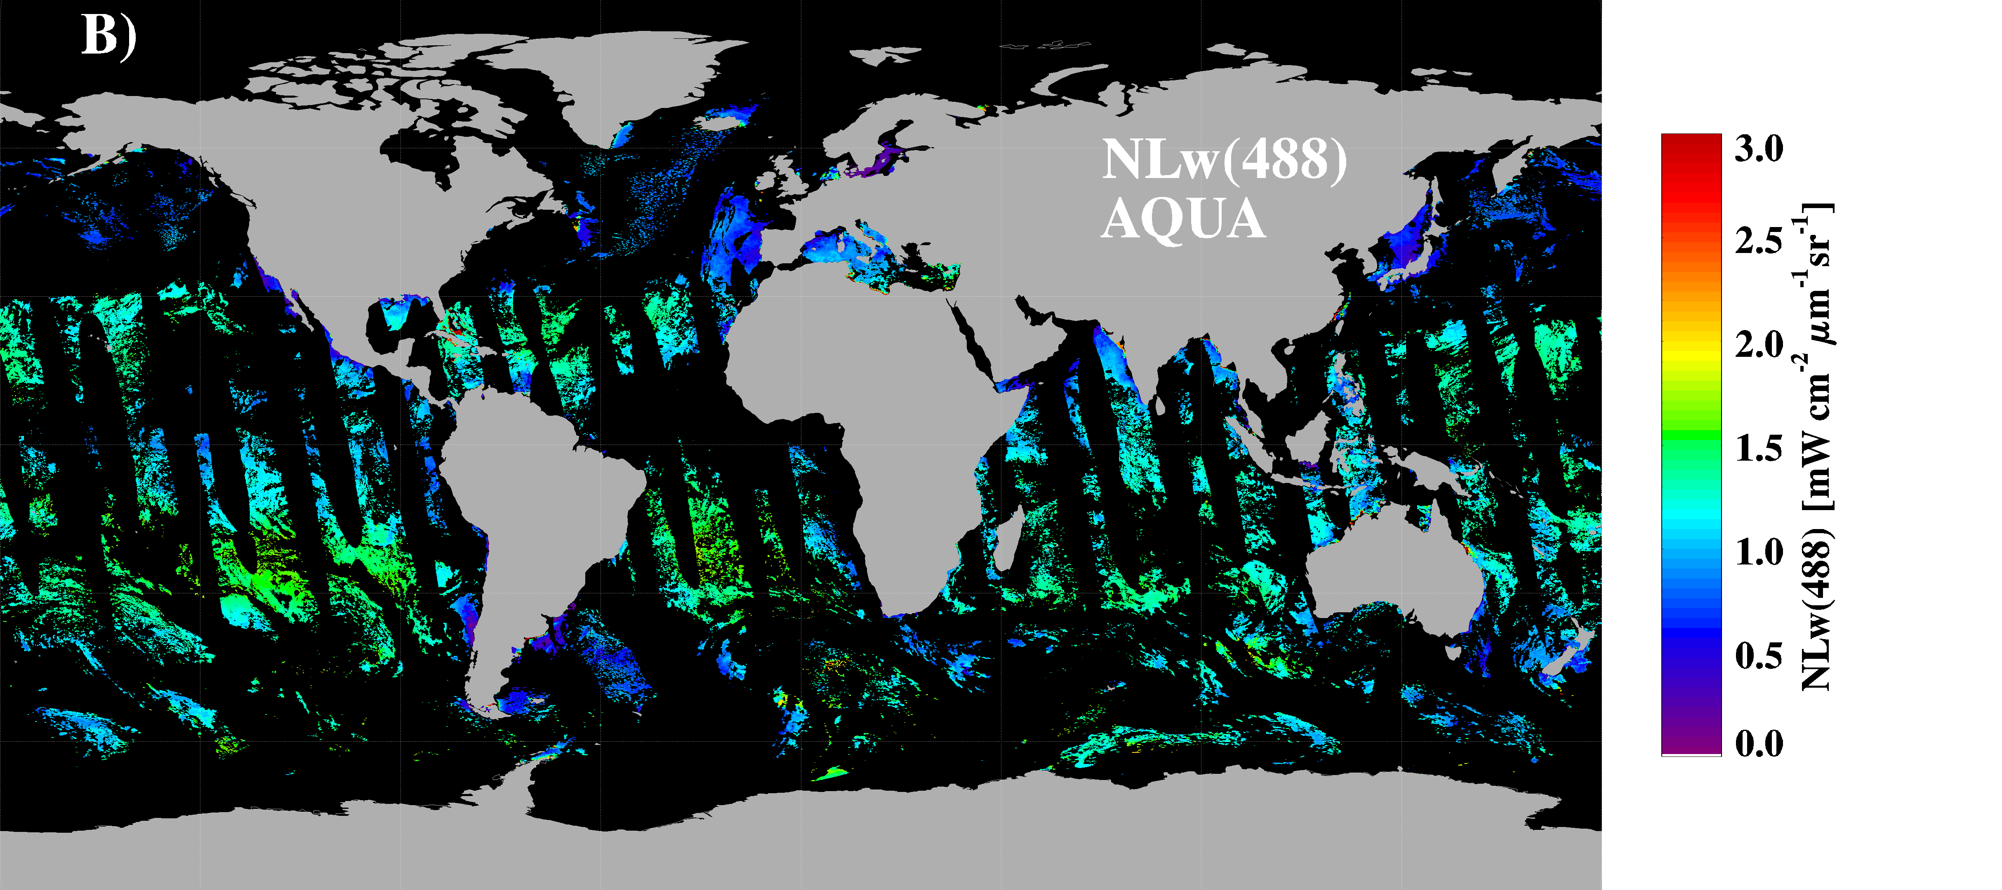
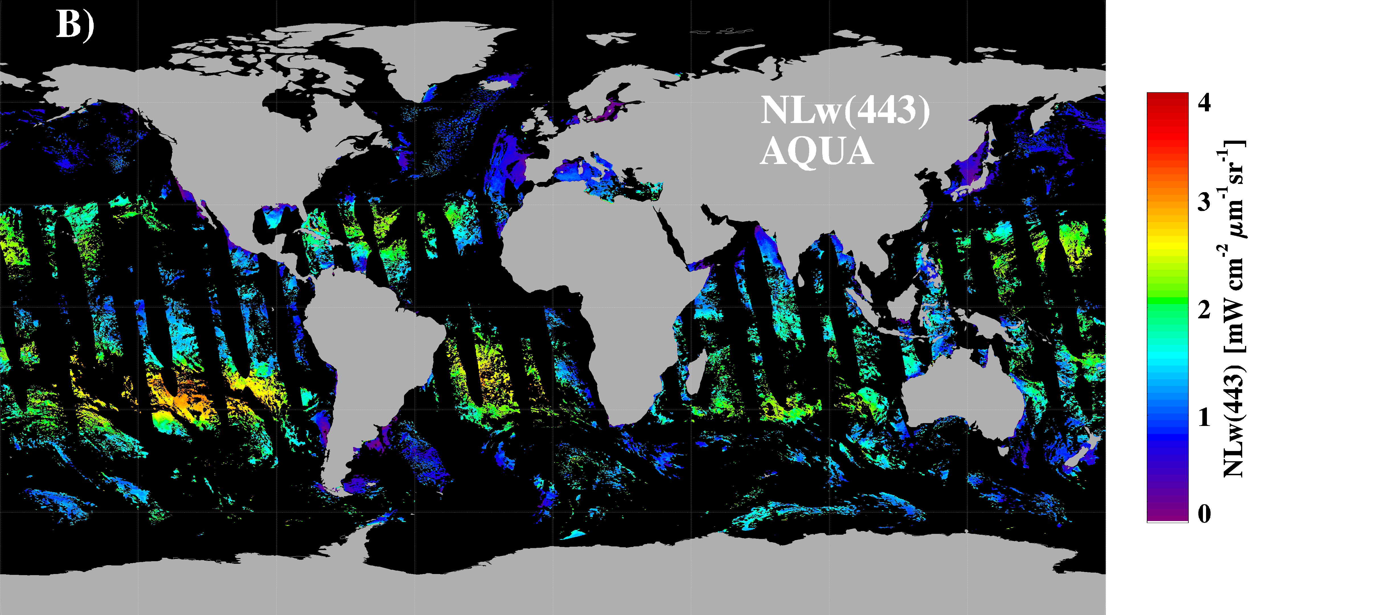
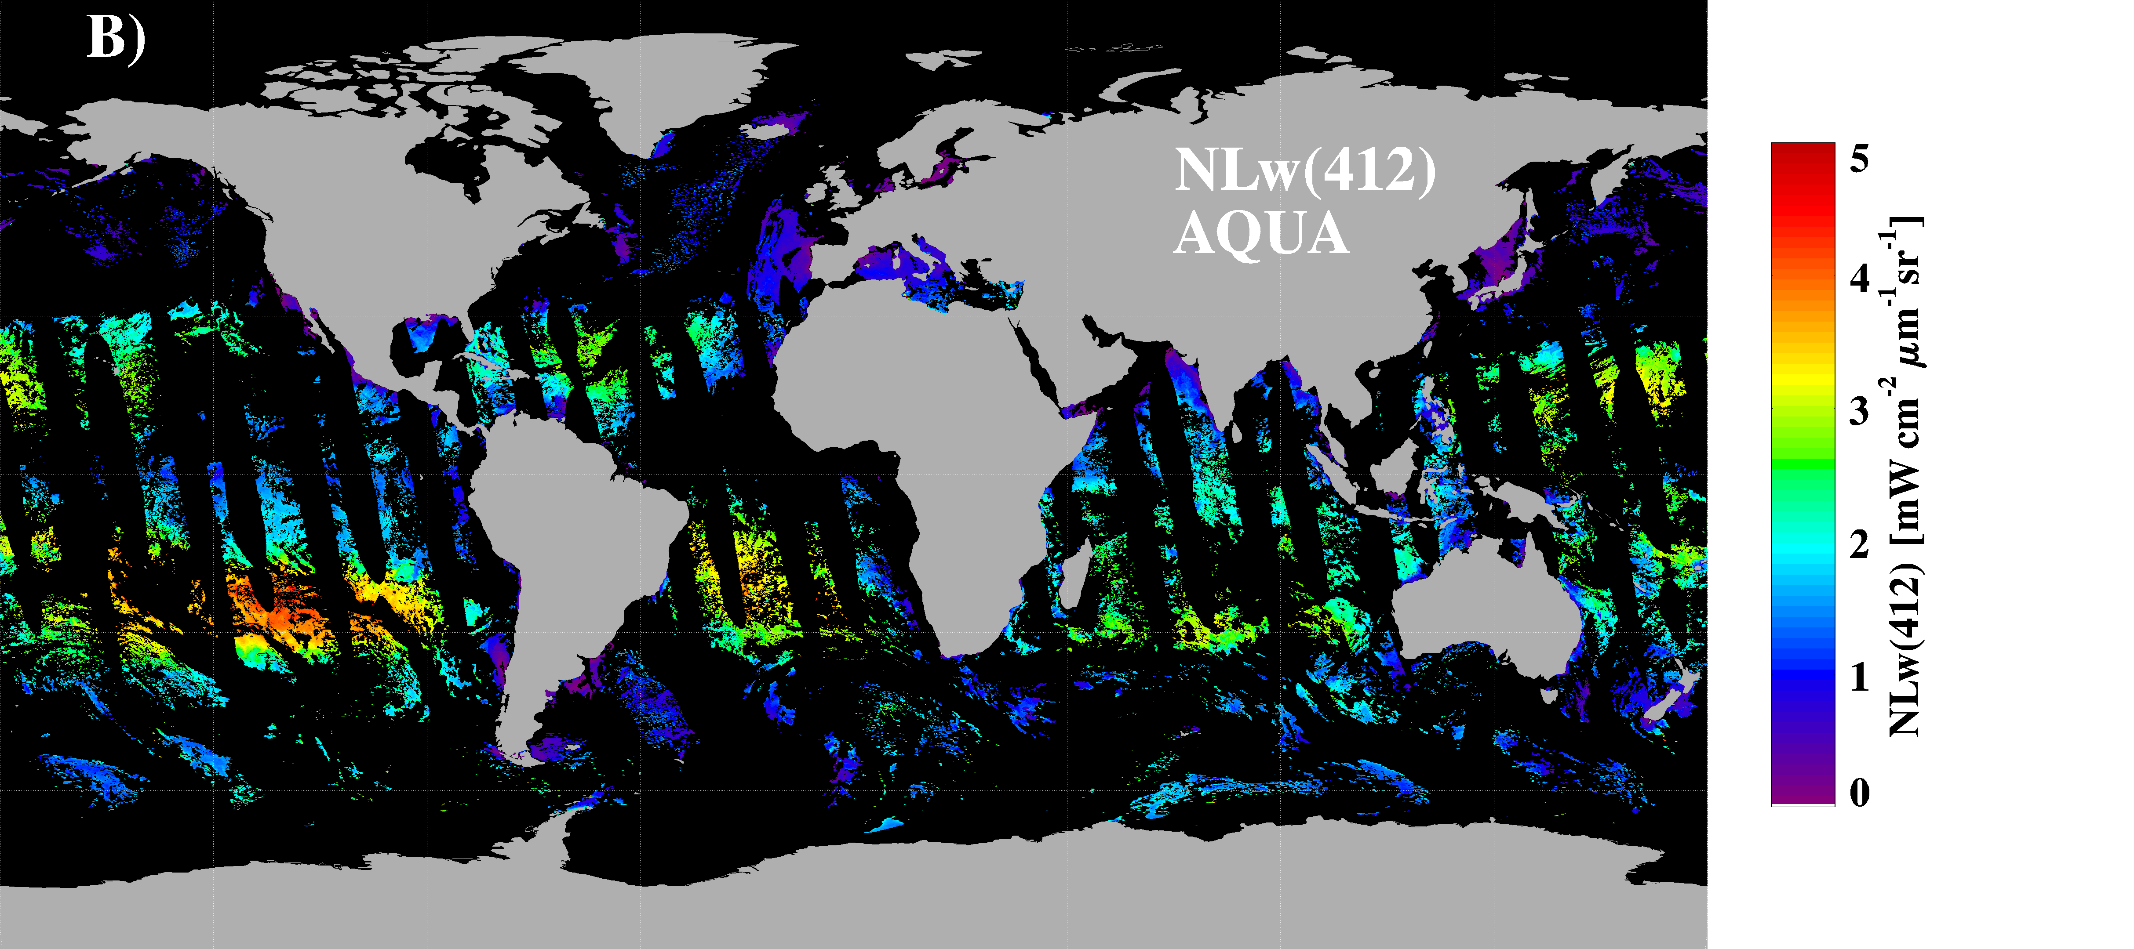
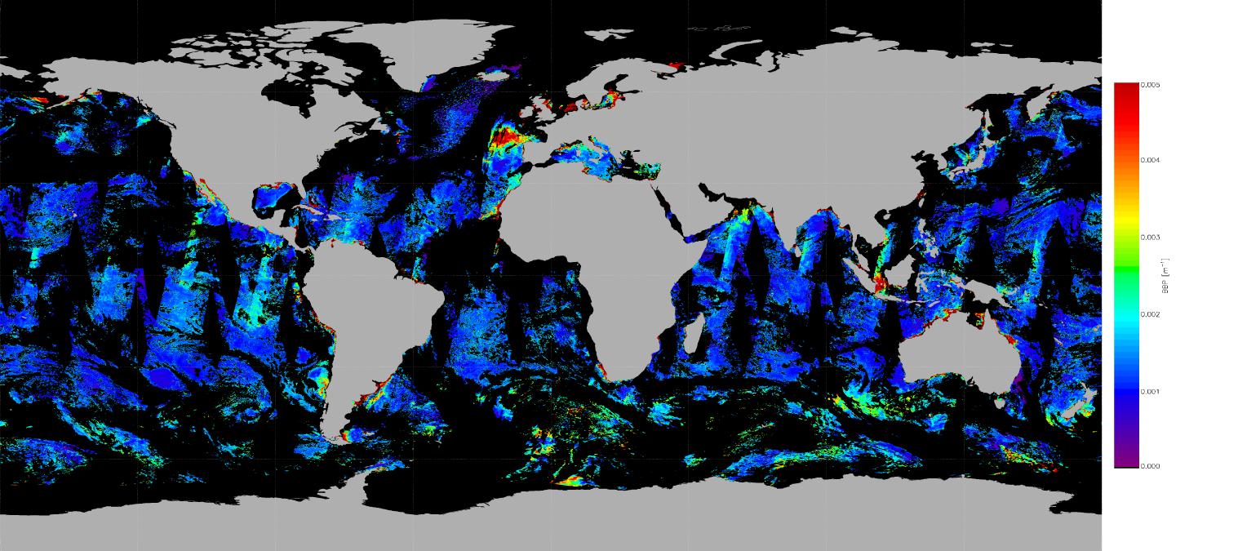
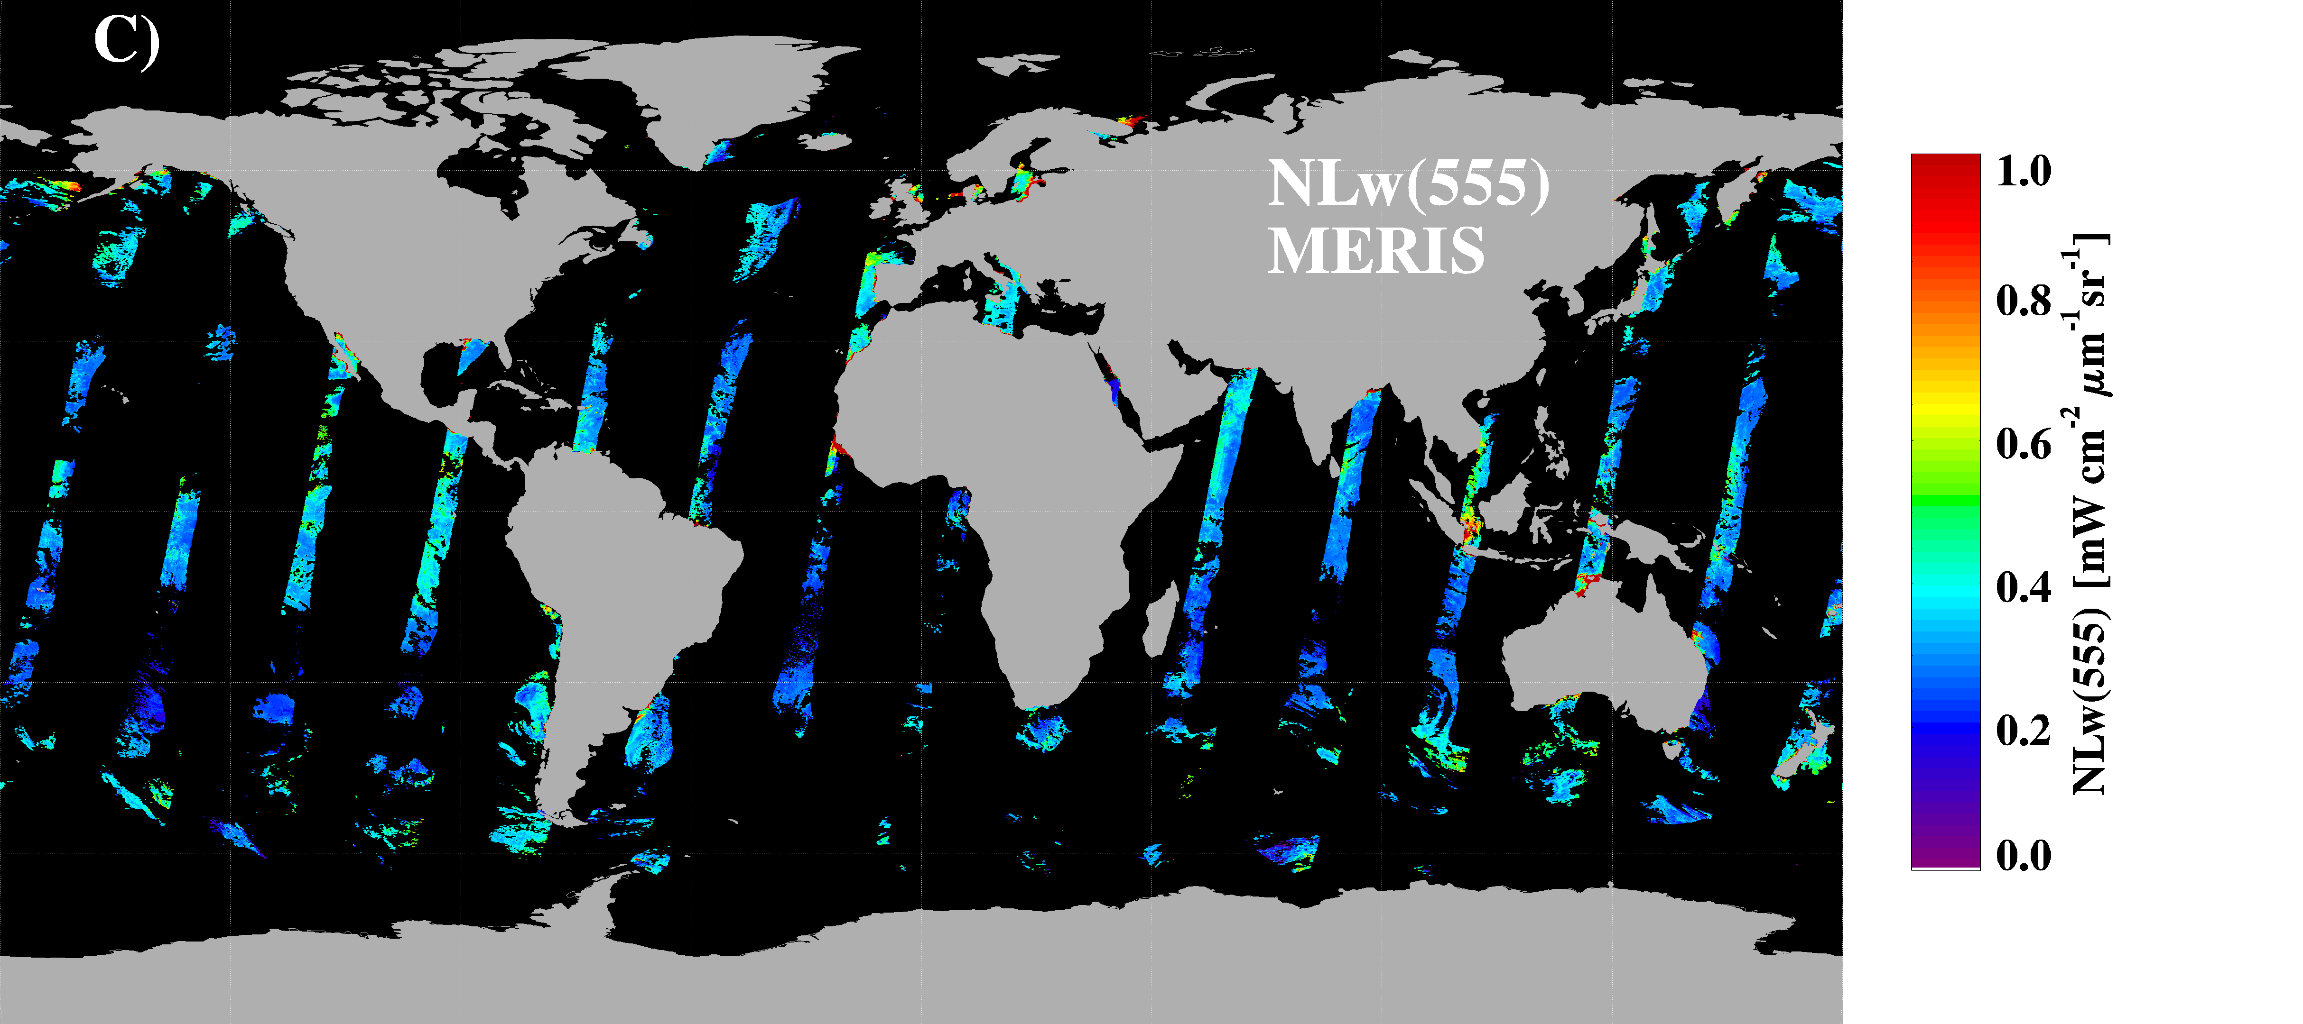
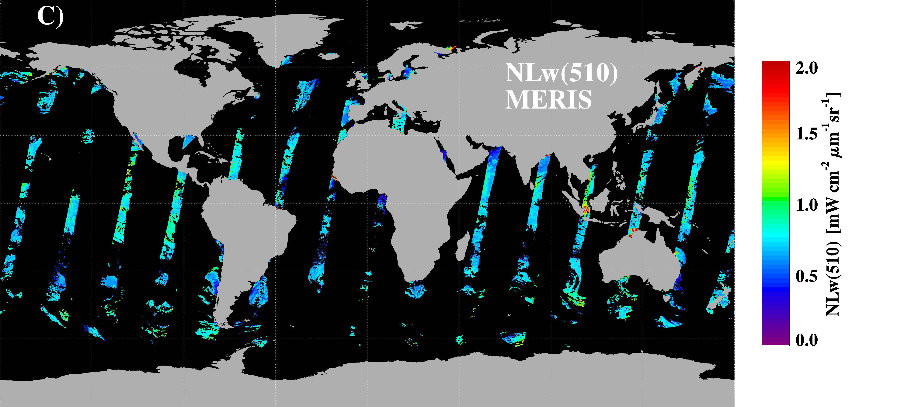
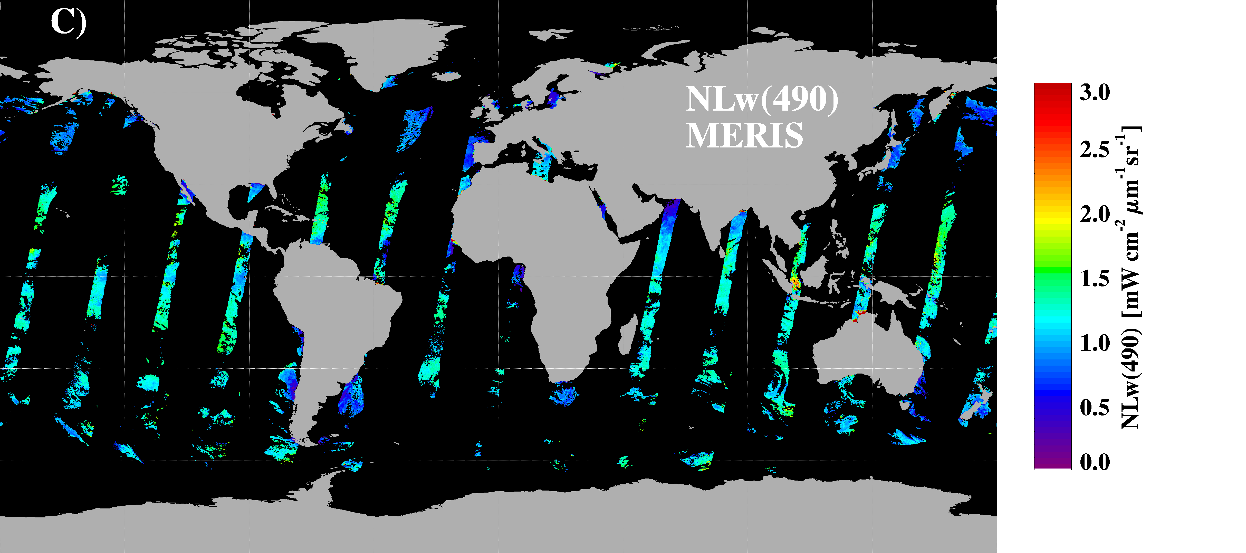
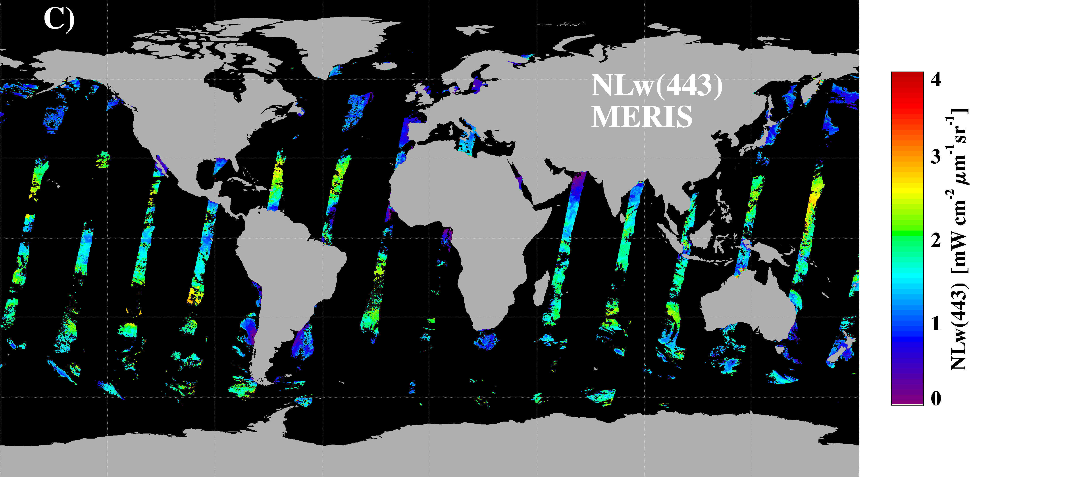
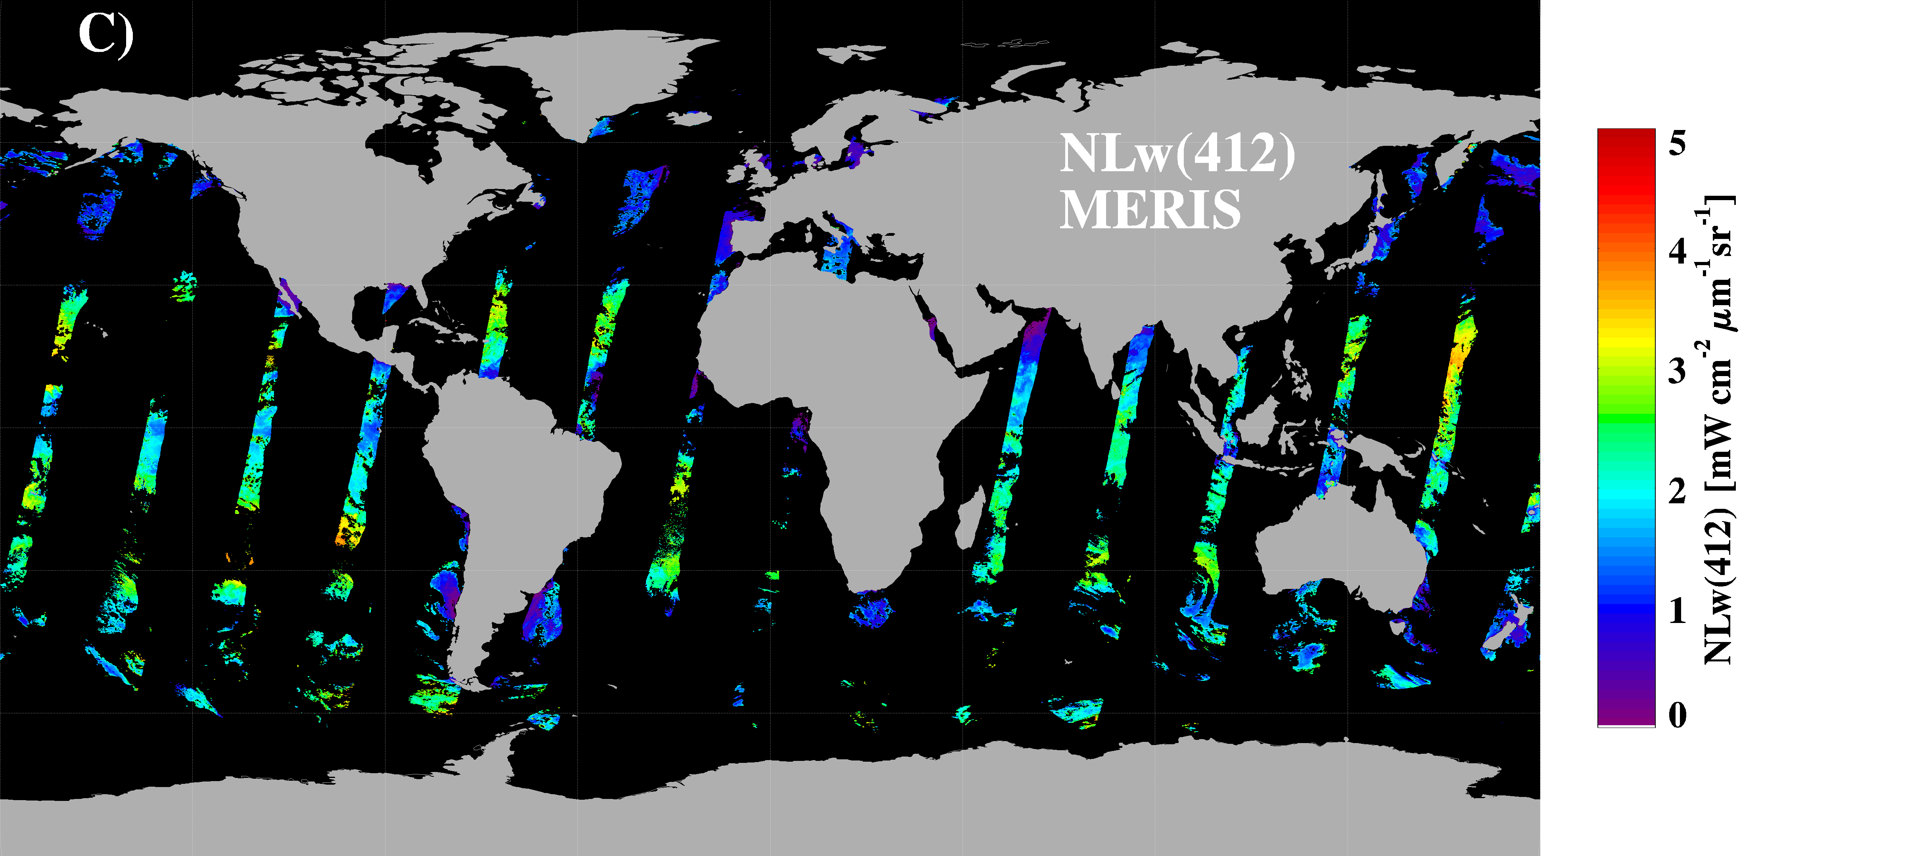
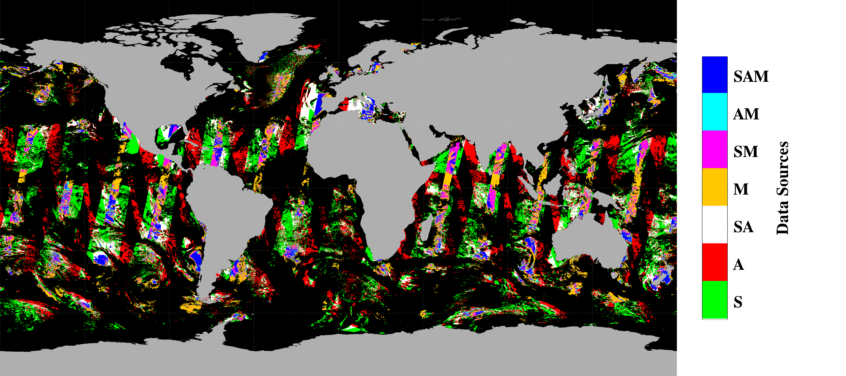
Ocean Color MEaSUREs Example of current products: GSM merged data
555 nm
510 nm
490 nm
443 nm
412 nm
CHL
+ σ
LwN(λ)
SeaWiFS
547 nm
531 nm
488 nm
CDM
443 nm
+ σ
412 nm
LwN(λ)
AQUA
GSM01
model
BBP
+ σ
560 nm
510 nm
490 nm
443 nm
412 nm
Data Sources
LwN(λ)
MERIS
Notes:
Daily L3b data. Talk about other products: uncertainties, data origin, daily, 4-D, 8-D, Monthly (individual sensors and merged). Merged SeaWiFS-AQUA (to be produced and distributed by OBPG soon). And Merged SeaWiFS-AQUA-MERIS (at UCSB). Tests on-going for adding Terra to the mix.

Slide 7
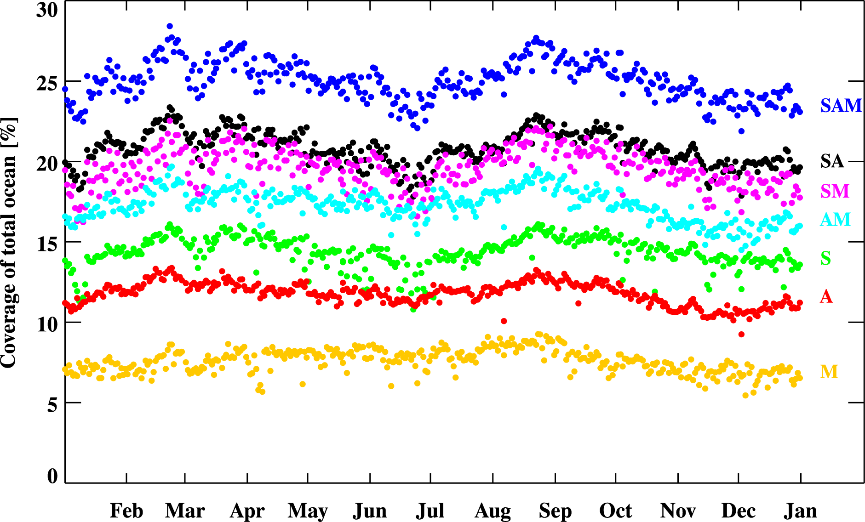
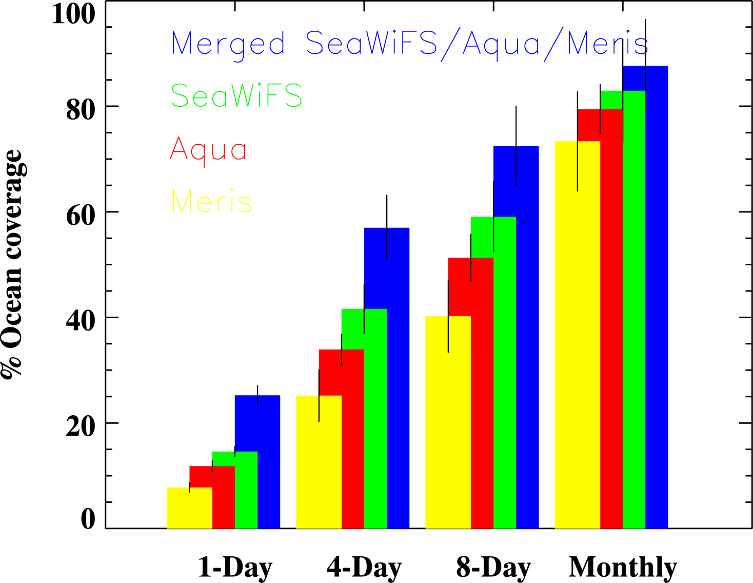
Ocean Color MEaSUREs
GSM01 merged data - Coverage
(Maritorena et al., RSE, 2010)
S: SeaWiFS A: AQUA M: MERIS
Daily coverage of the ocean 2002-2009
Composite imagery average coverage
Notes:
Numbers have changed because of recent reprocessing of SeaWiFS. AQUA and MERIS are being reprocessed

Slide 8
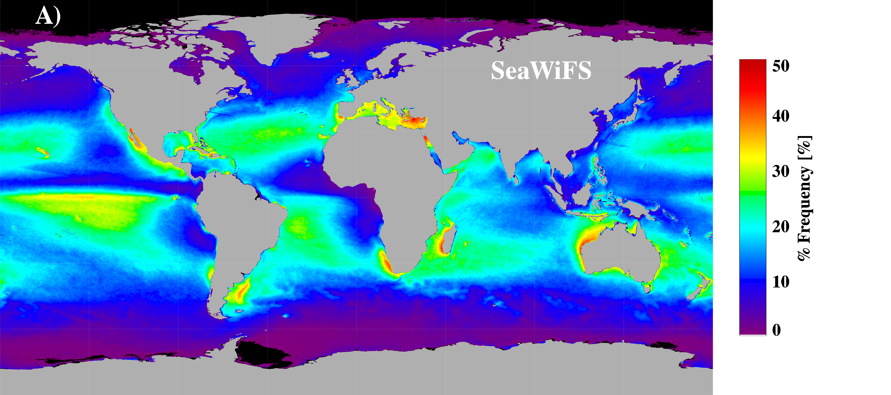
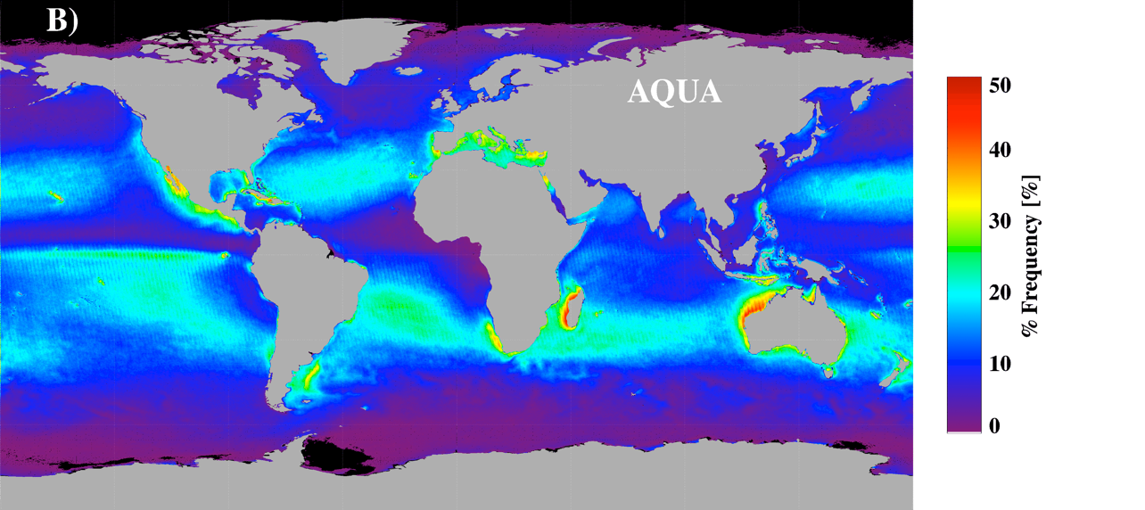
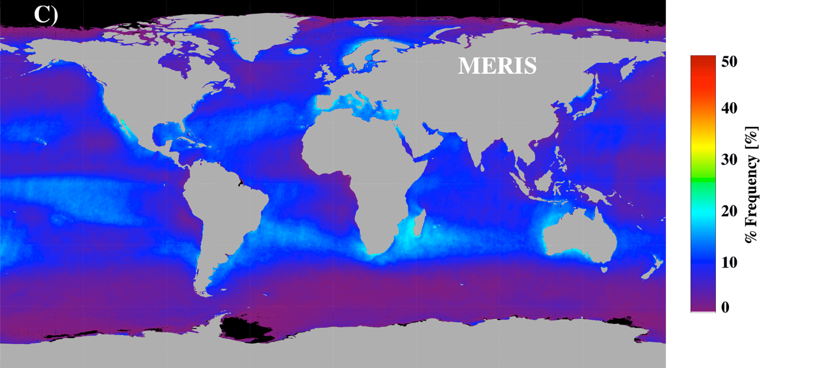
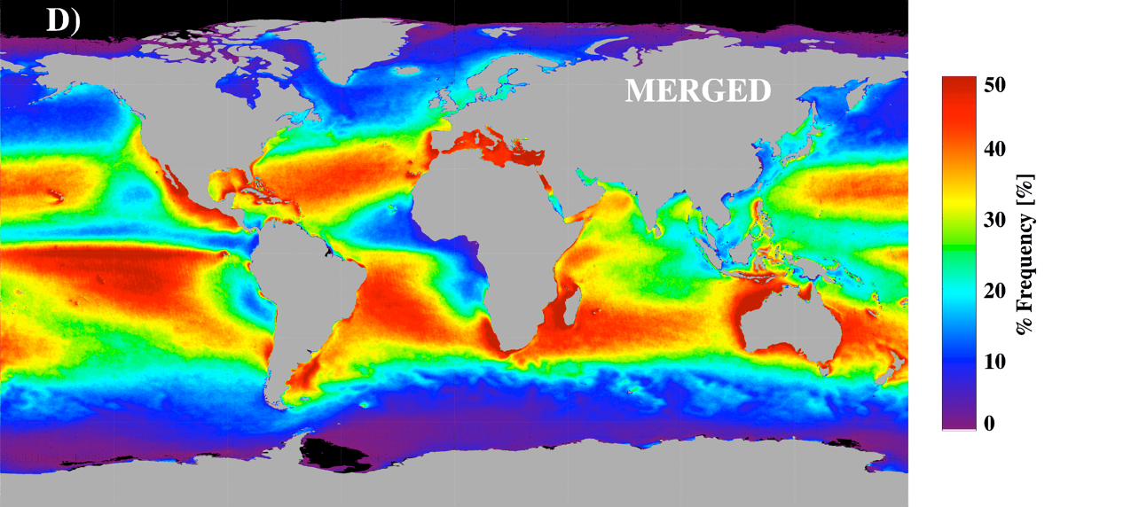
Ocean Color MEaSUREs
GSM01 merged data – Temporal Coverage
(Maritorena et al., RSE, 2010)
Geographic distribution of the coverage frequency (in % of total number of valid days) for the 2002-2009 period

Slide 9
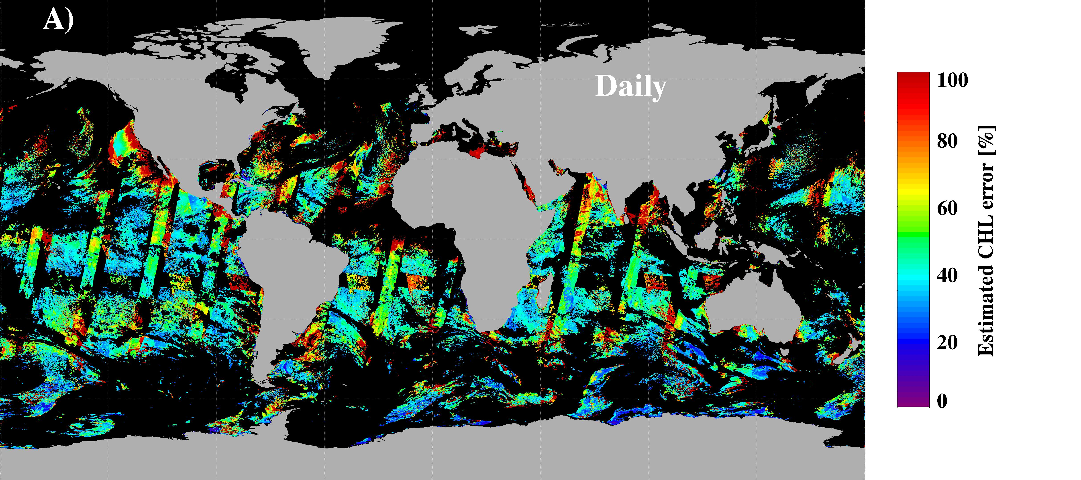
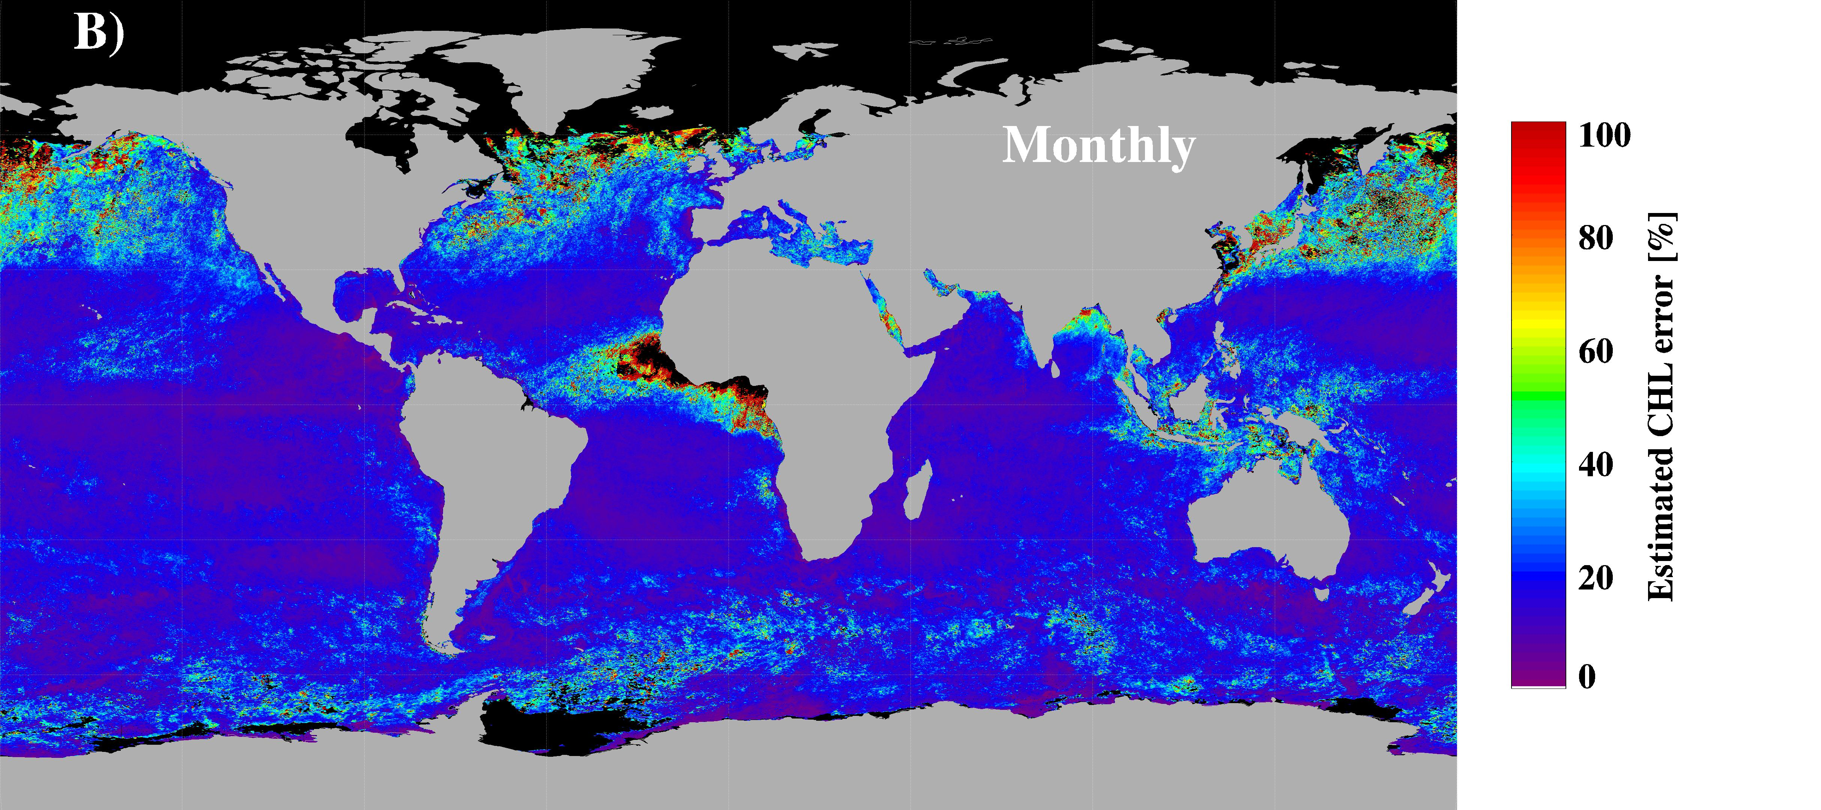
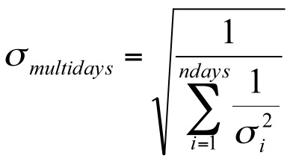
Ocean Color MEaSUREs
GSM Merged products uncertainties
(Maritorena et al., RSE, 2010)
Daily uncertainties
(from the diagonal elements of the covariance matrix used in the L.-M. minimization)
Composite uncertainties
(Assuming errors are independent from one day to the next)
Notes:
The daily uncertainty map show a wide range of variation with complex and uneven patterns that generally depends on which sensor or combination of sensors were available at each particular bin and how close the modeled and satellite NLw(λ) spectra are (see Maritorena et al., 2005). Uncertainties for the multi-day (composite) imagery can be calculated as sigma = sqrt(1/(sum(1/sigma_day^2))) under the assumption that the error is independent from one day to the next. Consequently the multi-days error estimates decrease as the number of days of data increases and the uncertainties for the composite imagery (figure 10B) are generally much smoother and lower than the daily values.

Slide 10
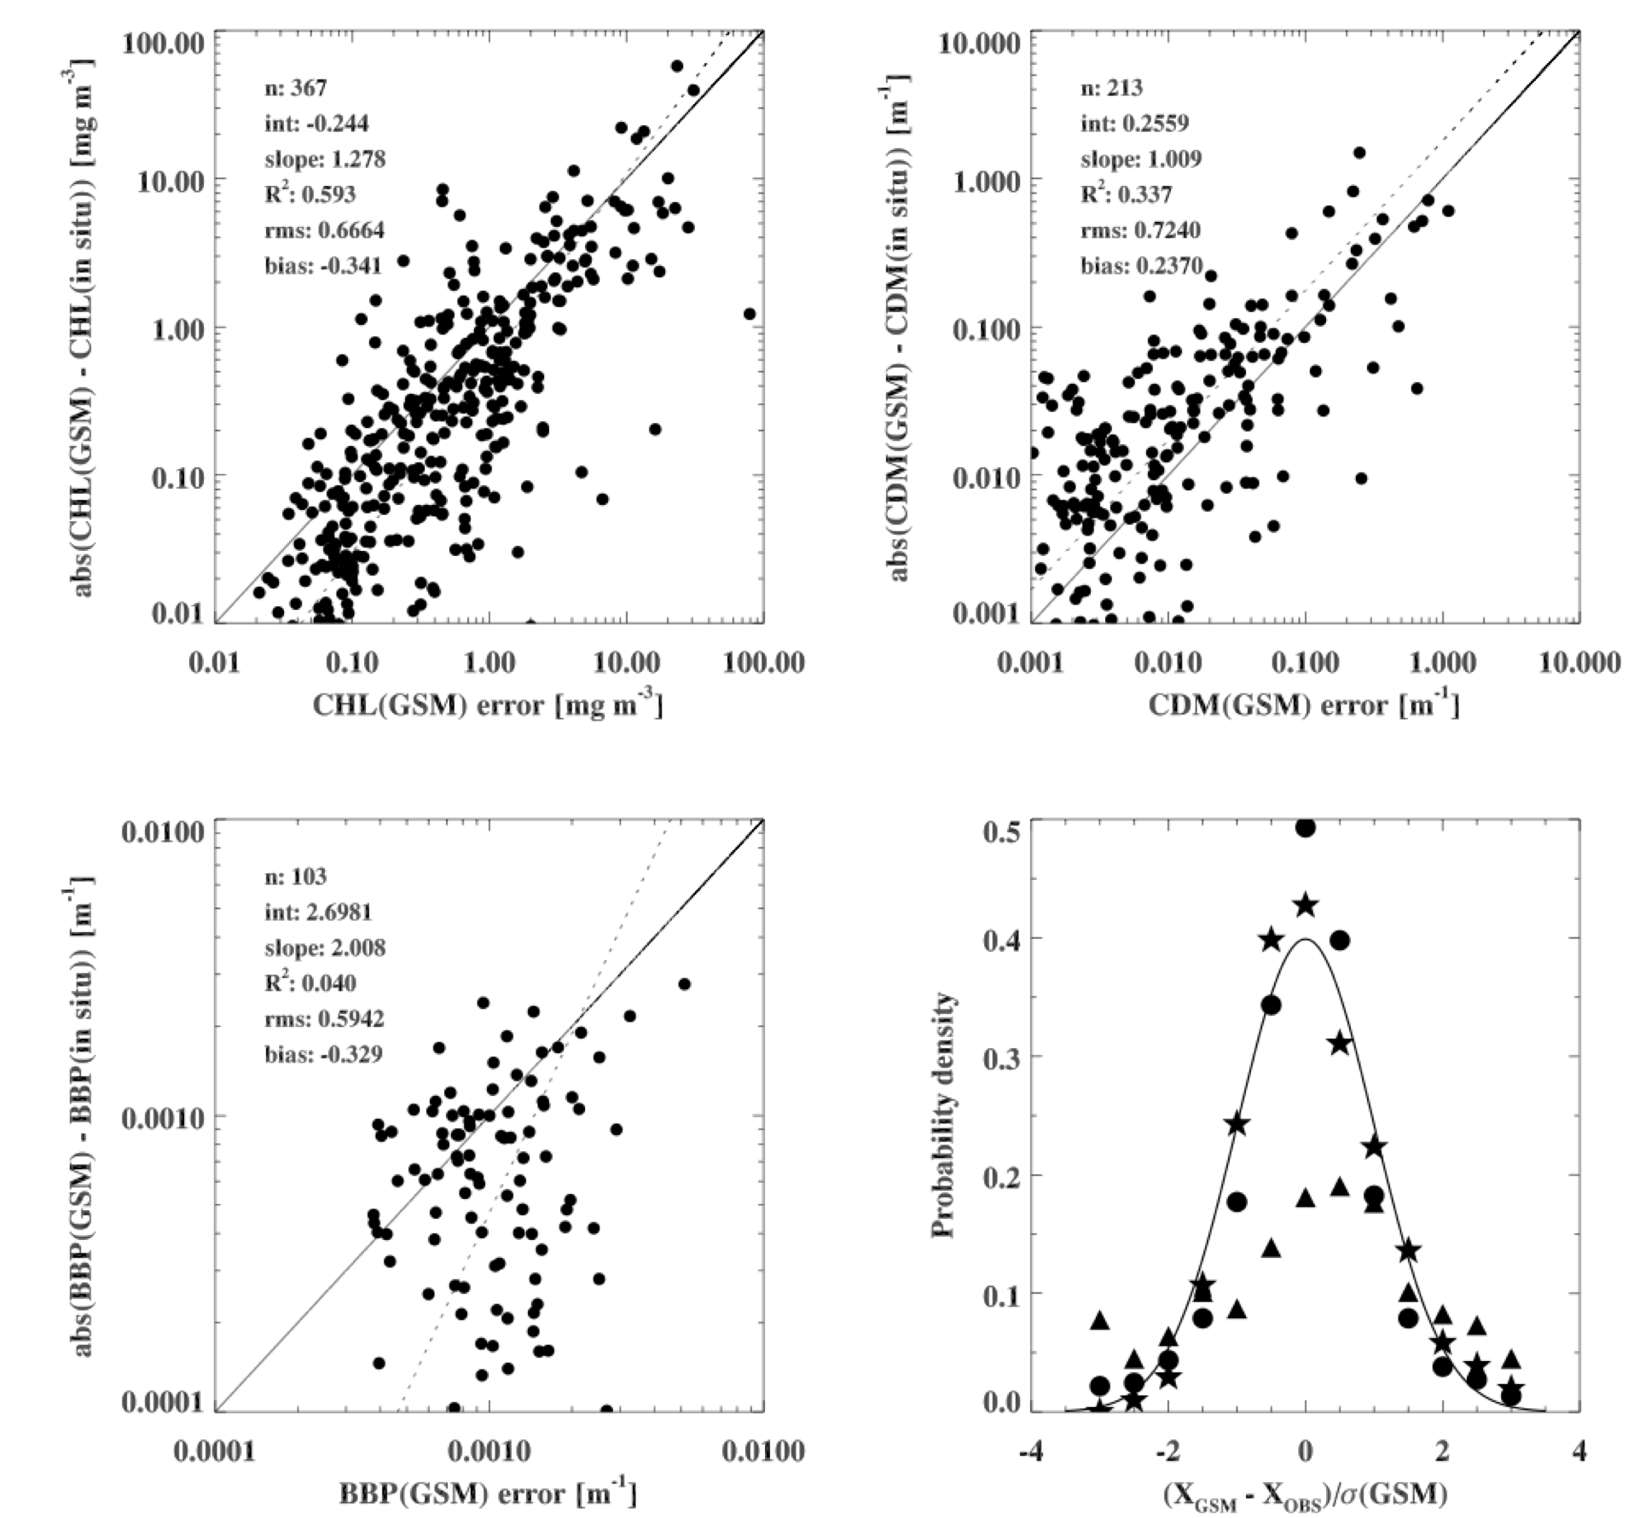
GSM Products uncertainties - Validation
Using the NASA NOMAD in situ data set
(Rrs(λ), CHL, CDM, BBP), we compared the actual error to the predicted error.
Results show that a usually conservative overestimation of the GSM01 errors for CHL and BBP but errors tend to be underestimated for CDM
(Maritorena et al., RSE, 2010)
Notes:
The symmetrical distribution observed for the three GSM01 retrievals indicates that the inversion does not introduce a bias (or a very small one in the case of CDM). Updates or improved parameterization of the model should result in the improvement in the CDM uncertainty estimates.

Slide 11
Ocean Color MEaSUREs
Validation – Satellite Matchup analyses
GSM products
(Maritorena et al., RSE, 2010)
S A M AM SM SA SAM
In situ data = NASA NOMAD + Other sources (1997-2007)
Matchups with 9 km resolution data. Same day. Unique bin.
Notes:
Coastal stations. Atmospheric correction issue.

Slide 12
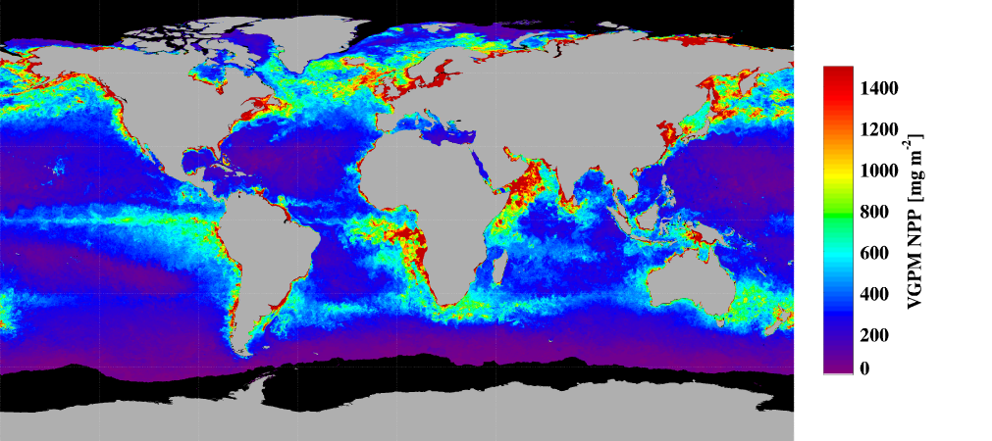
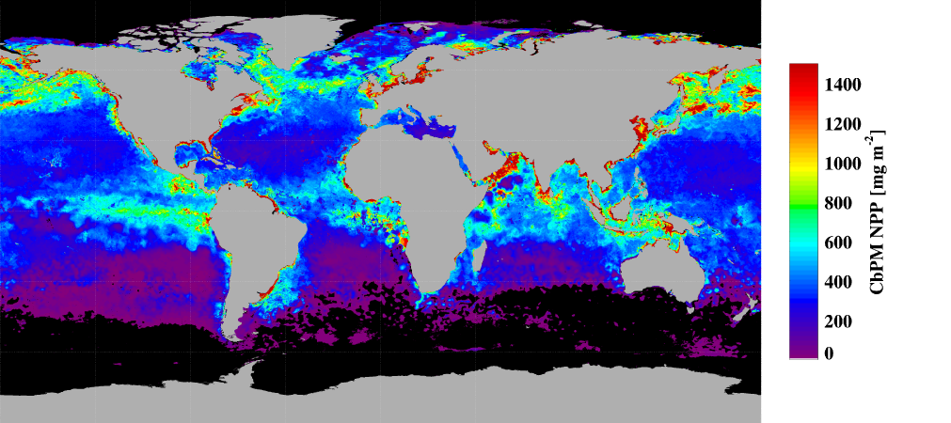
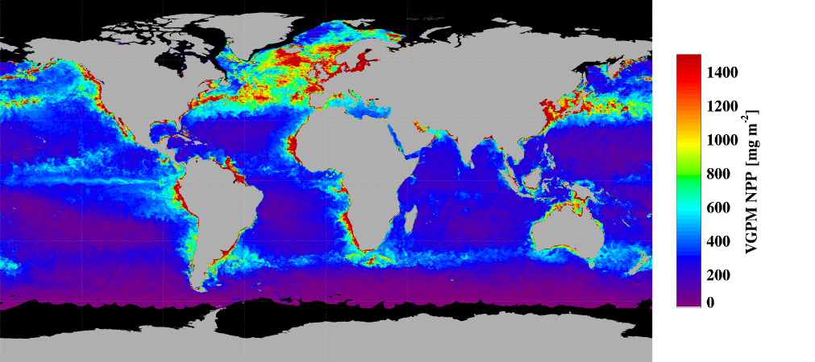
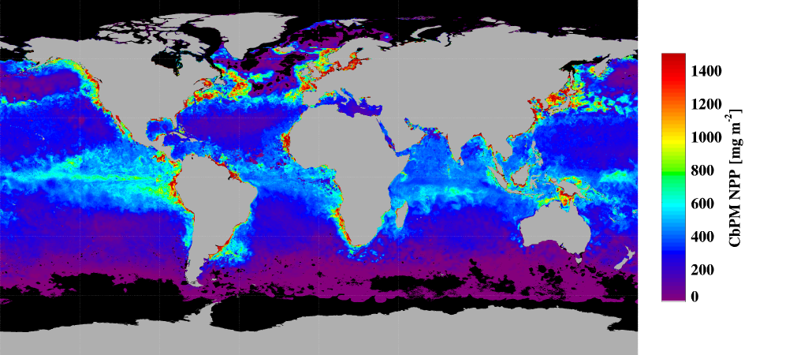
Ocean Color MEaSUREs Examples of current products
NPP
VGPM September 6-13 2005
CbPM September 6-13 2005
VGPM May 9-16 2006
CbPM May 9-16 2006
8-Day and Monthly Net Primary Production (NPP) from both the VGPM and CbPM models are generated by OSU.

Slide 13
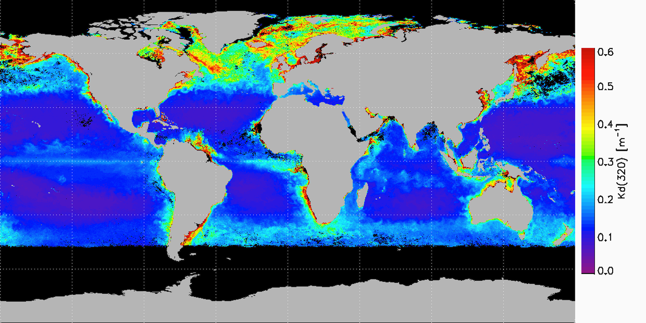
Ocean Color MEaSUREs - Future evaluation products
DIFFUSE ATTENUATION IN THE UV AND VISIBLE (320-555 nm)
Bonhommeau et al., Submitted
K_{d}(UV-Vis) is derived from an empirical expression that links the diffuse attenuation coefficient at any wavelength in the 320-555 nm range to the CHL, the CDM absorption and the BBP.
Large data set of K_{d}(UV-Vis), Rrs(λ) and IOP measurements.
The K_{d}(UV) maps were generated from the CDM and BBP retrievals of the GSM01 model using SeaWiFS data. Lowest Kd are for 380 nm.

Slide 14
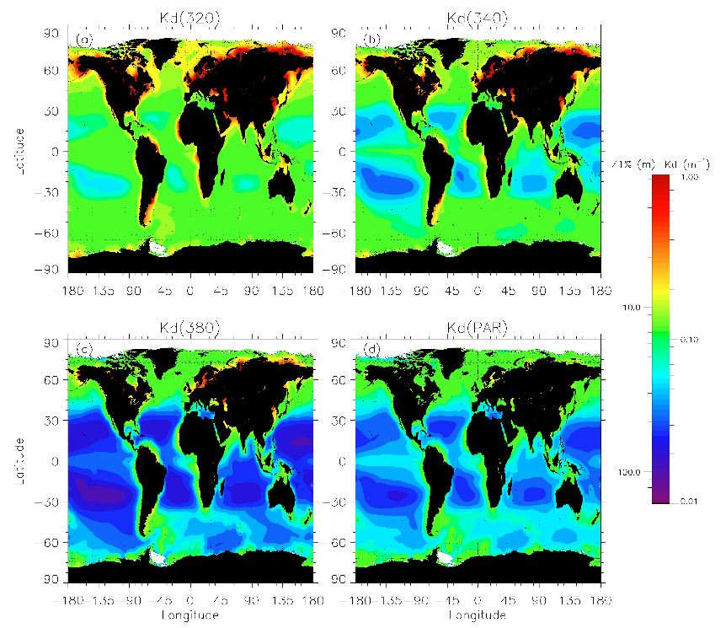
Ocean Color MEaSUREs - Future evaluation products
DIFFUSE ATTENUATION IN THE UV AND VISIBLE (320-555 nm)
Bonhommeau et al., Submitted
Globally, the ocean is the most transparent at 380 nm

Slide 15
Ocean Color MEaSUREs Examples of future evaluation products
PARTICLE SIZE DISTRIBUTION
PSD slope
Particle concentration for a differential size class
Bio-volume
Kostadinov et al., JGR, 2009
Notes:
Particle Size Distribution (PSD) slope (upper left image), particle concentration for a differential size class (upper right image) and bio-volume (Integral of PSD by volume; lower right image). These products are obtained using a mix of bio-optical modeling of b_{bp}(λ) and Mie theory calculations. The maps were derived using monthly global SeaWiFS normalized water-leaving radiance observations.

Slide 16
Ocean Color MEaSUREs Where to get the data ?
2 Sources (UCSB and OBPG):
Initially, the products are available at the UCSB MEaSUREs Website:
UCSB
Wiki: http://wiki.icess.ucsb.edu/measures/index_php/Main_page
ftp: ftp.oceancolor.ucsb.edu//pub/org/oceancolor/MEaSUREs
OPeNDAP server: http://dub-oceancolor.icess.ucsb.edu:8080/opendap/
OBPG (OC MEaSUREs Data Center)
Transition of some products to OBPG has started
MEaSUREs evaluation products will be available through the OceanColor Web Level-3 Browser http://oceancolor.gsfc.nasa.gov/
Notes:
In the future:Web-based, user-friendly interface with slicing & dicing capability

Slide 17
The Ocean Color MEASURES Project Where to get the data ???
http://wiki.icess.ucsb.edu/measures/index.php/Main_page
OCRT Meeting – 11-13 May, 2010 - New Orleans

Slide 18
Ocean Color MEaSUREs
NASA wants to know which products are useful. We have to report on various metrics about what products are downloaded, what volumes,…
Users feedback is important:
What science is done with the data,
Papers where the MEaSUREs products are used,
Issues with the data,
Like/don’t like a product (and why),
What they would like to see different,
Where to post feedback and comments about the MEaSUREs products ?
Wiki
e-mail: stephane@icess.ucsb.edu
Ocean Color gathering events (e.g. OCRT meetings) are probably a good place to discuss the fate of the MEaSUREs products
OCRT Meeting – 11-13 May, 2010 - New Orleans

Slide 19
Ocean Color MEaSUREs
Wiki:
http://wiki.icess.ucsb.edu/measures/index_php/Main_page
ftp:
ftp.oceancolor.ucsb.edu//pub/org/oceancolor/MEaSUREs
OPeNDAP server:
http://dub-oceancolor.icess.ucsb.edu:8080/opendap/
OceanColor Web Level-3 Browser (coming soon):
http://oceancolor.gsfc.nasa.gov/
OCRT Meeting – 11-13 May, 2010 – New Orleans

