Slide 1
Description of SPEXone synthetic orbit data
Guangliang Fu and Otto Hasekamp

Slide 2
Creation of synthetic orbit L1C measurements
Orbit information (latitude, longitude, viewing and solar geometry) is generated by SRON orbit simulator.
Atmosphere/surface input parameters are obtained from different sources:
AOD and land surface BPDF (Bi-direction Polarization Distribution Function) are from POLDER L2 data;
Aerosol modes information effective radius (reff), effective variance (veff), Aerosol Layer height (ALH), column number (N), Aerosol refractive component coefficients, and Aerosol spherical fractions are from ECHAM-HAM simulations;
Cloud info, ocean surface wind speed, Chl-a, and land surface Ross-Li Bi-directional Reflection Distribution Function (BRDF) are from MODIS data;
Spectral dependent part of BRDF is from from GOME-2 data.
The synthetic measurements (radiance and polarization) are then created by running the forward model using the above input parameters in orbit.
2

Slide 3
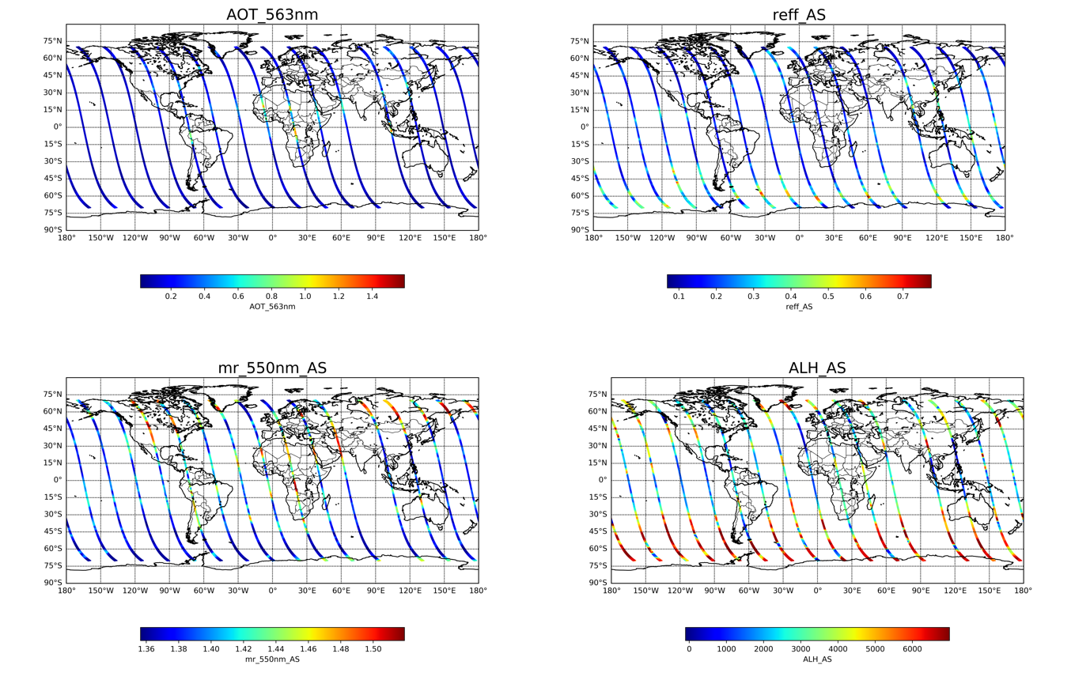
Creation of synthetic orbit L1C measurements
Input parameters over orbit.
SPEXone: 71360 pixels/ each orbit, ~1 Million per day
3

Slide 4
Creation of synthetic orbit L1C measurements
Input parameters over orbit.
Aerosol properties from ECHAM
To test the retrieval robustness, we build up a set of aerosol inputs based on the 7 modes from ECHAM (a general circulation model developed by the Max Planck Institute for Meteorology). The 7 modes from ECHAM are:
NS: Nucleation soluble
KS: Aitken soluble
KI: Aitken insoluble
AS: Accumulation soluble
AI: Accumulation insoluble
CS: Coarse soluble
CI: Coarse insoluble
For each mode, the volume fractions of water (H2O), sulfate (SO4), Sea Salt (SS), Black Carbon (BC), Organic Carbon (OC), Dust (DU) are given. Based on this, we compute the refractive index of each mode.
We acknowledge Thanos to provide the ECHAM simulations.
4

Slide 5
Creation of synthetic orbit L1C measurements
Input parameters over orbit.
For each mode, the effective radius is computed from the total volume and column number. For the modes NS, KS, KI, AS, AI, the effective variance = 0.24, and for the modes CS and CI, the effective variance = 0.62.
The number density and the Aerosol Layer Pressure (ALP) of each mode are also given. We compute Aerosol Layer Height (ALH) based on the function of pressure related to altitude.
Each mode has a different vertical profile.
5

Slide 6
Creation of synthetic orbit L1C measurements
SRON L1C simulator
SRON L1C simulator
Forward model, i.e., the SRON radiative transfer model LINTRAN (Landgraf et al 2001, Hasekamp and Landgraf 2002, 2005; Schepers et al 2014).
Rayleigh scattering;
Scattering and absorption by aerosols;
Gas absorption;
Cloud;
Output: Stokes parameters I, Q, U
We first simulate I,Q,U at very high spectral resolution. Then we convolve with the SPEXone radiometric ISRF and sample at 400 output wavelengths. We also perform a demodulation procedure and subsequent convolution with Gaussian polarimetric ISRF to get I, Q,U (and DoLP, AoLP, etc) at the 50 polarimetric bands.
6

Slide 7
Creation of synthetic orbit L1C measurements
Description of the SPEXone synthetic L1C dataset.
The SPEXone L1C dataset follows the latest NASA L1C format. The dataset is shared to the community from NASA webpage.
(Please refer to the document for the description of variables and dimensions, here we add some extra information specified to SPEXone)
Radiance (I) at 400 wavelengths from 380 nm to 784 nm; polarization (DoLP, Q/I, U/I) at 50 wavelengths from 385 nm to 770 nm.
There are three files for the dataset:
PACE_SPEXone.0715T054822.L1C.5.0km.nc ### SPEXone L1C with the NASA format
PACE_SPEXone.0715T054822.L1C.5.0km-aux.nc ### auxiliary info
- It (i.e., the preprocessor file) contains: water-mask, cloud-mask, the auxiliary info including meteo info.
- At this stage, we created aux files based on AFGL database. This will be updated as realistic if a standard for the format and the contents are decided soon.
PACE_SPEXone.0715T054822.L1C.5.0km-truth.nc ### aerosol and surface properties
- It contains: The microphysical properties of 7 ECHAM modes as well as the surface properties, cloud properties, Aerosol layer heights for each mode.
7

